Slide 1

First World War

Slide 2
First World War 1914–18
The First World War began when Britain and Germany went to war in August 1914, and Prime Minister Andrew Fisher's government pledged full support for Britain. The outbreak of war was greeted in Australia, as in many other places, with great enthusiasm.

Slide 3
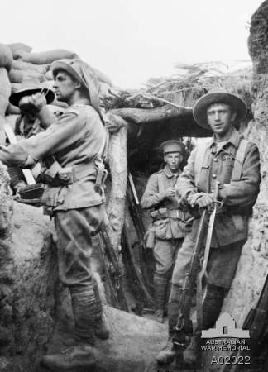
Australian troops in the Turkish Lone Pine trenches.

Slide 4
Australia's early involvement in the Great War included the Australian Naval and Military Expeditionary Force landing at Rabaul on 11 September 1914 and taking possession of German New Guinea at Toma on 17 September 1914 and the neighbouring islands of the Bismarck Archipelago in October 1914.
On 14 November 1914 the Royal Australian Navy made a significant contribution when HMAS Sydney destroyed the German raider SMS Emden.

Slide 5
On 25 April 1915 members of the Australian Imperial Force (AIF) landed at Gallipoli together with troops from New Zealand, Britain, and France.
This began a campaign that ended with the evacuation of troops on 19 and 20 December 1915.
Following Gallipoli, Australian forces fought campaigns on the Western Front and in the Middle East.

Slide 6
Throughout 1916 and 1917 losses on the Western Front were heavy and gains were small.
In 1918 the Australians reached the peak of their fighting performance in the battle of Hamel on 4 July.
From 8 August they then took part in a series of decisive advances until Germany surrendered on 11 November.

Slide 7
The Middle East campaign began in 1916 with Australian troops participating in the defence of the Suez Canal and the allied reconquest of the Sinai peninsula.
In the following year Australian and other allied troops advanced into Palestine and captured Gaza and Jerusalem;
by 1918 they had occupied Lebanon and Syria. On 30 October 1918 Turkey sued for peace.

Slide 8
For Australia, as for many nations, the First World War remains the most costly conflict in terms of deaths and casualties.
From a population of fewer than five million, 416,809 men enlisted, of which over 60,000 were killed and 156,000 wounded, gassed, or taken prisoner.

Slide 9
The outbreak of war was greeted in Australia, as in many other places, with great public enthusiasm.
In response to the overwhelming number of volunteers, the authorities set exacting physical standards for recruits.
Yet, most of the men accepted into the army in August 1914 were sent first to Egypt, not Europe, to meet the threat which a new belligerent, the Ottoman Empire (Turkey), posed to British interests in the Middle East and the Suez Canal.

Slide 10
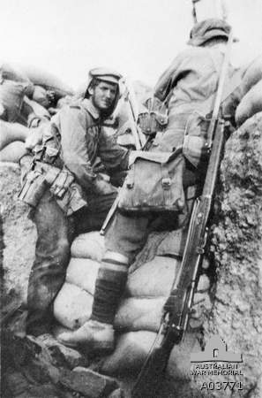
An Australian digger uses a periscope in a trench captured during the attack on Lone Pine, Gallipoli, 8 August 1915.

Slide 11
After four and a half months of training near Cairo, the Australians departed by ship for the Gallipoli peninsula, with troops from New Zealand, Britain, and France.
The Australians landed at what became known as ANZAC Cove on 25 April 1915 and established a tenuous foothold on the steep slopes above the beach.

Slide 12
During the early days of the campaign, the allies tried to break through Turkish lines, while the Turks tried to drive the allied troops off the peninsula.
Attempts on both sides ended in failure and the ensuing stalemate continued for the remainder of 1915.

Slide 13
The most successful operation of the campaign was the evacuation of troops on 19 and 20 December, under cover of a comprehensive deception operation.
As a result, the Turks were unable to inflict more than a very few casualties on the retreating forces.

Slide 14
After Gallipoli the AIF was reorganised and expanded from two to five infantry divisions, all of which were progressively transferred to France, beginning in March 1916.
The AIF mounted division that had served as additional infantry during the campaign remained in the Middle East.

Slide 15
When the other AIF divisions arrived in France, the war on the Western Front had long been settled in a stalemate, with the opposing armies facing each other from trench systems that extended across Belgium and north-east France, from the English Channel to the Swiss border.
The development of machine-guns and artillery favoured defence over attack and compounded the impasse, which lasted until the final months of the war.

Slide 16
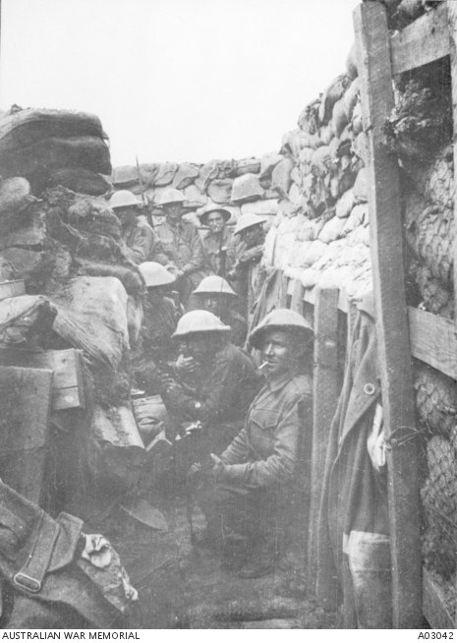
Troops of 53rd Battalion wait to don equipment for the attack at Fromelles, 19 July 1916. Only three of these men survived.

Slide 17
While the overall hostile stasis continued throughout 1916 and 1917, the Australians and other allied armies repeatedly attacked, preceded by massive artillery bombardments intended to cut barbed wire and destroy enemy defences.
After these bombardments, waves of attacking infantry emerged from the trenches into no man's land and advanced towards enemy positions.

Slide 18
The surviving Germans, protected by deep and heavily reinforced bunkers, were usually able to repel the attackers with machine-gun fire and artillery support from the rear.
These attacks often resulted in limited territorial gains followed, in turn, by German counter-attacks. Although this style of warfare favoured the defence, both sides sustained heavy losses.

Slide 19
In July 1916 Australian infantry were introduced to this type of combat at Fromelles, where they suffered 5,533 casualties in 24 hours.
By the end of the year about 40,000 Australians had been killed or wounded on the Western Front. In 1917 a further 76,836 Australians became casualties in battles, such Bullecourt, Messines, and the four-month campaign around Ypres, known as the battle of Passchendaele.

Slide 20
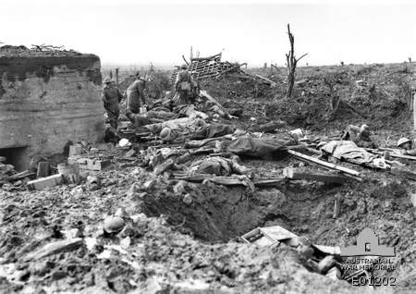
Australian wounded infantrymen at the first battle of Passchendaele, near Zonnebele railway station.

Slide 21
In March 1918 the German army launched its final offensive of the war, hoping for a decisive victory before the military and industrial strength of the United States could be fully mobilised in support of the allies.
The Germans initially met with great success, advancing 64 kilometres past the region of the 1916 Somme battles, before the offensive lost momentum.

Slide 22
Between April and November the stalemate of the preceding years began to give way, as the allies combined infantry, artillery, tanks, and aircraft more effectively, demonstrated in the Australian capture of Hamel spur on 4 July 1918.
The allied offensive, beginning on 8 August at Amiens, also contributed to Australian successes at Mont St Quentin and Péronne and to the capture of the Hindenburg Line.
In early October the Australian divisions withdrew from the front for rest and refitting; they were preparing to return when Germany surrendered on 11 November.

Slide 23
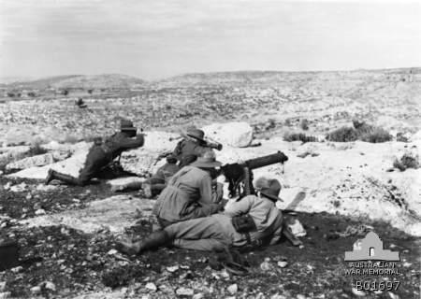
3rd Australian Light Horse Regiment machine-gunners in action at Khurbetha-Ibn-Harith, near Palestine, 31 December 1917.

Slide 24
Unlike their counterparts in France and Belgium, the Australians in the Middle East fought a mobile war against the Ottoman Empire in conditions completely different from the mud and stagnation of the Western Front.
he light horsemen and their mounts had to survive extreme heat, harsh terrain, and water shortages. Nevertheless, casualties were comparatively light, with 1,394 Australians killed or wounded in three years of war.

Slide 25
This campaign began in 1916 with Australian troops participating in the defence of the Suez Canal and the allied reconquest of the Sinai peninsula.
In the following year Australian and other allied troops advanced into Palestine and captured Gaza and Jerusalem;
by 1918 they had occupied Lebanon and Syria. On 30 October 1918 Turkey sued for peace.

Slide 26
Australians also served at sea and in the newly formed flying corps.
The Royal Australian Navy (RAN), under the command of the Royal Navy, made a significant contribution early in the war, when HMAS Sydney destroyed the German raider Emden near the Cocos Islands in November 1914.

Slide 27
The Great War was the first armed conflict in which aircraft were used; about 3,000 Australian airmen served in the Middle East and France with the Australian Flying Corps, mainly in observation capacities or providing infantry support.

Slide 28
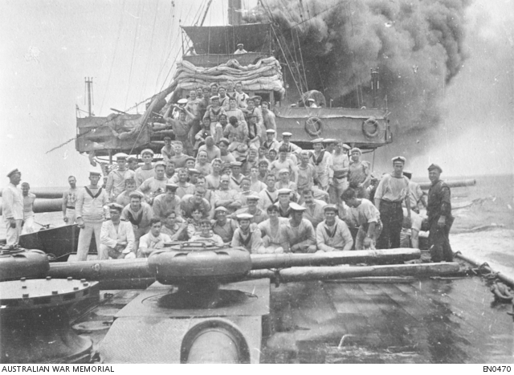
HMAS Sydney at full speed, ten minutes after the ceasefire was ordered in her battle with the German cruiser Emden.

Slide 29
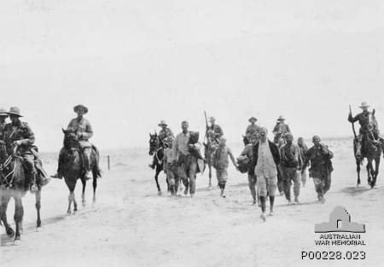
9th Australian Light Horse bring in Turkish prisoners in the Sinai, 13 April 1916.

Slide 30
Australian women volunteered for service in auxiliary roles, as cooks, nurses, drivers, interpreters, munitions workers, and skilled farm workers.
While the government welcomed the service of nurses, it generally rejected offers from women in other professions to serve overseas.
Australian nurses served in Egypt, France, Greece, and India, often in trying conditions or close to the front, where they were exposed to shelling and aerial bombardment.

Slide 31
The effect of the war was also felt at home. Families and communities grieved following the loss of so many men, and women increasingly assumed the physical and financial burden of caring for families.
Anti-German feeling emerged with the outbreak of the war, and many Germans living in Australia were sent to internment camps.

Slide 32
Censorship and surveillance, regarded by many as an excuse to silence political views that had no effect on the outcome of war, increased as the conflict continued.
Social division also grew, reaching a climax in the bitterly contested (and unsuccessful) conscription referendums held in 1916 and 1917.

Slide 33
When the war ended, thousands of ex-servicemen, many disabled with physical or emotional wounds, had to be re-integrated into a society keen to consign the war to the past and resume normal life.

Slide 34
Heroes of first world war

Slide 35
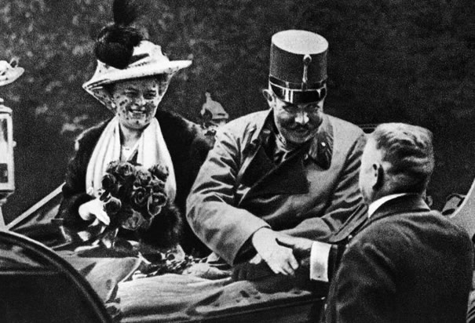
Archduke Franz Ferdinand and his wife, Sophia: The June 28, 1914, assassination of Franz Ferdinand, heir to the Austro-Hungarian Empire, by Serbian nationalist Gavrilo Princip set off a chain of events that ended in the outbreak of World War I.

Slide 36
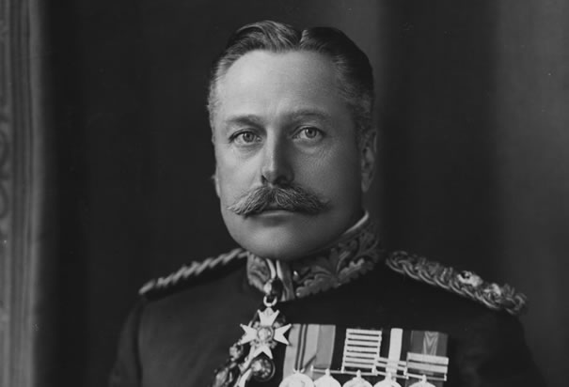
General Douglas Haig: Haig commanded British forces at the Battle of the Somme, losing 60,000 men on the first day. By the end of the campaign, the Allies had lost more than 600,000 men--and advanced fewer than eight miles. Haig rebounded with success in 1918, but remains one of the most controversial generals of the war.

Slide 37
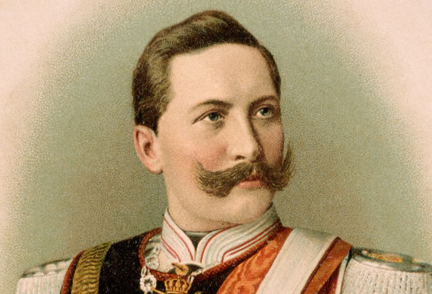
Kaiser Wilhelm II: A fierce militarist, Wilhelm II encouraged aggressive Austro-Hungarian diplomatic policies following the assasination of Franz Ferdinand. The Kaiser was nominally in charge of the German army, but the real power lay with his generals. As World War I drew to a close, he was forced to abdicate in 1918 .

Slide 38
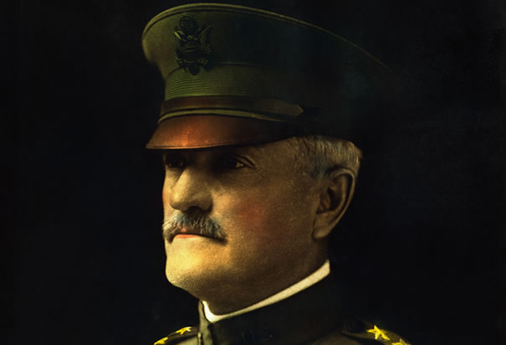
General John J. Pershing: A graduate of West Point and a veteran of the Battle of San Juan Hill, "Black Jack" Pershing was named commander of the American Expeditionary Force when the United States entered World War I in April 1917.

Slide 39
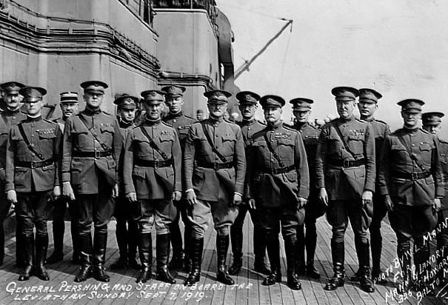
General Pershing and Staff: General Pershing initially resisted efforts to combine American troops with British and French forces, but after the Meuse-Argonne offensive failed to break the stalemate on the Western Front, a joint Allied command was launched. In November 1918, an armistice finally put an end to the fighting.

Slide 40
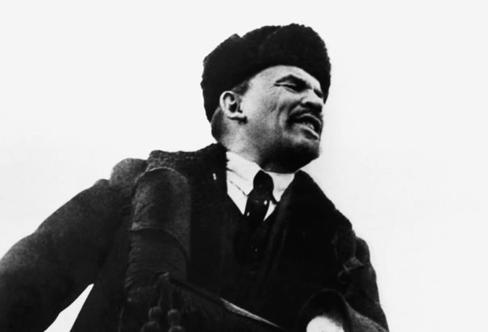
Vladmir Lenin: After the Bolsheviks seized power during the Russian Revolution of 1917, Lenin negotiated the Treaty of Brest-Litovsk. The treaty ended Russia's involvement in World War I, but on humiliating terms: Russia lost territory and nearly one-quarter of its population to the Central Powers.

Slide 41
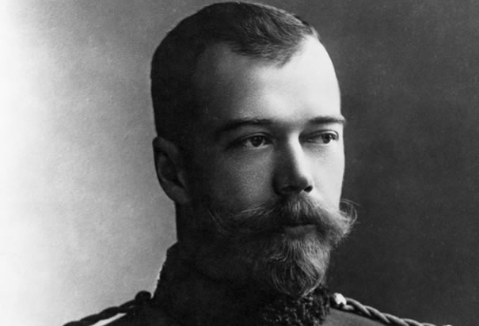
Tsar Nicholas II: When Austria-Hungary declared war on Serbia, Russia's alliance with its Balkan neighbor forced it to enter the war against the Central Powers. The tsar assumed control of the Russian army, with disastrous results. In 1917, he was forced to abdicate, and he and his family were executed in 1918.

Slide 42
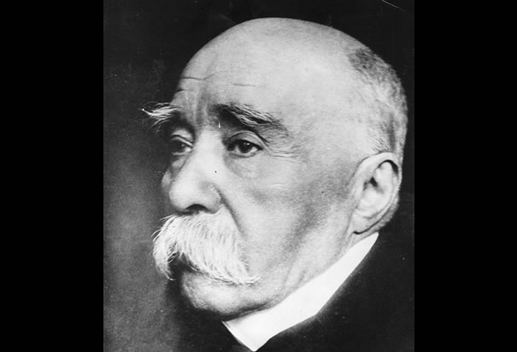
Georges Clemenceau : As prime minister of France from 1917 to 1920, Clemenceau worked to restore French morale and concentrate Allied military forces under Ferdinand Foch. He led the French delegation to the peace talks ending World War I, during which he insisted on harsh reparation payments and German disarmament.

Slide 43
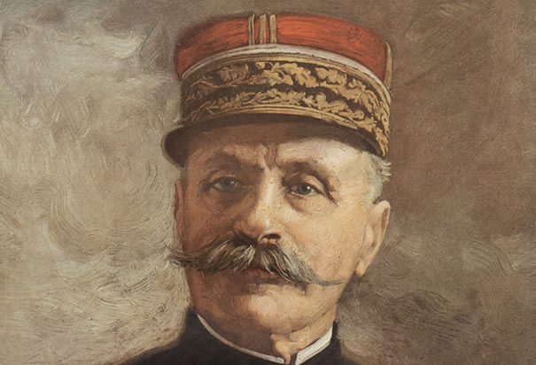
Ferdinand Foch: Foch led French forces at the First Battle of the Marne, but was removed from command after the Battle of the Somme in 1916. In 1918, he was named Allied Supreme Commander, coordinating the war's final offensives. Foch was present at the armistice ending the war in November, 1918.

Slide 44
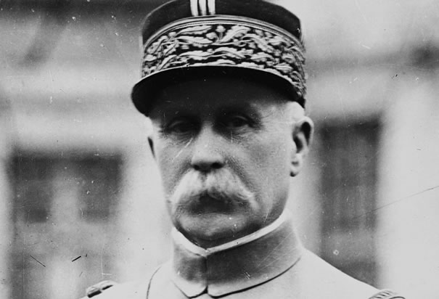
Marshall Philippe Pétain: Pétain became a national hero in France after his success at the Battle of Verdun during World War I. However, during World War II, Pétain headed the Vichy regime, a pro-German puppet government, and as a result has a mixed and deeply controversial legacy.

Slide 45
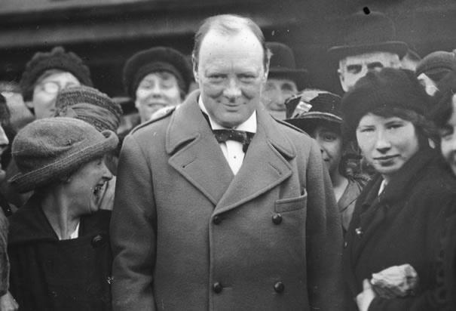
Winston Churchill, 1918: In 1911, Churchill became First Lord of the Admiralty. In this position, he worked to strengthen the British navy. He was pushed out of office after the disastrous 1915 Gallipoli campaign, in modern-day Turkey, which resulted in more than 250,000 Allied casualties.

Slide 46
Thank You
Prepared By:
Lavanya Thammaiah.T. ,
Smart Class co-ordinator,
General Thimayya Public School,
Madikeri.

