Slide 1
Social Welfare and Environment
Presented by:-
R.VIDYABATHY,
M.Sc., B.Ed., M.Phil.,
PG Asst. IN CHEMISTRY
G.B.H.S SCHOOL,
VEPPANAPALLI,
KRISHNAGIRI Dt.

Slide 2
Man has been endowed with reason with the power to create, so that he can add to what has been given. But up to now he hasn’t been a creator, only a destroyer. Forests keep disappearing, rivers dry up,wildlifes become extinct,the climates ruined and the land grows poorer and uglier everyday. -Anton Chekhov (Uncle Vanya 1897)

Slide 3
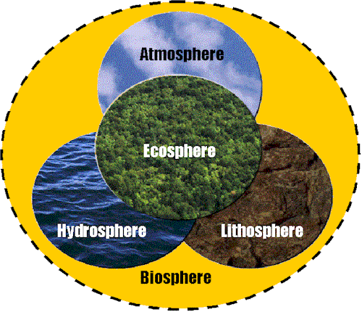

Slide 4
Natural
Resources
Renewable resources
Non-renewable resources
Potentially renewable resources

Slide 5
Renewable resources | Non-Renewable resources | Potentially Renewable resources
Direct solar energy | Fossil fuels | Fresh air
Winds | Metallic minerals (iron, copper, aluminum) | Fresh water
Tides | Nonmetallic minerals (clay, sand, phosphates) | Fertile soil
Flowing water | Electricity and atomic energy | Plants and animals (biodiversity)

Slide 6
Types of Natural resources
Energy resources
Forest resources
Food and Water resources
Land and Mineral resources

Slide 7
Methods of Conservation of Resources
Material substitution
Holding materials : Plastic cups = Paper cups
Plastic plates = Palm plates
Energy usage : Atomic energy = Solar energy
so that water and Uranium consumption is
reduced
Product life extension
Durability of a product is extended for long years

Slide 8
Recycling
Waste paper is collected for new paper production so
that timber resources can be preserved
Sea water can be desalinated to drinking water
Waste reduction
Organic waste can be used as a natural fertilizers
Sago and Starch industrial waste known as “THIPPI”
is now being used in cattle feed industries
“BAGASSE”, a sugar mill waste is now used as a raw
material in paper mill

Slide 9
Pollution
Soil pollution
Water pollution
Noise pollution
Air Pollution

Slide 10
Recent environmental issues in Tamil Nadu
From the time the public become aware of Kaveri
Delta Coal Bed Methane Extraction project, fervently
opposed by the farmers of Kaveri delta region as well
as agricultural and environmental experts at Tanjore.
World's Wettest Area - Cherrapunji - Dries Up
The area once recorded more than 1,042 inches
(2,540 cm) of rain in just one year - a global
record
Tourists come here to see rain, not sun and if there
are no rains, no clouds, why should the tourists come?
The cement plant polluted the environment and added
to the population pressure in the area. And if there are
more people, the pressure on the forests will increase

Slide 11
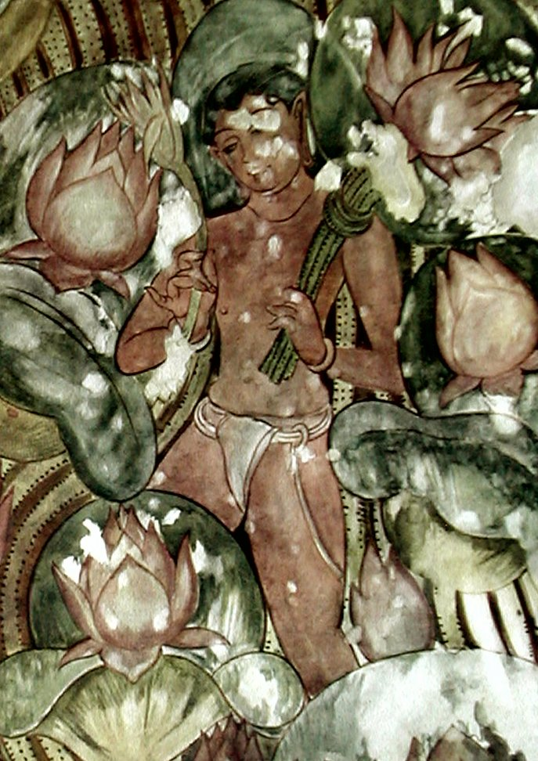
Beautiful Fresco Paintings in the Cave Temple
at Sittanavasal

Slide 12
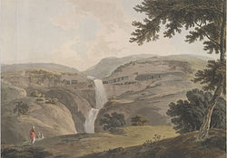
ELLORA CAVE PAINTINGS AT AURANGABAD , MAHARASTRA

Slide 13
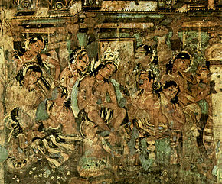
Mural in Ajanta Caves, Jataka stories Mahajanaka renouncing the worldly life

Slide 14
WILDLIFE ISSUES IN OUR COUNTRY
A herd of 15 elephants damaged agricultural crops in a village
near Hosur , police said. The elephants were strayed into the
Lakkasandaram village from the Marakatta reserved forest area
and started damaging standing crops in agricultural fields owned
by farmers issued on March 02, 2012
A tiger, which had caused scare among locals in
Krishnagiri area, was caught in a trap laid by forest
and wildlife officials issued on March 26, 2012
Bear attacks two forest guards who rescued it from a well
at Krishnagiri area issued On Monday July 1, 2013
The male leopard that was captured in a camera trap set by forest
officials in Vallam Reserved Forests in Chengalpattu Forest Range
issued on July 18, 2014 .
Wild Elephant kills one person at Maharajakadai in Krishnagiri
district issued on Sep 18, 2014

Slide 15
CONCLUSION
Every year June 5th is the World
Environment Day
I will spend my heaven doing good on The Earth

Slide 16
NET RESOURCES
http://www.world of teaching.com is home to over a thousand power points submitted by teachers. This is a completely free site and requires no registration. Please visit and I hope it will help in your teaching.

