Slide 1
ROCKS

Slide 2
What are rocks?
A rock is a naturally occurring solid mixture of one or more minerals.
Rocks are classified by how they are formed, their composition, and texture
Rocks change over time through the rock cycle

Slide 3
TYPES OF ROCKS
ROCKS ARE DIVIDED INTO THREE GROUPS BASED ON HOW THE ROCKS FORMED
IGNEOUS
SEDIMENTARY
METAMORPHIC

Slide 4
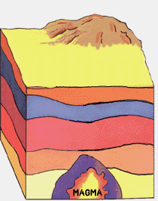
IGNEOUS ROCKS
Igneous rocks are formed by the cooling and hardening of molten rocks

Slide 5
TYPES OF IGNEOUS ROCKS
EXTRUSIVE/VOLCANIC ROCKS
Forms at the surface.
When magma reaches the surface it is called Lava. LAVA cools and hardens to form EXTRUSIVE rocks. When the cooling is very fast (almost instant) it will form rocks without crystals (GLASSY TEXTURE) e.g. Obsidian, while if it is not that fast it will form tiny crystals (FINE-GRAINED) e.g. Basalt

Slide 6
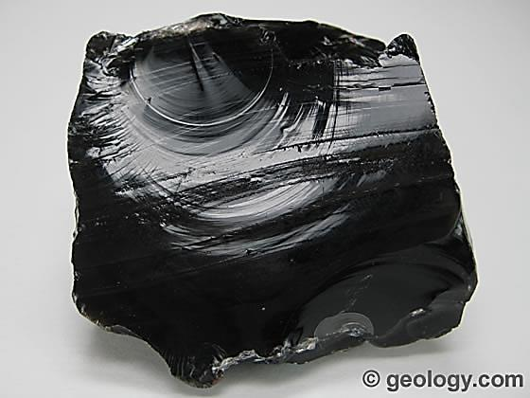
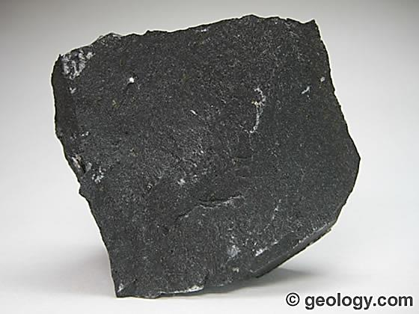
Obsidian B. Basalt

Slide 7
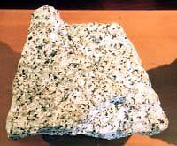
2. INTRUSIVE/PLUTONC ROCKS
Magma does not always reach the surface but may solidify below the Earth’s surface. In this case it forms intrusive igneous rocks.
Since the magma takes a longer time to solidify below the surface, the rocks formed has bigger crystals e.g. Granite

Slide 8
CHARACTERISTICS OF IGNEOUS ROCKS
Has crystals except those that solidify very fast
Are not stratified
Do not contain fossils

Slide 9
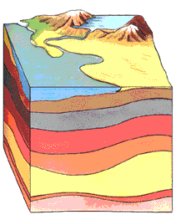
SEDIMENTARY ROCKS
Sedimentary rocks are formed by erosion
Sediments are moved from one place to another
Sediments are deposited in layers, with the older ones
on the bottom
The layers become compacted and cemented together to form rocks
http://www.fi.edu/fellows/payton/rocks/create/sediment.htm

Slide 10
Sedimentary Rocks are formed at or near the Earth’s surface
No heat and pressure is involved
Usually occur in layers (Strata)
Stratification – the process in which sedimentary rocks are arranged in layers

Slide 12
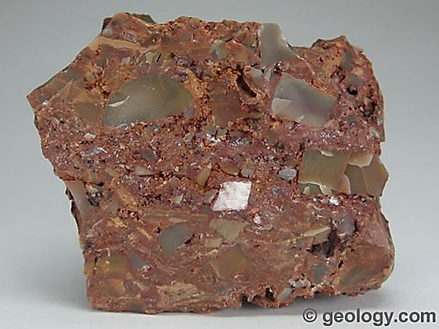
TYPES OF SEDIMENTARY ROCKS
CLASTIC ROCKS
made of fragments of rock cemented together e.g. Breccia

Slide 13
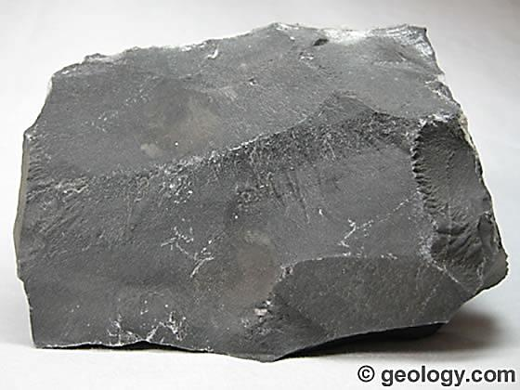
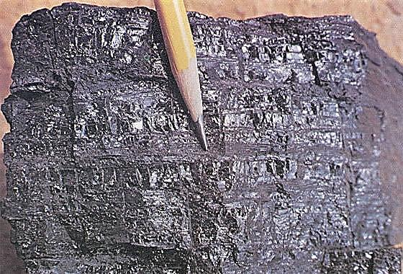
2. NON-CLASTIC
Minerals crystallize out of solution to become rock e.g. limestone
Or are formed from remains of plants and animals (also referred to as biogenic rocks) e.g. coal
A. Limestone B. Coal

Slide 14
CHARACTERISTICS OF SEDIMENTARY ROCKS
May contain fossils
Are stratified
They are not banded

Slide 15
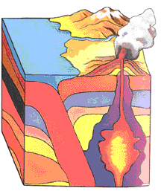
METAMORPHIC ROCKS
Metamorphism means to change.
Rocks change with temperature
and pressure.
Usually takes place deep in
the Earth

Slide 16
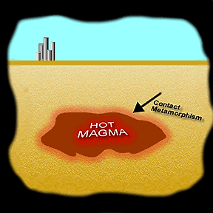
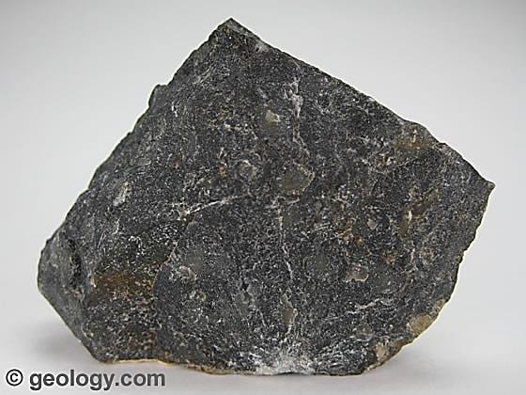
Contact Metamorphism– Rocks are heated by nearby magma (affects a small scale)
Increased temperature changes the composition of the rock, old minerals are changed into new ones
Hornfel is a fine-grained non-foliated metamorphic rock produced by contact metamorphism

Slide 17
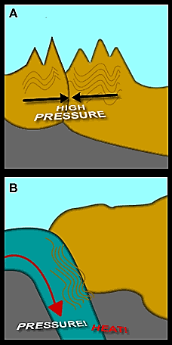
Regional metamorphism: affects a large area and results from plate tectonics
Rocks are changed due to pressure

Slide 18
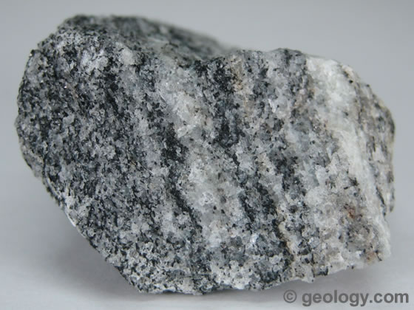
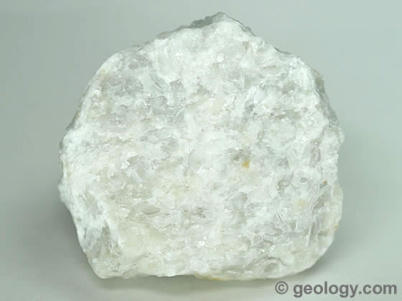
Metamorphic rocks can be foliated, i.e. showing layers/bands of minerals e.g. Gneiss or non- foliated e.g. Marble
A. Gneiss B. Marble

Slide 19
CHARACTERISTICS OF METAMORPHIC ROCKS
May be foliated/banded
Rarely contain fossils
React with acids

Slide 20
THE ROCK CYCLE
Rocks change from one form to another, any type of rock can change into another type, for instance, an igneous rock into sedimentary or metamorphic and vice versa.

Slide 21
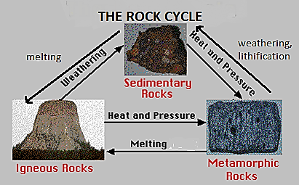

Slide 22
USES OF ROCKS
Source of minerals e.g. gold
Used in construction
As aquifers, they are good sources of water
They form mountains, which are places of scenic beauty e.g. Mulanje mountain

