Slide 1
Our Earth’s Resources
We use things the
Earth gives us to help us live better lives.

Slide 2

Resource
A resource is something that we can get from the earth over and over again
Examples of resources are:
  Air
  Water
  Soil
  Rocks

Slide 3
How we use them
We use resources to make things and to grow things we need
Examples of things we use:
  Water to drink and grow plants for food, shelter, and clothing
  Soil to grow plants for food, shelter, and clothing
  Rocks for building and jewelry
  Metals to make cans, building parts, and jewelry
  Sand to make glass
  Oil to make plastics and gasoline

Slide 4
Reduce, Reuse, and Recycle
In order to make resources last, we must take care of them
Resources can be:
  Renewable – grow over time, like trees
  Nonrenewable – we can never get more, like aluminum
  Inexhaustible – we will never run out, like air or water, BUT it can be ruined by pollution

Slide 5

  So, we must
    REDUCE how much we use
    REUSE what we can
    RECYCLE whatever we can
    In order to help our Earth be able to keep providing for our needs.

Slide 6
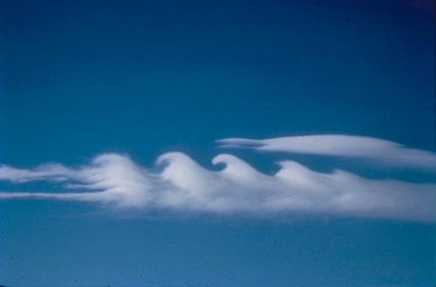
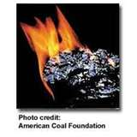
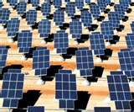
Examples of resources

Slide 7


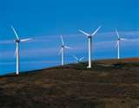
Water

Slide 8
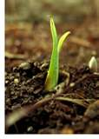
Soil

Slide 9
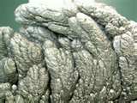
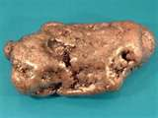
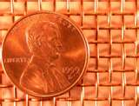
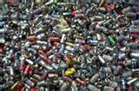
Copper and aluminum

Slide 10
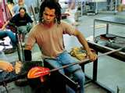
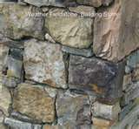

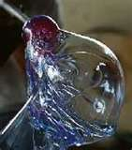

Sand and Limestone

Slide 11
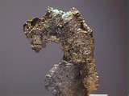
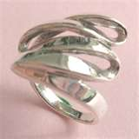


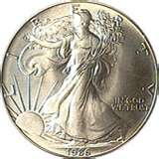
Salt and Silver

Slide 12
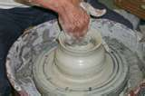
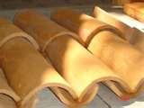
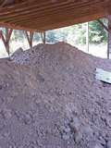
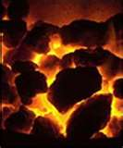
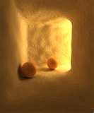
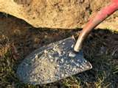
Clay and coal

Slide 13

REMEMBER TO:
Reduce
Reuse
Recycle
Save our Natural Resources!

Slide 14
This powerpoint was kindly donated to
www.worldofteaching.com
http://www.worldofteaching.com
Is home to well over a thousand powerpoints submitted by teachers. This a free site. Please visit and I hope it will help in your teaching

