Slide 1

Oceans
Water, water everywhere…
But only on the Earth!

Slide 2
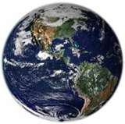
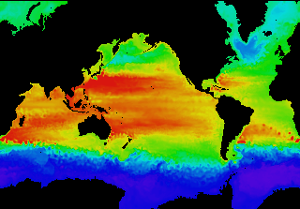
Oceans
Over 70% of the Earth’s surface is covered by water
Of that, 95% is salt water – only 5% is fresh water – and part of that is ice

Slide 3
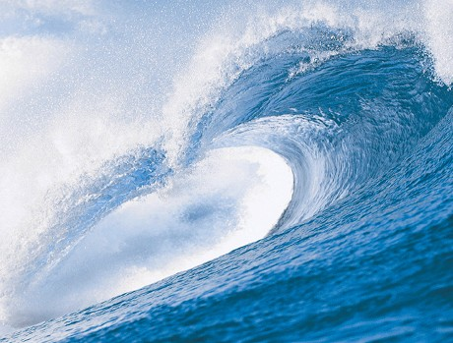

Ocean names
All the oceans are really just one body of water
This is divided into the four named oceans:
    Pacific
    Atlantic
    Indian
    Arctic

Slide 4
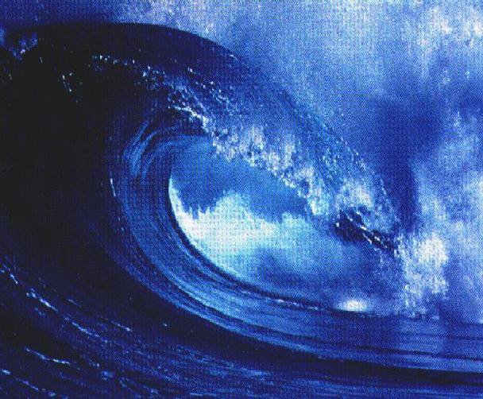
Tides
The oceans are always in motion
Tides happen twice daily
Tides are caused by the pull of gravity by the moon, and to a lesser degree by the sun
Why do you think the sun would pull less than the moon?

Slide 5
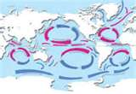
Currents
There are two type of Ocean Currents:
Surface Currents-Surface Circulation
These waters make up about 10% of all the water in the ocean.
These waters are the upper 400 meters of the ocean.

Slide 6
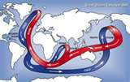
Currents
Deep Water Currents-Thermohaline Circulation
These waters make up the other 90% of the ocean
These waters move around the ocean basins by density driven forces and gravity
The density difference is caused by different temperatures and salinity
These deep waters sink into the deep ocean basins at high latitudes where the temperatures are cold enough to cause the density to increase.

Slide 7
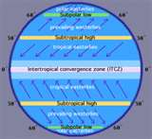
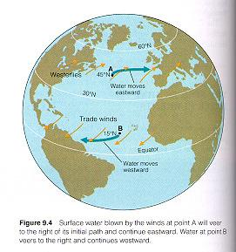
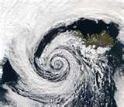
Forces
Ocean Currents are influenced by two types of forces
1. Primary Forces--start the water moving
The primary forces are:
  Solar Heating
  Winds
  Gravity
  Coriolis effect

Slide 8
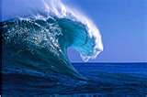
Forces
2. Secondary Forces--influence where the currents flow
Surface Circulation
  Solar heating cause water to expand. Near the equator the water is about 8 centimeters high than in middle latitudes. This cause a very slight slope and water wants to flow down the slope.
  Winds blowing on the surface of the ocean push the water. Friction occurs between the wind and the water's surface.

Slide 9
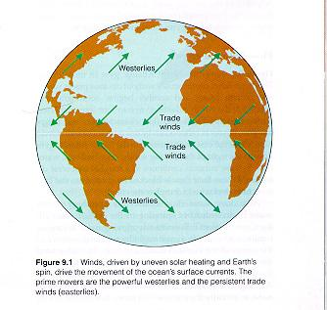

Wind direction

Slide 10
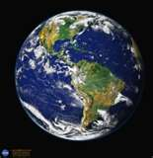
Wind
A wind blowing for 10 hours across the ocean will cause the surface waters to flow at about 2% of the wind speed.
  Water will pile up in the direction the wind is blowing.
  Gravity will pull the water down the "hill" or pile of water.
  But the Coriolis Force causes the water to move to the right (in the northern hemisphere) around the mound of water.

Slide 11
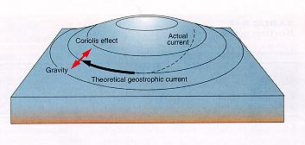
Mounding

Slide 12
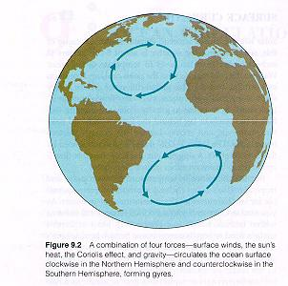
These large mounds of water and the flow around them are called Gyres. The produce large circular currents in all the ocean basins.
  Gyres

Slide 13
Remember the Coriolis Force move objects to the right in the northern hemisphere, and to the left in the southern hemisphere

Slide 14
This powerpoint was kindly donated to
www.worldofteaching.com
http://www.worldofteaching.com
Is home to well over a thousand powerpoints submitted by teachers. This a free site. Please visit and I hope it will help in your teaching

