Slide 1
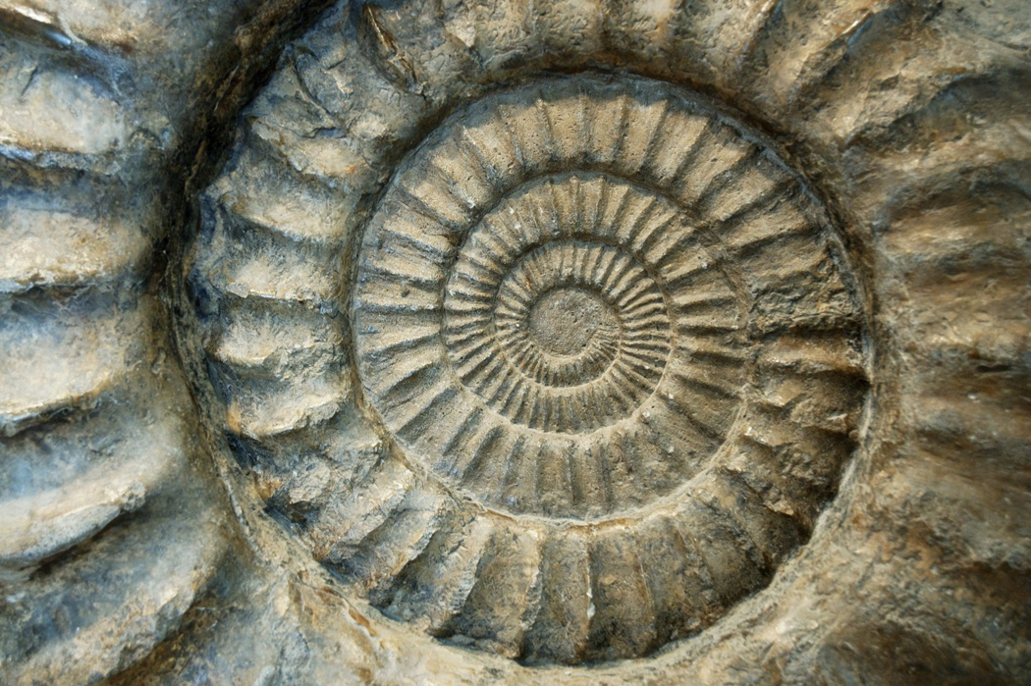
Fossils
Traces of the past……

Slide 2
What happened before
Fossils are traces of things that happened long ago
Plants and animals can become fossils
We have only discovered a small number of the plants and animals from the past
Fossils are not the original, only a copy

Slide 3
Plants
The most famous example of fossilized plants is petrified wood
Ferns, tree leaves, and other plants have been found, too

Slide 4
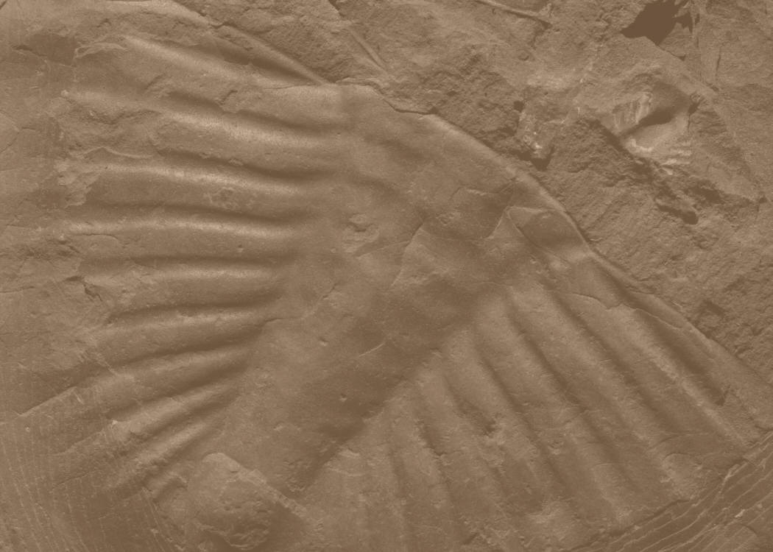
Animals
The most famous fossils are of dinosaurs
There are also fossils of sea creatures and mammals
Sometimes many fossils are found in one place because of a flood, earthquake, or other disaster

Slide 5
How fossils are found
Fossils are often found by accident
Paleontologists and geologists use clues in the rocks to find good places to hunt for fossils
Excavating fossils is hard work, and must be done carefully

Slide 6
How are fossils made?
A fossil is made when a plant or animal is covered quickly with mud or ash
The organism’s tissues are replaced over a long period of time with minerals from the soil it was buried in
Fossils can be dated by the layer of rock they were found in, or by radiocarbon dating

Slide 7
Clues to the past
Many fossils give us an idea of what life was like long ago
Plants give clues about the diet of animals
Animals give clues about the availability of plants and the climate when they lived
Many clues fit together to make a more complete picture of what the world was like long ago

Slide 8
Can we ever really know?
No matter how many clues we have, we can never really know what life was like long ago
We can make an educated guess, and fill in the gaps using what we know about life today
It’s fun to imagine what it was like when the dinosaurs lived. Try it next time you feel bored!

Slide 9
This powerpoint was kindly donated to
www.worldofteaching.com
http://www.worldofteaching.com
Is home to well over a thousand powerpoints submitted by teachers. This a free site. Please visit and I hope it will help in your teaching

