Slide 1
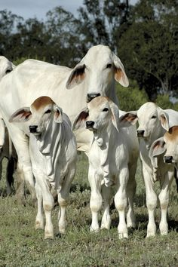
Food and Labor
Bos indicus type cows in Brazil.
Where do these types of cows usually live? Why do they look so different?

Slide 2
Food and Labor
First bovine was domesticated 10,500 years ago in SE Turkey.
All domestic cattle today are descendants of only 80 tamed wild oxen called Aurochs.
Bollongio et al.Modern Taurine Cattle descended from small number of Near-Eastern founders. Molecular Biology and Evolution. 2012

Slide 3
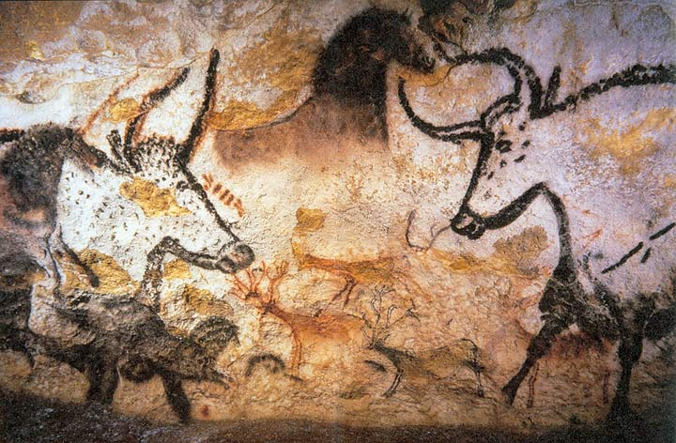
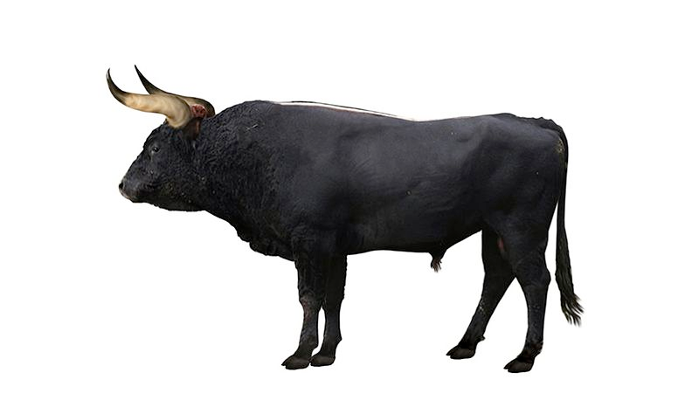
Auroch
Extinct-the last female died in Poland in 1627
Painting in Lascaux cave in France-17,300 years ago
Restorative drawing from a skeleton found in Germany

Slide 4
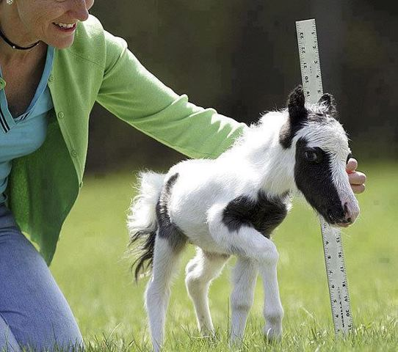
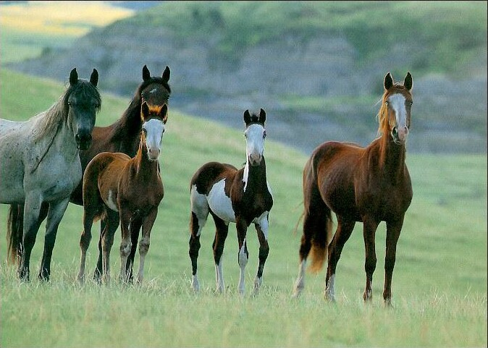
Food and Labor
Equines: Equus ferus caballus

Slide 5
Food and Labor
Horses started to be domesticated 4000-3000 BCE. (6000-5000 years ago)
Scientists don’t really know the exact ancestor. Only 1 truly wild horse exists.
They were probably first used for meat and then for work and transportation.

Slide 6
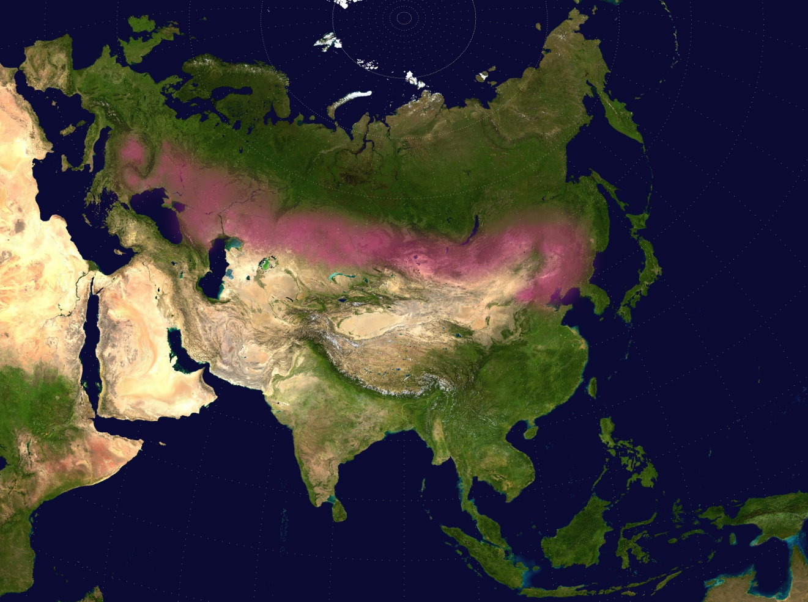
Food and Labor
The Eurasia steppe is the only place that horses survived after the last Ice Age.

Slide 7
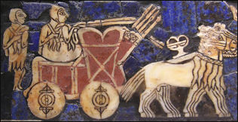
Food and Labor
5000 year old cart drawing found in today’s Iraq.

Slide 8
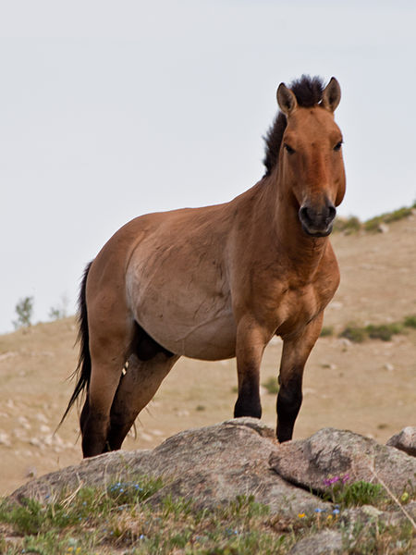
Food and Labor
Equines: Equus ferus przewalskii
The only true wild horse left.
Przewalskii’s horse is endangered and may be a completely different species anyway.

Slide 9
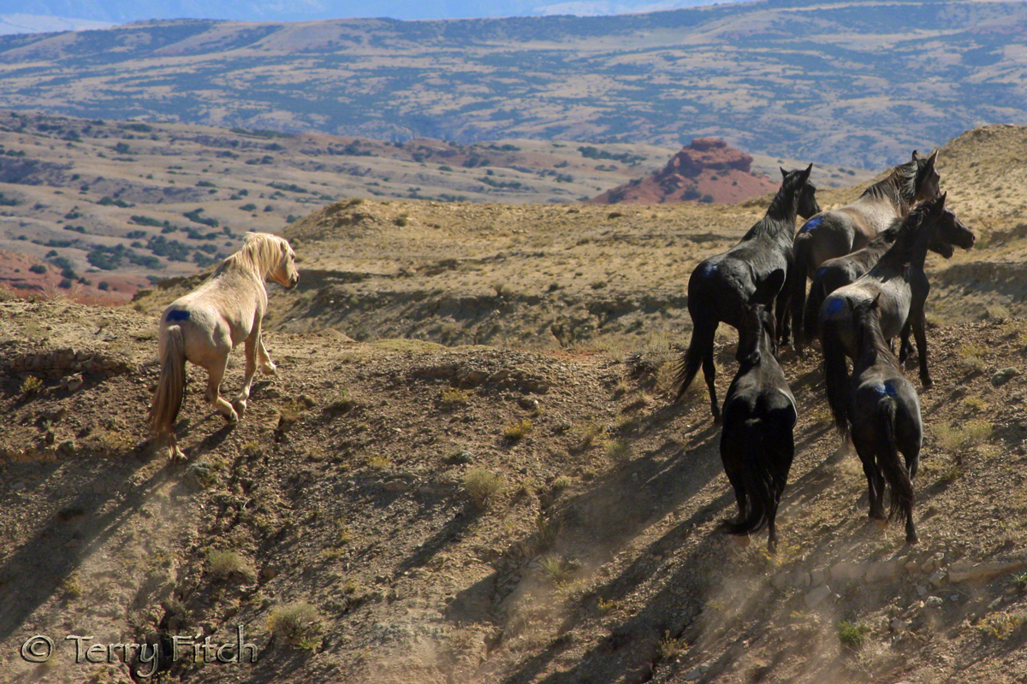
Food and Labor
Mustangs are not wild horses. They are…
Feral: originated from domestic animals

Slide 10
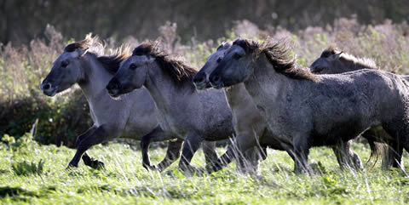
De-extinction
Some people are trying to “breed back” an extinct species. It’s like the reverse of domestication. Selecting for wild traits from original ancestor.
The Tarpan was a wild horse that went extinct in 1910. These are Heck horses…very similar
Their coat turns more white in winter.
The Nazis starting the rebreeding program.

Slide 11
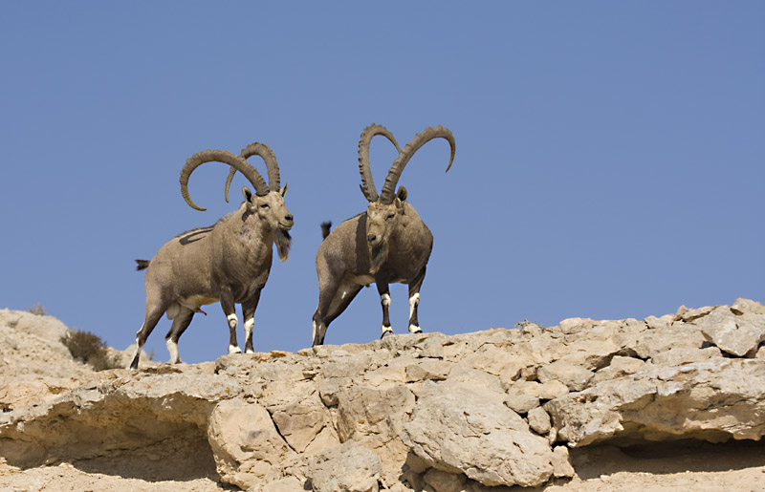
De-extinction
The last Ibex, a type of goat, went extinct in 2000 as scientists tried to collect the DNA from the last one named, Celia.
Since 2003 Celia’s DNA has been used in a cloning project in an attempt to “de-extinct" the species.
In 2009, it worked! But the baby only lived 7 minutes after birth.

Slide 12
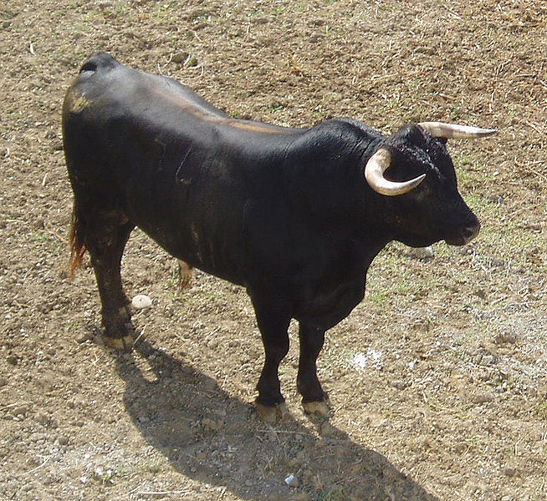
De-extinction
Artist rendition of Auroch
Spanish fighting bull

Slide 13
Create a chart for domestication:
Domestic Animal Wild Ancestor Where? When? How? Why?
Dog
Cat
Chicken
Sheep
Cattle
Horses
There will be a quiz on the chart…on THURSDAY.

Slide 14
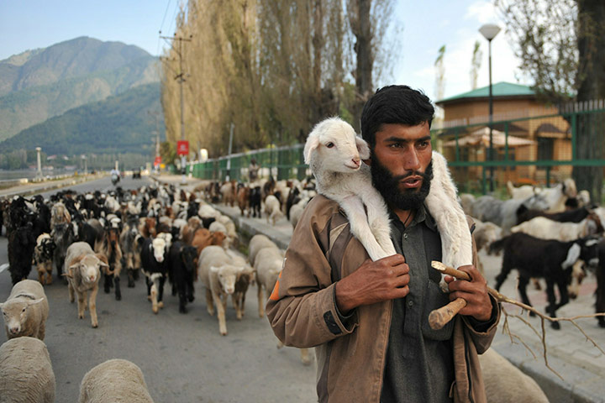
Effects of Domestication
After animals become domesticated, they become dependent upon man.
What changed?
Why?

Slide 15
BECAUSE WE CREATED MONSTERS!!!

Slide 16
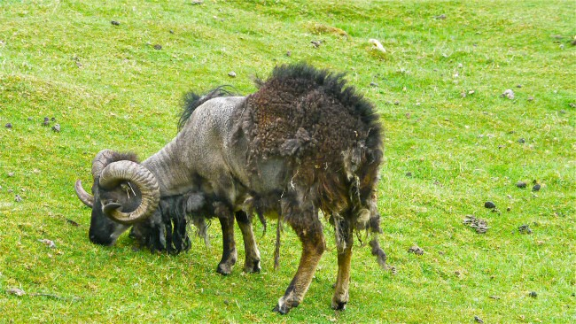
We created monsters!!
Wild sheep shed most of their wool in summer…
Feral Soay Sheep off the coast of Scotland. They are close the ancient breeds.

Slide 17
We created monsters!!
Domestic sheep have been bred to produce a lot of quality wool and it never stops growing…
So humans have to shear sheep usually once per year or…

Slide 18
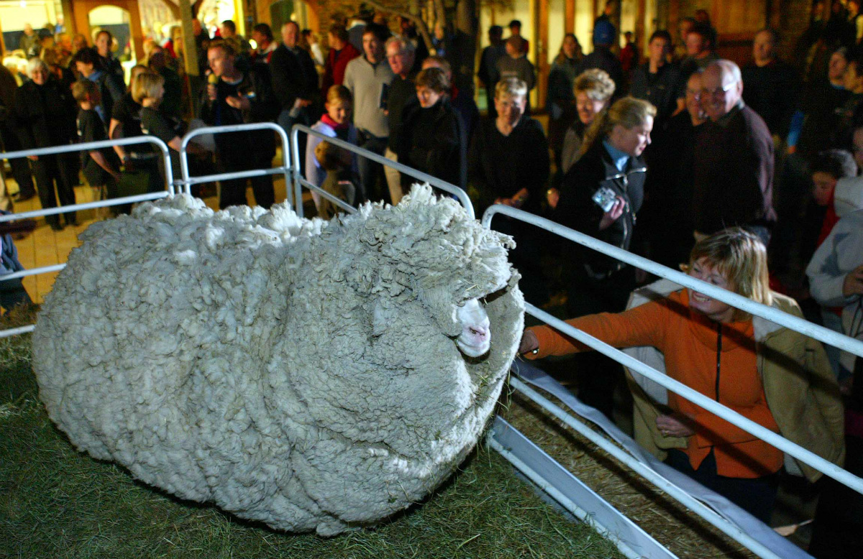

Slide 19
We created monsters!!
“Shrek” was a Merino sheep that lived in New Zealand. He avoided being shorn by hiding in a cave for six years!
When they did find him, he wasn’t recognizable. They thought maybe some strange thing was eating this sheep.
When they sheared him, the amount of wool was enough to make 20 men’s suits, 60lbs of wool!

Slide 20
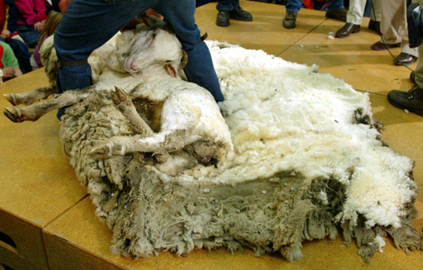
We created monsters!!

Slide 21
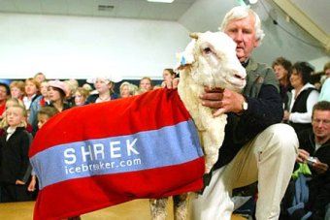
We created monsters!!

Slide 22
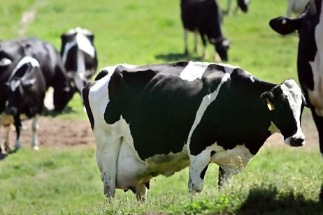
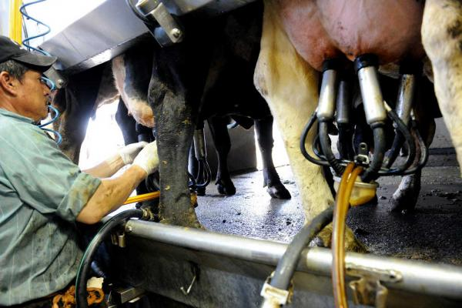
We created monsters!!
Cows (Holsteins) average about 9 gallons of milk a day, while lactating.
The record in 2010 was set by a cow that made almost 30 gallons/day.

Slide 23
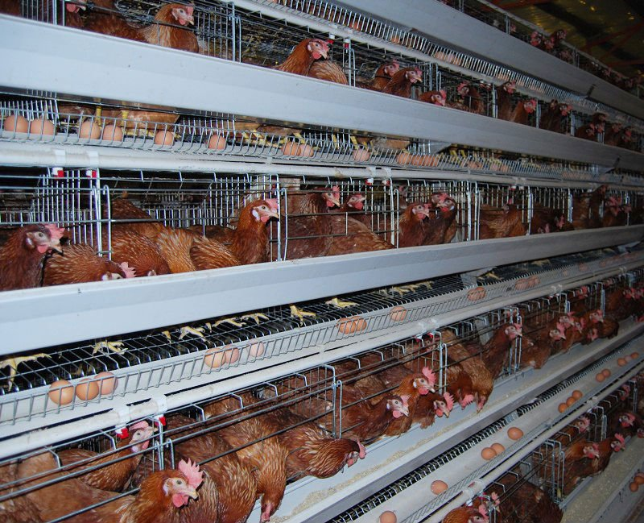
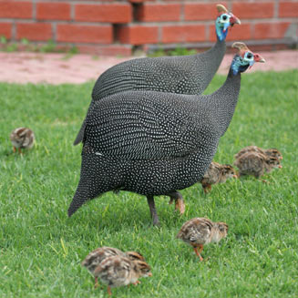
We created monsters!!
Modern chickens produce 250 eggs/year versus 20 in wild species.

Slide 24
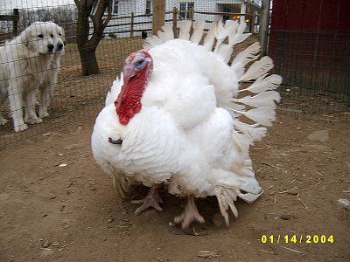
We created monsters
Most poultry can not fly, but why?
They are bred for size which makes them incapable of flight. They are too heavy.
They also can’t breed naturally because the males chest is so big.
Some species have their wings clipped at birth.
Ducks and Geese

Slide 25
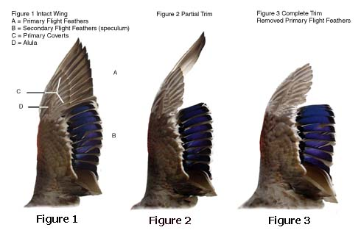
We created monsters
Most poultry can not fly, but why?
Some species have their wings clipped at birth.
Ducks and Geese

Slide 26
How do animals help us?
Food
Fiber
Labor
Medicine/Research
Pets/Companionship

