Slide 1
Domestication of Dogs
Wolves to Dogs-Two hypotheses
https://www.youtube.com/watch?v=nzwYJzAY1go

Slide 2
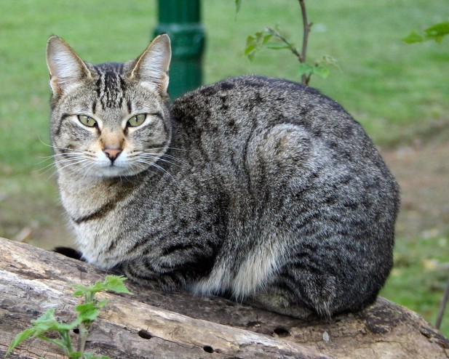
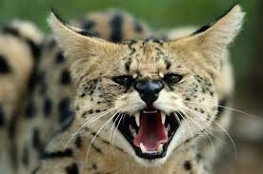
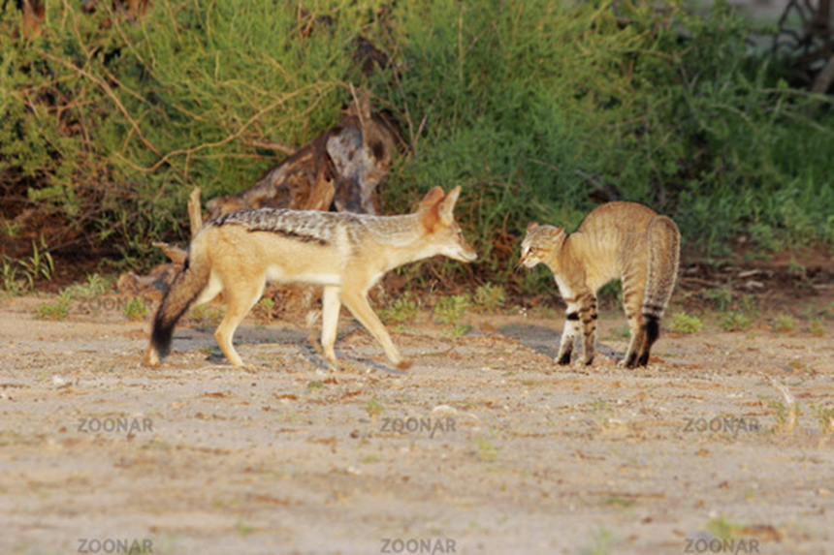
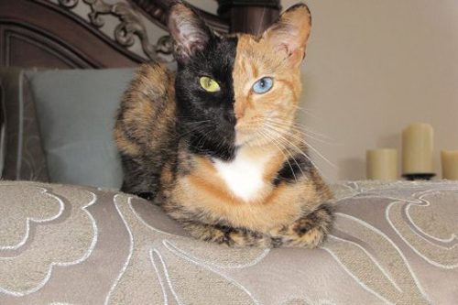
Cats

Slide 3
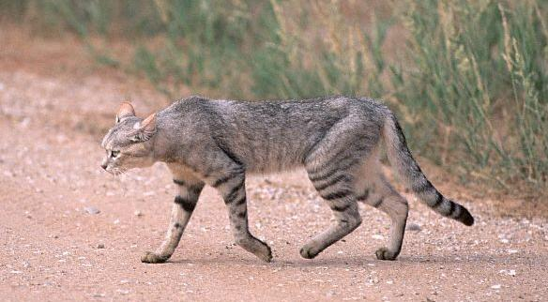
Cats
Cat thought to be domesticated 8,000-10,000 years ago.
2004 Study found genetic evidence the cat descended from African Wildcats (Felis silvestri lybica) in the near and mid-east
“Oldest known pet cat? 9,500-year-old burial found on Cyprus”. John Pickrell. National Geographic News. April, 8, 2004

Slide 4
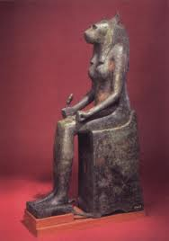
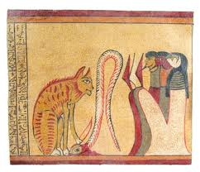
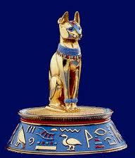
Cats
Domesticated 3,500 years ago- Evidence via pictures of cats have been found in the Egyptian tombs.
The domestic cat controlled rats and mice and therefore, disease. Companionship as well as.

Slide 5
Cats
How do you think cats were domesticated?
Is there the same controversy as with the wolves?

Slide 6
Cats
Flipping Cats!!!!
https://www.youtube.com/watch?v=RtWbpyjJqrU&feature=youtu.be

Slide 7
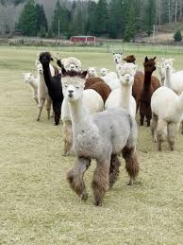
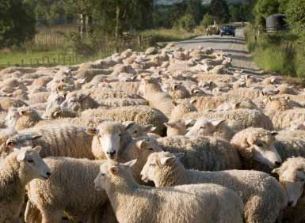
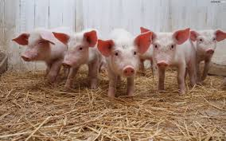
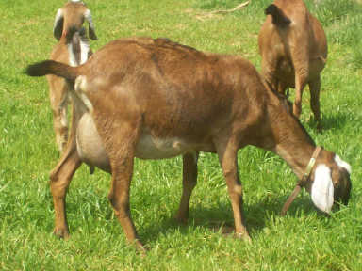
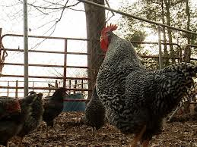
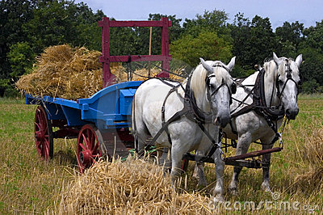
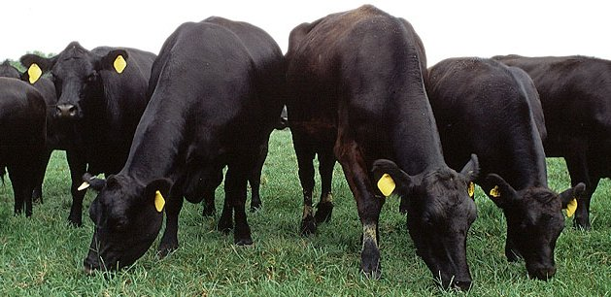
Livestock
Livestock- domesticated animals raised in an agricultural setting for commodities, i.e. food, fiber, and labor.

Slide 8
Domestication of Livestock
What was one of the first livestock animals to be domesticated ?
Jungle fowl or as we know today the CHICKEN.
Why?
Take a few minutes to read the reason….
Jungle Fowl Article-read and respond

Slide 9
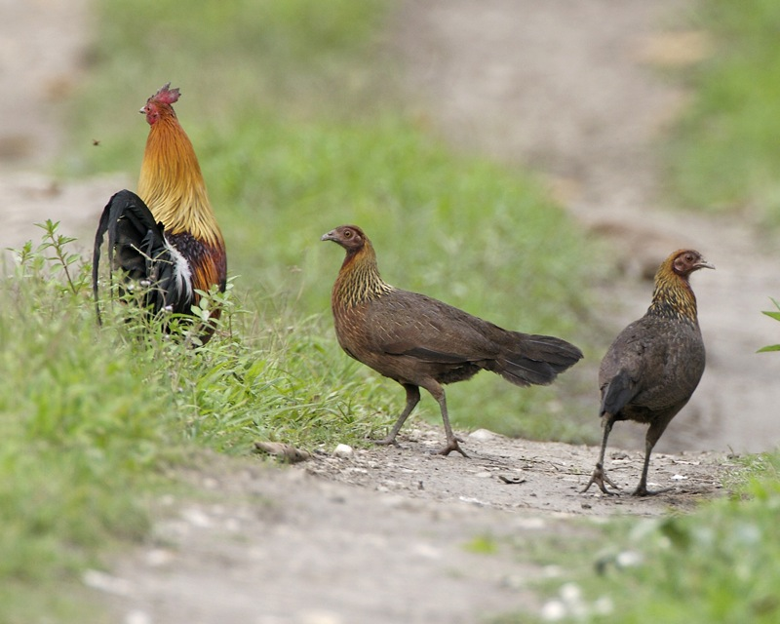
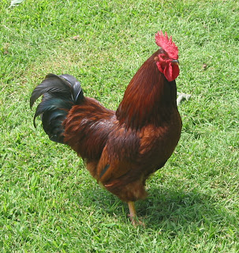
Domestication of Livestock
NH Red-Gallus gallus domesticus
Red Jungle fowl-Gallus gallus

Slide 10
Domestication of Livestock
The private life of chickens-Video
The Private Life of Chickens
https://www.youtube.com/watch?v=1c06xOF4uQ8

