Slide 1


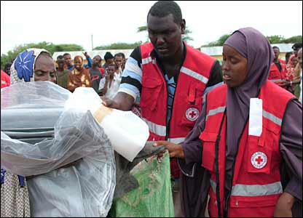
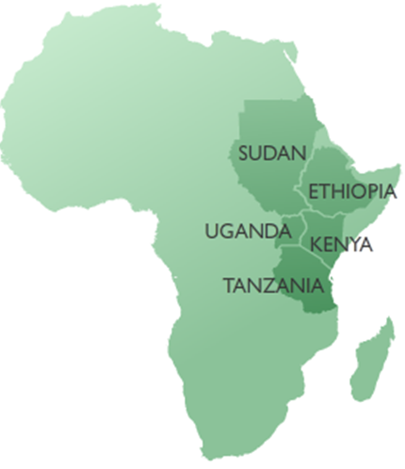
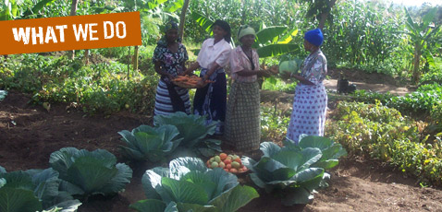

DEVELOPMENT

Slide 2
What is Development
The term development refers to an act of getting better by expanding, enlarging or refining.
This term can also be used to refer to the process in which something exceeds by degrees to a different stage.
Development is the act of improving quality of life and making sure everyone has the preference in what that life looks like.

Slide 3
Features of development
Steady Electricity
Good roads
Security of life and property
Disciplined citizens
Quality education
Existence of employment opportunities
Good governance

Slide 4
Reasons Why Ledc’s are Underdeveloped
Lack of Industrialization
Poverty /lack of capital
Illiteracy
Lack of research
Lack of technology
Debt burden

Slide 5
Types of development
Economic – Living standard of the masses which includes GDP
Social- Life of the people and the infrastructures in the country.
Political- The level and type of governance being practiced in the country.
Environmental- This has to do with the natural appearance of the environment.

Slide 6
Patterns of Development in the World
The world is divided into two groups
(i) The more economically developed countries (MEDC’s) which include the richer, more industrialised countries of the so called developed North.
(ii) The less economically developed countries (LEDCs) which include the poorer, less industrialised countries of the so called developing South

Slide 7
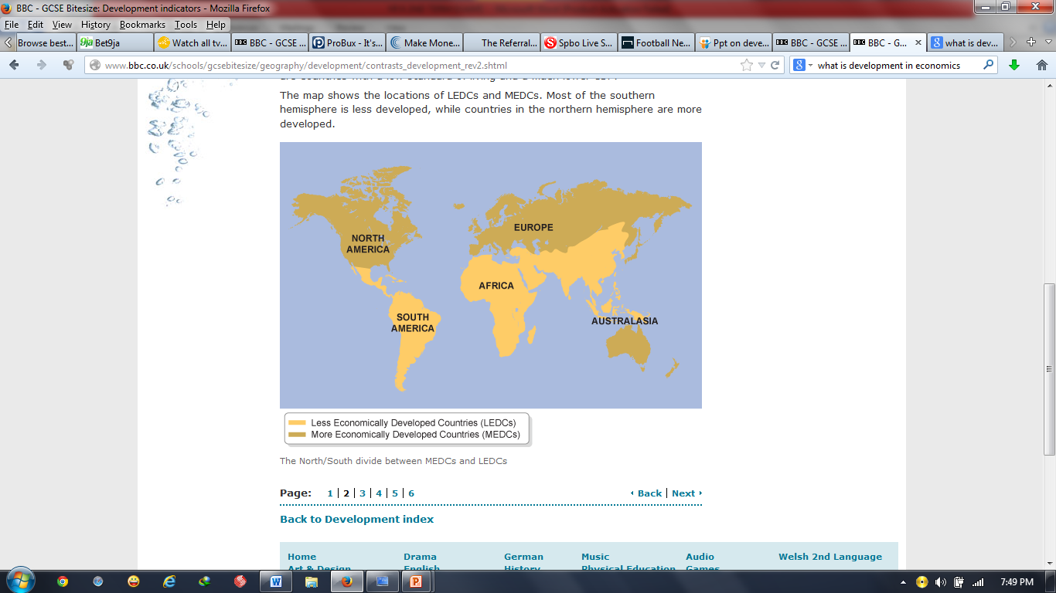

Slide 8
Countries exhibit different levels of development. The factors which affect development may be economic, social, cultural or technical.

Slide 9
Measuring development
Studying development is about measuring how developed one country is compared to other countries, or to the same country in the past. Development measures how economically, socially, culturally or technologically advanced a country is.
The two most important ways of measuring development are economic development and human development.
Economic development is a measure of a country's wealth and how it is generated (for example agriculture is considered less economically advanced then banking).
Human development measures the access the population has to wealth, jobs, education, nutrition, health, leisure and safety - as well as political and cultural freedom. Material elements, such as wealth and nutrition, are described as the standard of living. Health and leisure are often referred to as quality of life.

Slide 10
What are development indicators
These are used to examine whether a country is developed or not.
Geographers use a series of development indicators to compare the development of one country to another.
There is not a single way to calculate the level of development of a country

Slide 11
Health. Does the population have access to medical care?
Industry. What type of industry dominates? LEDCs focus on primary industries, such as farming, fishing and mining. MEDCs focus on secondary industries, such as manufacturing. The most advanced countries tend to focus more on tertiary or service industries, such as banking and information technology.
Education. Do the population have access to education? Is it free? What level of education is available (ie primary, secondary or further/higher education)?

Slide 12
Economic development indicators
To assess the economic development of a country, geographers use economic indicators including:
(i) Gross Domestic Product (GDP) is the total value of goods and services produced by a country in a year.
(ii) Gross National Product (GNP) measures the total economic output of a country, including earnings from foreign investments.
(iii) GNP per capita is a country's GNP divided by its population. (Per capita means per person.)
(iv) Economic growth measures the annual increase in GDP, GNP, GDP per capita, or GNP per capita.
(v) Inequality of wealth is the gap in income between a country's richest and poorest people. It can be measured in many ways, (eg the proportion of a country's wealth owned by the richest 10 per cent of the population, compared with the proportion owned by the remaining 90 per cent).

Slide 13
(vi) Inflation measures how much the prices of goods, services and wages increase each year. High inflation (above a few percent) can be a bad thing, and suggests a government lacks control over the economy.
(vii) Unemployment is the number of people who cannot find work.
(viii) Economic structure shows the division of a country's economy between primary, secondary and tertiary industries.
(ix) Demographics study population growth and structure. It compares birth rates to death rates, life expectancy and urban and rural ratios. Many LEDCs have a younger, faster-growing population than MEDCs, with more people living in the countryside than in towns. The birth rate in the UK is 11 per 1,000, whereas in Kenya it is 40

Slide 14
Human development indicators
(i) Life expectancy - the average age to which a person lives, eg this is 79 in the UK and 48 in Kenya.
(ii) Infant mortality rate - counts the number of babies, per 1000 live births, who die under the age of one. This is 5 in the UK and 61 in Kenya.
(iii) Poverty - indices count the percentage of people living below the poverty level, or on very small incomes (eg under £1 per day).
(iv) Access to basic services - the availability of services necessary for a healthy life, such as clean water and sanitation.
(v) Access to healthcare - takes into account statistics such as how many doctors there are for every patient.
(vi) Risk of disease - calculates the percentage of people with diseases such as AIDS, malaria and tuberculosis.

Slide 15
(vii) Access to education - measures how many people attend primary school, secondary school and higher education.
(viii) Literacy rate - is the percentage of adults who can read and write. This is 99 per cent in the UK, 85 per cent in Kenya and 60 per cent in India.
(ix) Access to technology - includes statistics such as the percentage of people with access to phones, mobile phones, television and the internet.
(x) Male/female equality - compares statistics such as the literacy rates and employment between the sexes.
(xi) Government spending priorities - compares health and education expenditure with military expenditure and paying off debts.

Slide 16

Measures of development
Name | What it is | A measure of… | As a country develops it gets….
Gross Domestic product (GDP) | The total value of goods and services a country produces in a year . Its often given in US dollars (US$) | wealth | Higher
Gross national income (GNI) | The total value of goods and services of people of that nationality produce in a year ( i.e. GDP + money from people living aboard).Its also called Gross national product (GNP) | Wealth | higher
GNI per head | This is the GNI divided by the population of a country . Sometimes called GNI per capita. | wealth | higher
Birth rate | The number of live babies born per thousand of the population per year. | Womens rights | lower
Death rate | The number of deaths per thousand of the population per year. | health | lower

Slide 17


Name | What it is | A measure of… | As a country develops it gets….
Infant mortality rate | The number of babies who i.e. under 1 year old per thousand born | health | Lower
People per doctor | The average number of people for each doctor | health | Lower
Literacy rate | The percentage of adults who can read and write | education | Higher
Access to safe water | The percentage of people who can get clean drinking water. | health | Higher
Life expectancy | The average age a person can expect to live to. | health | Higher
Human development index | This is a number that is calculated using life expectancy, literacy rate, education level and income per head | Lots of things | Higher

Slide 18
These measures have limitations when used on their own
The measures can be misleading when used on their own because they're averages- they don’t show up elite groups in the population or variations within the country.
They shouldn’t be used on their own because as a country develops some aspects develop before others. So it might seem that a country is more developed than it actually is.
Using more than one measure or using the HDI avoids these problems.

Slide 19
To balance inaccuracies, indices tend to be an amalgamation of many different indicators.
The United Nations Human Development Index (HDI) is a weighted mix of indices that show life expectancy, knowledge (adult literacy and education) and standard of living (GDP per capita). As Vietnam has a higher literacy rate and life expectancy than Pakistan, it has much higher HDI value even though it has a similar per capita GDP.
HDI is measured between 0 and 1. The USA has an HDI of 0.994 whereas Kenya has an HDI of 0.474.

Slide 20
Human Development Index(HDI)
HDI – A socio-economic measure, it focus on three variables of human welfare-
(i) life expectancy (health),
(ii) adult literacy( education) and
(iii) real GDP per capital(standard of living)

Slide 21
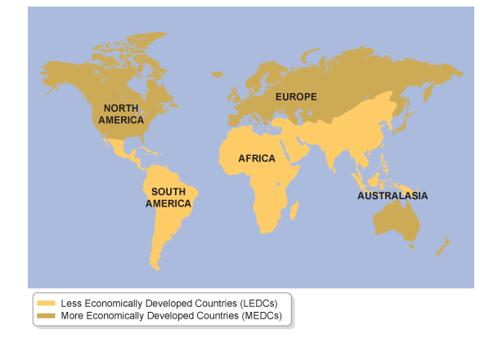
Global inequalities
The map shows the locations of LEDCs and MEDCs. Most of the southern hemisphere is less developed, while countries in the northern hemisphere are more developed.
Using this simple classification you couldn’t tell which countries were developing quickly and which weren't really developing at all.

Slide 22
Quality of life isn't the same as standard of living
As a country develops the quality of life and standard of living of people that live there improves.
Someone's standard of living is their material wealth.
Quality of life includes standard of living and other things that aren't easy to measure e.g. how safe they are or how nice their environment is.
In general the higher a persons standard of living the higher their quality of life . But just because they have a high standard of living doesn’t mean they have a good quality of life.
Different people in different parts of the world have different ideas about what an acceptable quality of life.

Slide 23
Causes of global inequalities
Environmental factors affect how developed a country is:
A poor climate:
if a country has a poor climate (really hot or cold) they wont be able to grow much.
This reduces the amount of food produced.
This can lead to malnutrition in some countries leading to people having a low quality of life.
People also have fewer crops to sell so less money to spend on goods and services.
The government gets less money from taxes as less is sold and bought, meaning there is less to spend on developing the country.
Poor farming land
If the land in a country is steep or has poor soil then they wont produce a lot of food . This has the same affects as having a poor climate
Limited water supplies
Some countries don’t have a lot of water. This makes it hard for them to produce a lot of food.

Slide 24
Causes of global inequalities
Lots of natural hazards
A natural hazard is an event that has the potential to affect peoples lives or property e.g earthquakes , tsunamis, volcanic eruptions, tropical storms, droughts, floods.
Countries that have a lot of natural disasters have to spend a lot of money rebuilding after disasters occur
.
Natural disasters reduce the quality of life for the people affected and they reduce the amount of money the government has to spend on development projects.
Few raw materials
Countries without many raw materials like coal, oil or metal ores tend to make less money because they have fewer products to sell.
This means they have less money to spend on development.
Some countries do have a lot of raw materials but still aren't very developed because they don’t have the money to develop the infrastructure to exploit them.

Slide 25
Factors influencing development
Social-Some government are corrupt. This means some people in the country get richer whilst other stay poor and have a low quality of life.
Economic_ countries with mineral deposits and energy resources were more likely to develop than countries that do not have
Political- If a country has an unstable government it might not invest in things like healthcare, education and improving the economy. This leads to slow development or no development at all.
If there's war in a country the country loses money that could be spent on development.

Slide 26
Economic factors:
Poor trade links
World trade patterns influence a countries economy and so affect their level of development.
If a country has poor trade links it wont make a lot of money so there will be less to spend on development
Lots of debt
Very poor countries borrow money from other countries and international organisations.
This money has to be paid back and sometimes with interest.
Any money a country makes is used to pay back the money so isn't used to develop
An economy based on primary products
Countries that mostly export primary products tend to be less developed.
This is because you don’t make much profit by selling primary products.
Their prices also fluctuate- sometimes the price falls below the cost of production.
This means people make less money so the government has less to spend on development

Slide 27
Social factors
Drinking water
If the only water people can drink is dirty then they will get ill from waterborne diseases such as typhoid and cholera.
Being ill reduces a persons quality of life.
Ill people can work so don’t add money to the economy and also cost money to treat.
The place of women in society
Women who have an equal place in society are more likely to be educated and to work.
Women who are educated and work have a better quality of life and the country ha more money to spend on development as there are more people contributing to the economy.
Child education
The more children that go to school the more developed a country will be. This is because they will get a better education and so will get better jobs. Being educated and having a good job improves a persons quality of life and increases the money the country has to spend on development.

Slide 28




A poor climate
Drinking water
Poor faming land
Limited water supplies
Child education
Lots of debt
war
Few raw materials
Unstable governments
Causes of global inequalities
Poor trade links
An economy based on primary products
The place of women in society
Lots of natural hazards
Corrupt governments

Slide 29
Consequences of Inequality
High birthrate and infant mortality rates
Poorer education facilities( lower levels of literacy, less time spent in school)
More jobs in primary and informal sector and fewer in the secondary, tertiary and formal sector
Smaller volume of trade, a need to ask for aid
Less purchasing power per capital

Slide 30

United Kingdom
Population 65 million
GDP ($US) 36039
Health 17
Life expectancy 78
Birth rates 12
Death rates 10
Urban 89%
HDI 0.939
Employment tertiary 69%
Employment primary 2%

Slide 31
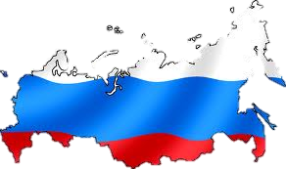
Russia
Population 143million Employment primary 24%
GDP ($US) 4078 Employment tertiary 29%
Health 42 HDI 0.795
Life expectancy 71 Urban 53%
Birth rates 10 Death rates 12

Slide 32
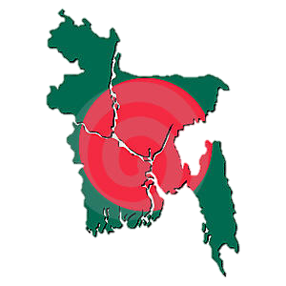
Bangladesh
Population 144million
GDP ($US) 405
Health 2
Life expectancy 61
Birth rates 27
Death rates 8
Urban 23%
HDI 0.520
Employment tertiary 19%
Employment primary 65%

Slide 33
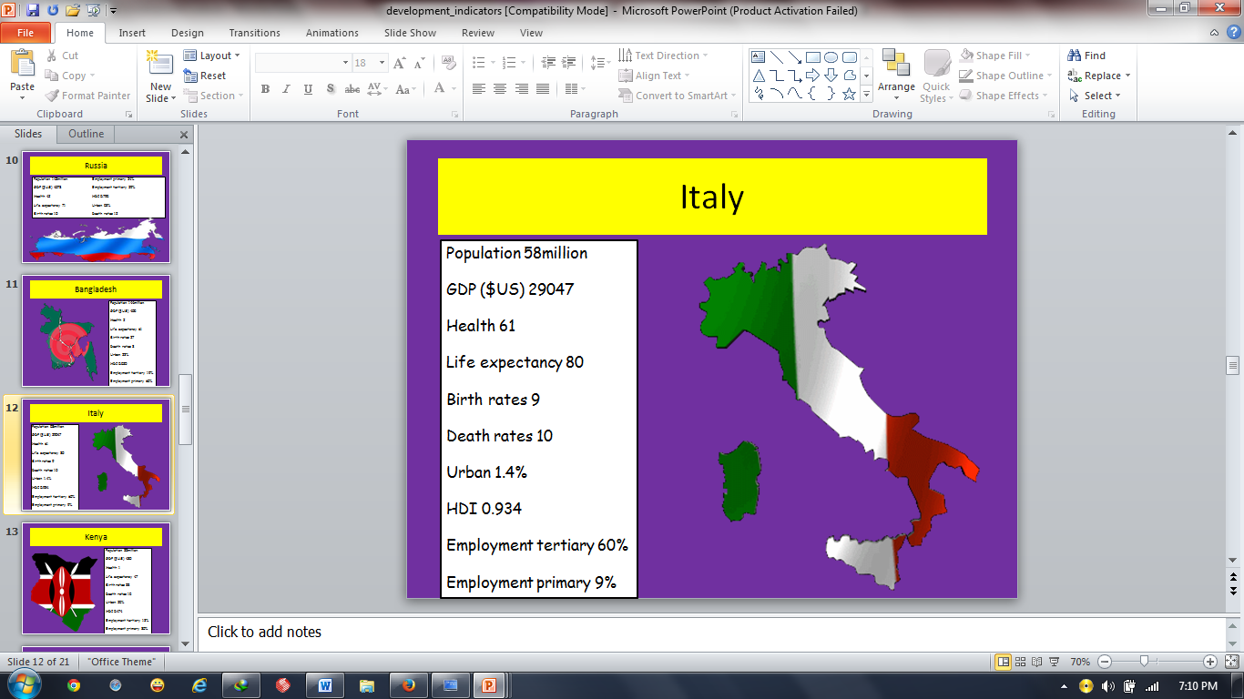

Slide 34
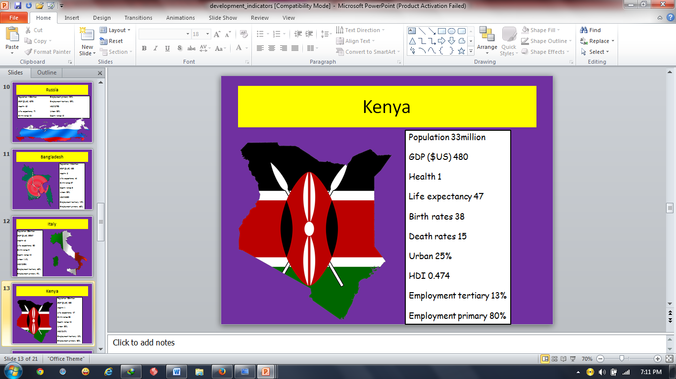

Slide 35
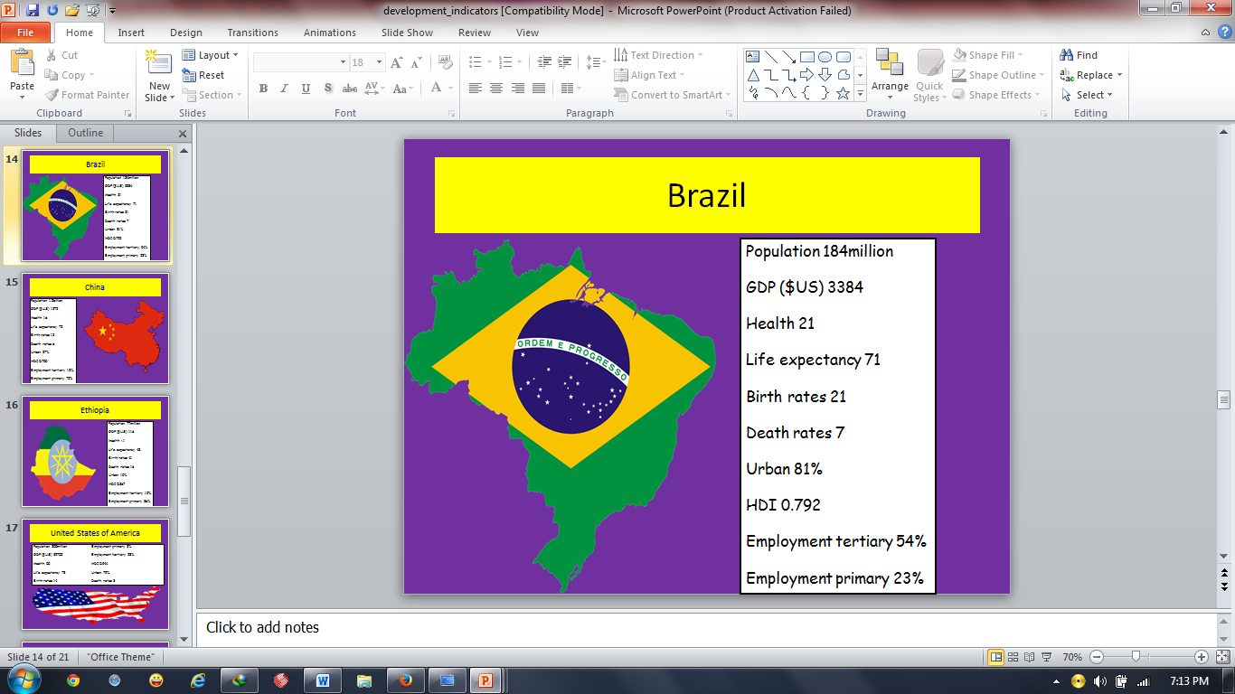

Slide 36
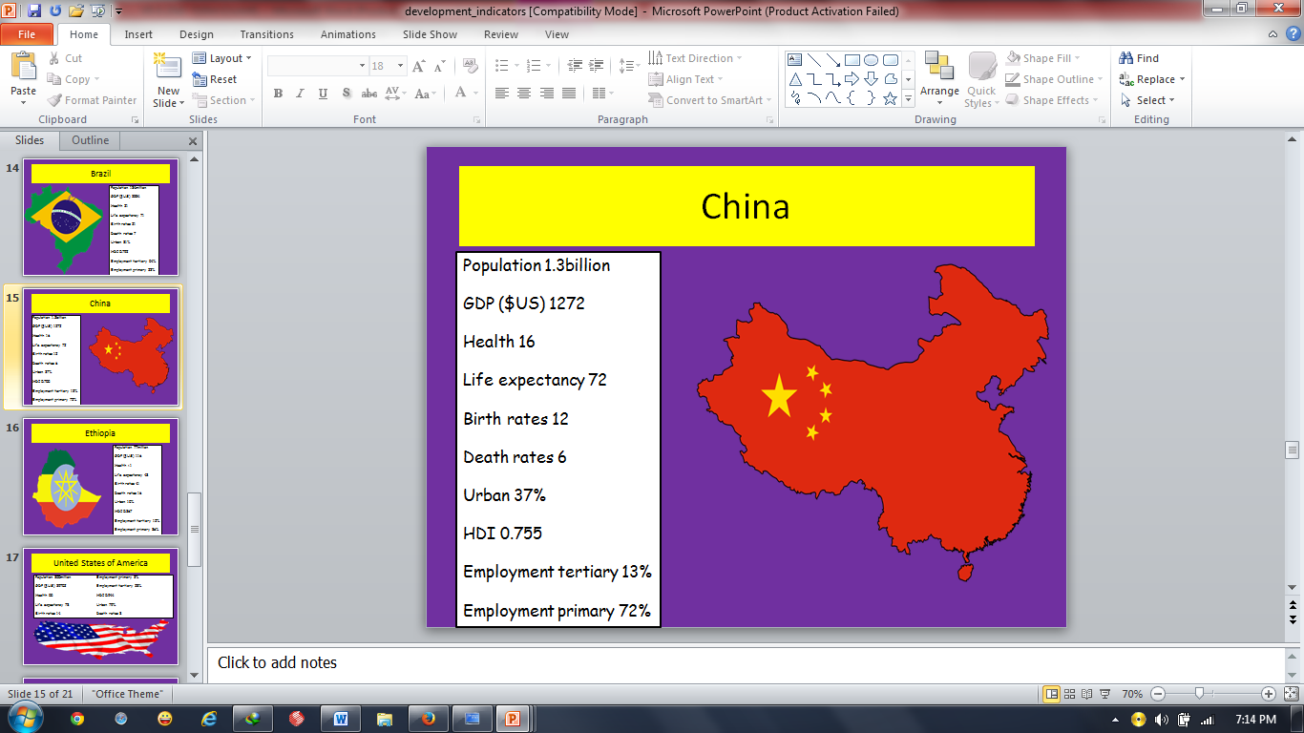

Slide 37
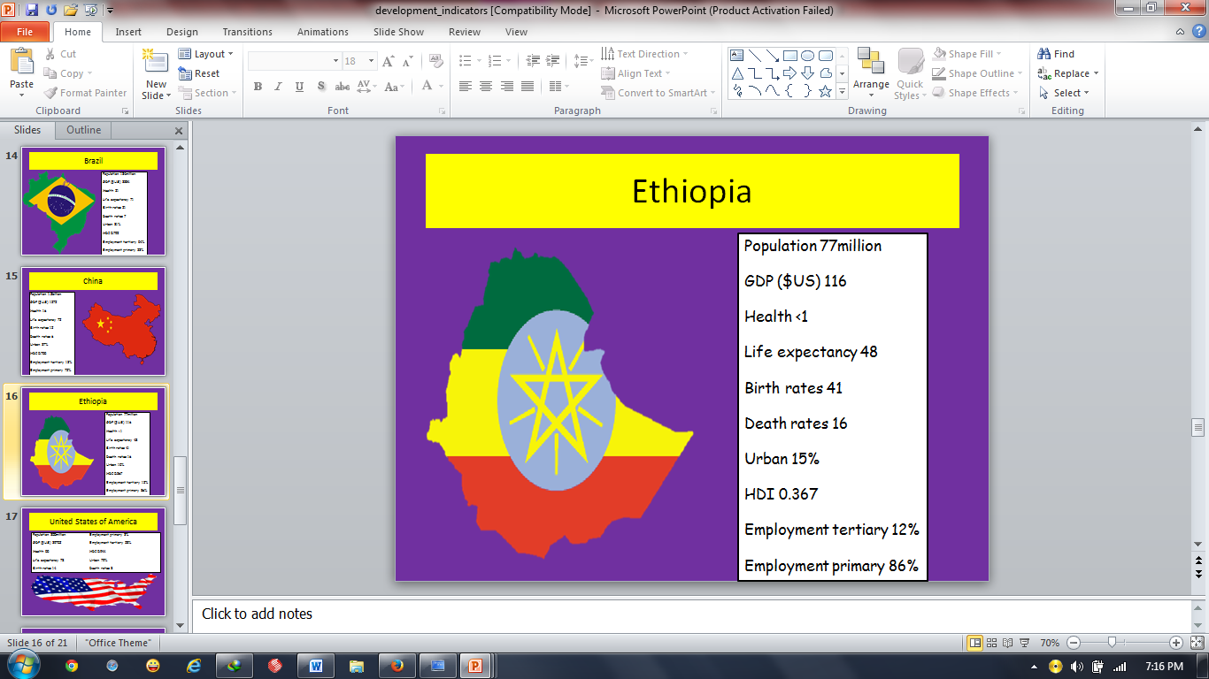

Slide 38
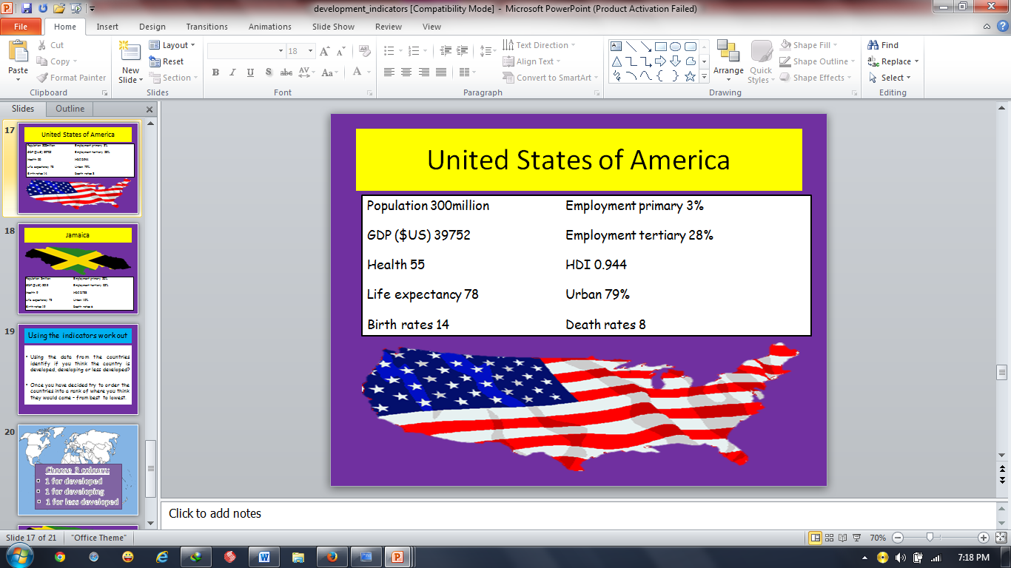

Slide 39
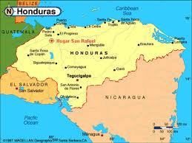
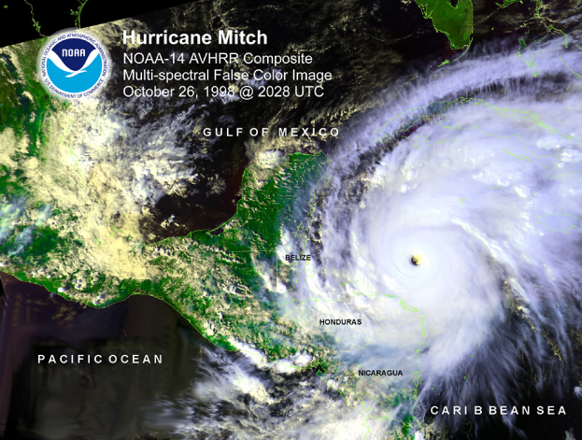
Global inequalities case study
Hurricane Mitch hit Nicaragua and Honduras in October 1998:
Nicaragua:
Around 3000 people were killed.
Crops failed and 50 000 animals died.
70% of roads were unusable and 71 bridges were damaged or destroyed.
23 900 houses were destroyed and 17 600 were damaged.
340 schools and 90 health centres were damaged or destroyed.
Honduras:
Around 7000 people were killed.
The hurricane destroyed 70% of the countries crops.
Around 70-80% of the transport infrastructure was severely damaged.
35 000 houses were destroyed and 50 000 more were damaged.
20% of schools were damaged as well as 117 health centres and six hospitals.

Slide 40
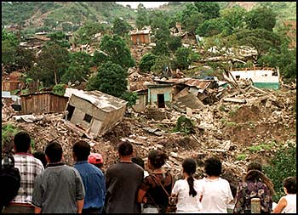
Hurricane Mitch set back development in Nicaragua
In 1998 the GDP grew by 4% which was less than estimated.
Exports of rice and corn went down because crops were damaged by the hurricane. This meant people earnt less money so were poorer and the government had less money to spend on development.
The total damage caused by the hurricane is estimated to be $1.2 billion
The education of children suffered- the number of children that worked rather than went to school increased by 8.1%

Slide 41
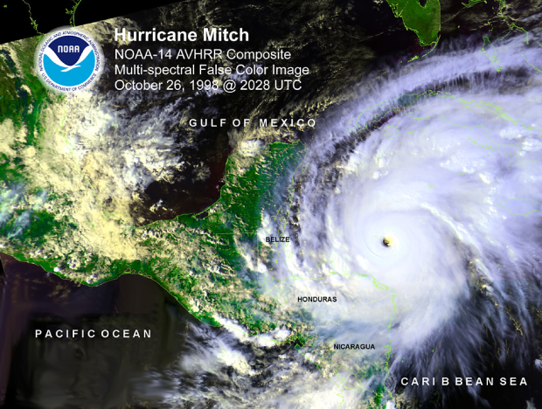
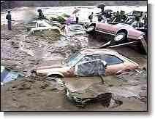
Hurricane Mitch set back development in Honduras
In 1998 money from agriculture made up 27% of the country's GDP. In 2000 this had fallen to 18% because of the damage to crops. This reduced the quality of life for people who worked in agriculture because they made less money.
GDP was estimated to grow 5% in 1998 but it only grew by 3% due to the hurricane. This meant less money was available for development.
The cost of repairing and repairing houses, schools and hospitals was estimated to be $439 million- this money could have been used to develop the country.
All these things set back development- the Honduran President claimed hurricane mitch destroyed 5o years of progress.

Slide 42
Reducing Global Inequality
Some people are trying to improve their own quality of life
Moving from rural areas to urban areas- things like water, food and jobs are easier to get in towns and cities.
Some people improve their quality of life by improving their environment e.g their houses.
Communities can work together to improve the quality of life for everyone in the community, e.g some communities build and run services like schools

Slide 43

Fair trade
Trading groups
These are groups of countries that make agreements to reduce barriers to trade (e.g. to reduce import taxes)- this increases trade between members of the group.
When a poor country joins a trading group, the amount of money the country gets from trading increases-more money means that more development can take place.
However, its not easy for poorer countries that aren't part of trading groups to export goods to countries that are part of trading groups. This reduces the export income of non-trading group countries and slows down their development.
Fair trade is all about getting a fair price for goods produced in poorer countries.
Companies who want to sell products labelled as fair trade have to pay produces a fair price .
Buyers also pay extra on top of the fair trade price to help develop the area the goods come from.
Only producers that treat their employees well can take part in the scheme.
Producers in a fair trade scheme often produce a lot because of the prices – this can lead them to produce too much. An excess will make world prices fall and cause producers who aren't in a fair trade scheme to lose out.

Slide 44
aid
Aid is given by one country in the form of money or resources.
The country that gives the aid is called the donor-the one that receives the aid is called the recipient.
There are two main sources of aid from donor countries- governments (paid for by taxes0 and Non governmental Organisations (NGOs, paid for by voluntary donations
Bilateral aid can be tied –this means its given with the condition that the recipient country has to buy the goods and services .This helps the economy of the donor country. However, if the goods and services are expensive in the donor country, the aid doesn’t go as far as it would if they were bought elsewhere.
Aid can be classed as either short term or long term depending on what its used for
There are two different ways donor governments can give aid to recipient countries
Directly to the recipient – bilateral aid
Indirectly through an international organisation that distributes the aid- this is called multilateral aid

Slide 45
Aid can be classed as either short term or long term depending on what its used for.
Type of aid | What it is | Advantage to recipient | Disadvantage to recipient
Short term | Money or resources to help recipient countries cope with emergencies e.g. earthquakes wars. | The impact of the aid will be immediate- more people will survive the emergency. | The development of a country remains unchanged.it may become reliant on aid.
Long term | Money or resources to help recipient countries become more developed, e.g. to improve healthcare | Countries will be less reliant on foreign aid as they become more developed. | It can take a while before the aid benefits a country, e.g. hospitals take a long time to be built.
Aid has one big disadvantage to donor countries- it costs them money and resources. However one advantage is that the recipient countries become their political allies.
Some recipient countries don’t use aid effectively because they have corrupt governments.

Slide 46
Here are some examples of development projects aid is spent on:
Long term aid
Constructing schools to improve literacy rates and hospitals to reduce mortality rates.
Building dams and wells to improve clean water supplies.
Providing farming knowledge and equipment to improve agriculture.
International aid donors encourage sustainable development
Sustainable development means developing in a way that doesn’t irreversibly damage the environment or use up resources faster than they can be replaced.
International aid donors encourage sustainable development in a number of ways:
What they do: | How its sustainable
Invest in renewable energy, to reduce the use of fossil fuels | Reduces the environmental impact of using fossil fuels
Educate people about their environmental impact | Reduces things like air and water pollution
Plant trees in areas that have been affected by deforestation | Makes sure there are still trees to use in the future

Slide 47
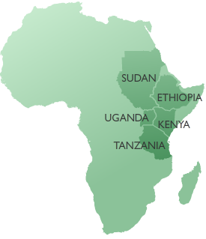

Reducing global inequality- Case study
FARM-Africa is a non governmental organisation that provides aid to eastern Africa.
Its funded by voluntary donations
It was founded in 1985 to reduce rural poverty.
FARM-Africa runs programmes in five African countries- Ethiopia, Sudan, Kenya, Uganda and Tanzania.
FARM-Africa has been operating in Ethiopia since 1988.

Slide 48
Project | Region | Problem | What's being done | Helping…
Rural women's Empowerment | Various | There are very few opportunities for Ethiopian women to make money. This means they have a low quality of life and struggle to afford things like healthcare | Women are given training and livestock to start farming. Loan schemes have been set up to help women launch small businesses. Women have been given legal training to advise other women of their rights. | Around 15 160 people
Prosopis Management | Afar | Prosopis, a plant introduced by the government to stabilise soils has become pest, it invades grazing land, making farming difficult. | Framers are shown how to convert Prosopis into animal feed. The animal feed is then sold , generating a new source of income. | Around 4400 households
Community Development Project | Semu Robi | Frequent droughts make farming difficult. This reduces the farmers income and can lead to malnutrition. Semu Robi is a remote region so getting veterinary care for livestock is difficult. | People are given loans to buy small water pumps to irrigate their farmland. This reduces the effects of drought. People are trained in basic veterinary care so they can help keep livestock healthy. | Around 4100 people directly and 60 000 indirectly by veterinary care.
Sustainable Forest Management | Bale | Forests are cut down to make land for growing crops and grazing livestock. Trees are also cut down for firewood.This reduces resources for future generations. | Communities are taught how to produce honey and grow wild coffee. These are then sold so people can make money without cutting down trees. Communities are also taught how to make fuel efficient stoves that use less wood. | Around 7500 communities

Slide 49
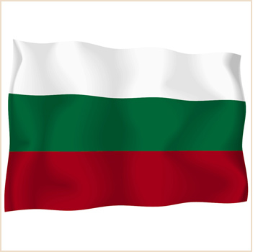

Inequalities in the EU-Case study
Bulgaria is less developed than the Uk
Bulgaria joined the EU in 2007.It is less developed than the UK for example:
IN 2007 Bulgaria had a GNI per head of $11 180 and the UK had a GNI per head of $33 800.
Life expectancy in Bulgaria is six years lower (73 compared to 79)
The HDI for Bulgaria is 0.824 whereas its 0.947 for the UK.

Slide 50


Here are a few reasons why Bulgaria is less developed than the uk:
The climate is temperate and there aren't many droughts. This creates good conditions for farming
Part of Bulgaria is very mountainous. The land on the mountains is steep and has poor soil.
The UK has good trade links- the UK has been a major trading centre for hundreds of years
There have been problems with political corruption since 1990
The UK has well developed manufacturing and service industries
The climate is temperate but there are droughts in summer and high snowfall and storms in winter. This makes farming difficult
Bulgaria was a communist country between 1944 and 1990

