Slide 1
Clouds

Slide 2

How do clouds form?
When water vapor in the air becomes liquid water or ice crystals.

Slide 3
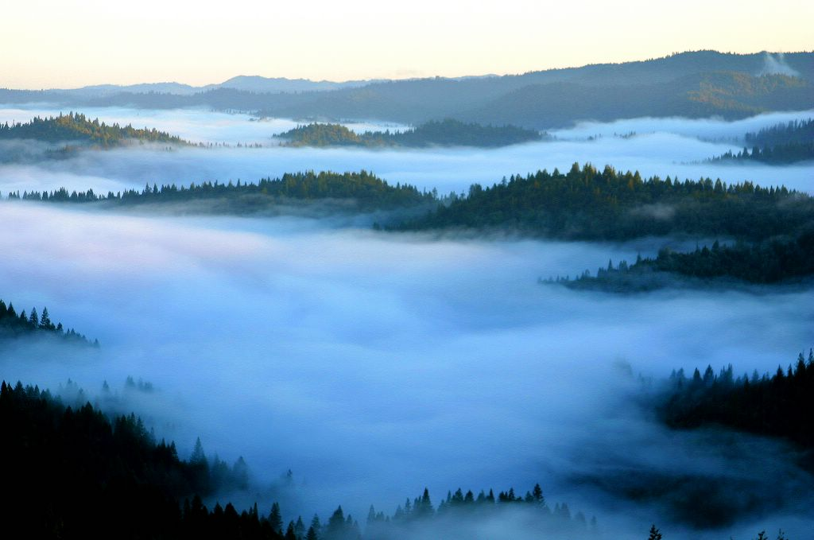
FOG
A cloud in contact with the ground.

Slide 4
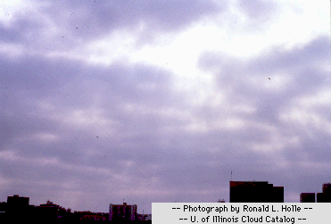
STRATUS
Sheets of low, grey clouds that bring light snow, rain, or drizzle.

Slide 5
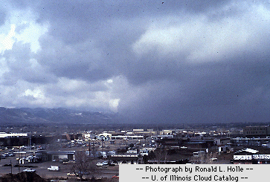
NIMBOSTRATUS
Thicker layer than stratus clouds that completely block out the sun. They cause steady rain or snow.

Slide 6
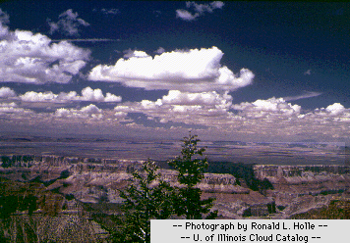
CUMULUS
White and puffy clouds that usually mean good weather.

Slide 7
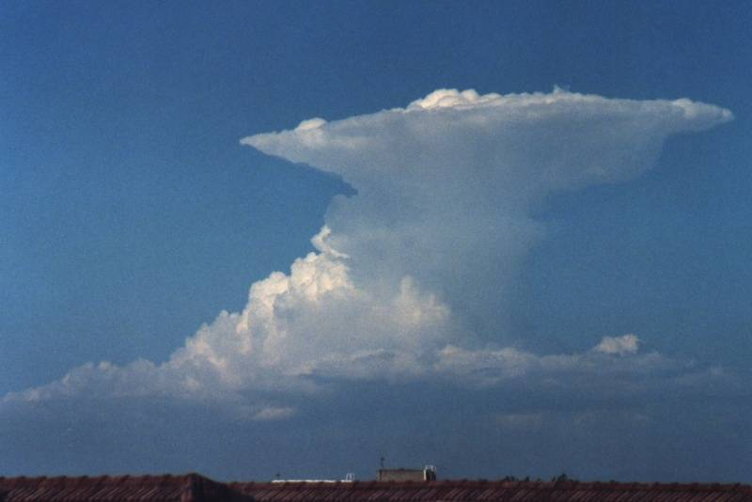
CUMULONIMBUS
Dark, towering clouds that are also called “thunderheads”. These clouds produce heavy rain, thunder, and lighting.

Slide 8
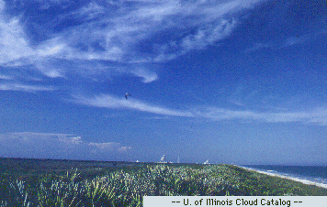
CIRRUS
Thin, featherlike clouds that are made of ice crystals high in the atmosphere. Usually means a change in the weather is coming.

Slide 9
This powerpoint was kindly donated to
www.worldofteaching.com
http://www.worldofteaching.com
Is home to well over a thousand powerpoints submitted by teachers. This a free site. Please visit and I hope it will help in your teaching

