Slide 1
BRIDGES

Slide 2
What is a bridge?
A bridge is a way to get across something
It can span a canyon, waterway, or road

Slide 3
What does a bridge need?
A good bridge must have a firm foundation
A good bridge must be sturdy
A good bridge must last a long time

Slide 4
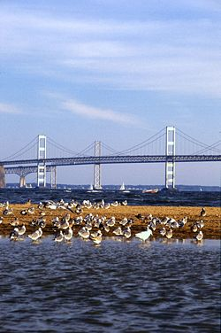
Chesapeake Bay Bridge

Slide 5
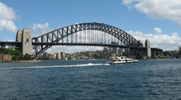
Sydney Harbor Bridge

Slide 6
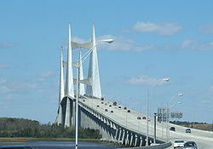
Dames Point Bridge

Slide 7
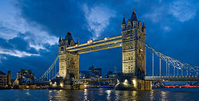
Tower Bridge

Slide 8
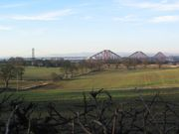
Firth of Forth Bridge

Slide 9
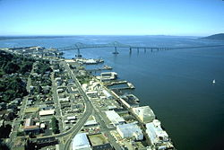
Astoria Bridge

Slide 10
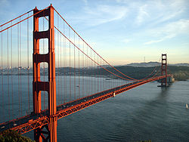
Golden Gate Bridge

Slide 11
So let’s get to building!
Goal: to build one bridge a week
Follow instructions
Read and learn the history and important facts about each bridge
Fridays will be to tear down the bridge in preparation for starting a new one the next week
Have FUN!

Slide 12
This powerpoint was kindly donated to
www.worldofteaching.com
http://www.worldofteaching.com
Is home to well over a thousand powerpoints submitted by teachers. This a free site. Please visit and I hope it will help in your teaching

