Slide 1
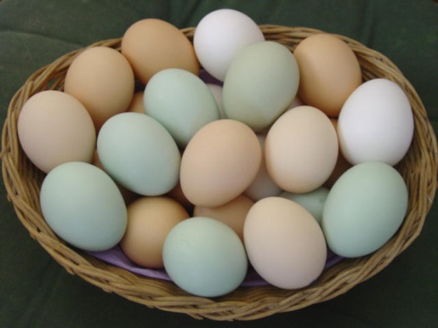
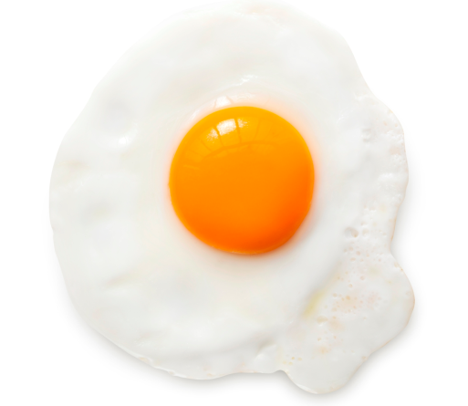
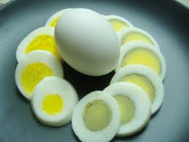
Animal Uses-Food
How can you tell if an egg is boiled or not?
The incredible, edible EGG!

Slide 2
Animal Uses-Food
What is another protein source that is produced by animal?
Eggs
The incredible, edible EGG!

Slide 3
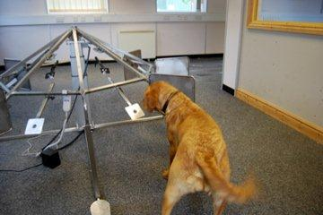
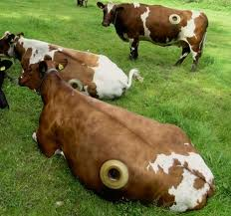
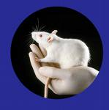
Animal Uses-medical research
Why do medical research with animals?
Animals and people get many of the same illnesses
Certain types of animals can stand in for humans with particular diseases
Information from these studies can help people and animals

Slide 4
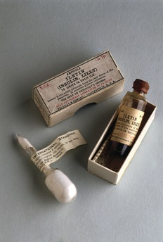
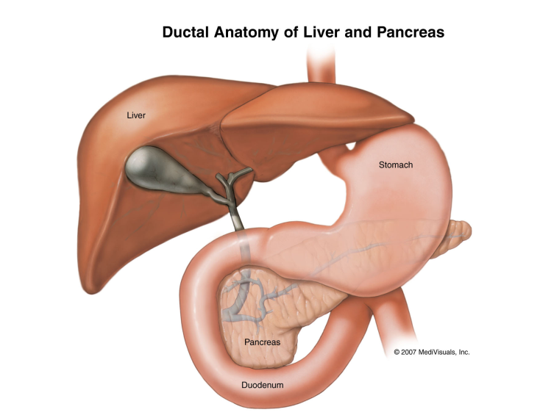
Animal Uses-medical research
Insulin was discovered from a dog!
In 1921, researchers thought they could find the cure for the “sugar disease” in the pancreas of dogs.
They isolated insulin and it lowered blood sugar in diabetic dogs.

Slide 5
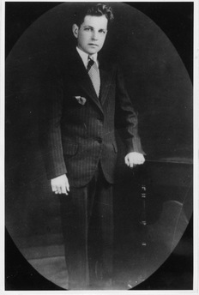
Animal Uses-medical research
After some preparation they got insulin ready for human use.
In 1922, when Leonard Thompson was 14 years old, he was dying of diabetes. The newly found insulin saved his life.
Photo courtesy of Eli Lilly and Company Archives. Copyright Eli Lilly and Company. All Rights Reserved.

Slide 6
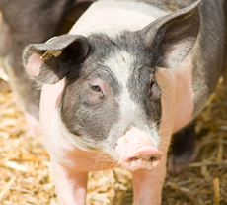
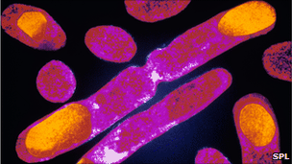
Animal Uses-medical research
Until the 1980’s, insulin was extracted from the pancreas of pigs and cattle.
Pig insulin was the closest to human insulin
Now human insulin is made by rDNA technology. DNA that makes insulin is grown inside bacteria or yeast cells. No animals needed.

Slide 7
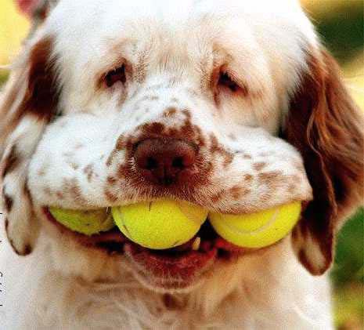
Animal Uses-medical research
Diabetic dog game
Diabetic Dog Game

Slide 8
Animal Uses-medical research
Animals can help as a step in many new technologies.
Such as growing new body parts!
Nova-Replacing Body Parts

Slide 9
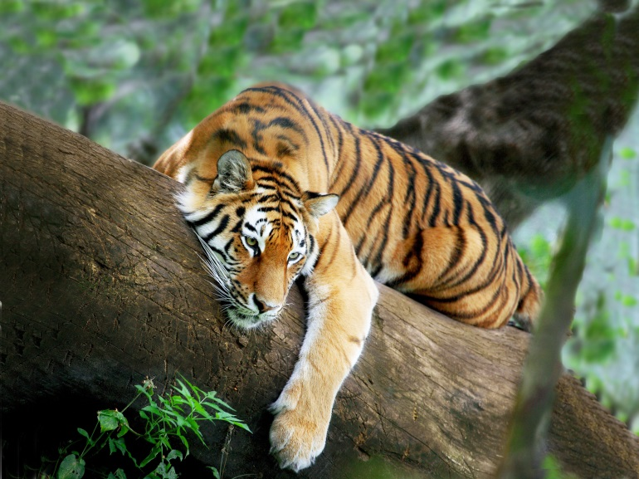
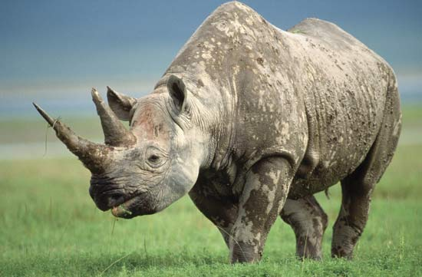
Animal Uses-medicine
China and other countries use animals for traditional medicines.
Tradition is hard to break
Tiger bones- used in wines, plasters, and medicines to treat arthritis and other joint ailments.
Only 3000-4000 tigers left
Rhino horn- used to treat fever, convulsions, and delirium.
Only 5000 Black Rhinos left

Slide 10
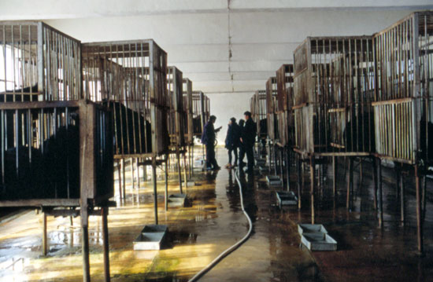
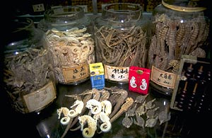
Animal Uses-medicine
China and other countries use animals for traditional medicines.
Tradition is hard to break
Black Bear- Bear bile is used to treat liver problems and headaches
Bear farms-painful and dangerous bile extraction
Seahorses- used to treat kidney and circulatory problems
32 countries harvest over 20,000,000 Seahorses/year!

Slide 11
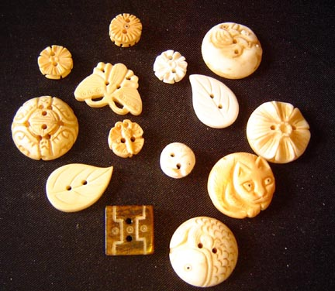
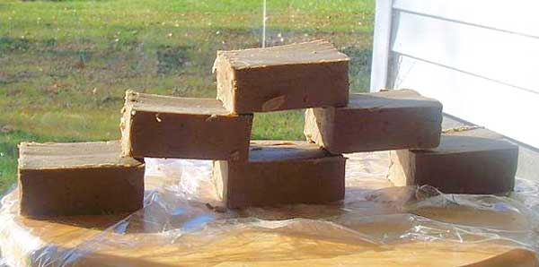
Animal Uses-by-products
Bone – buttons, mineral supplement for livestock feed
Fat- chemicals, creams, lubricants, soaps, food
Glands - medicines, food additives

Slide 12
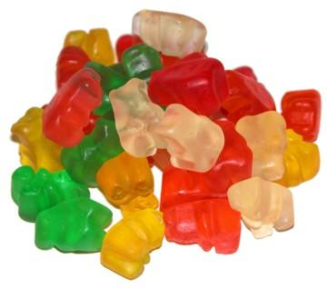
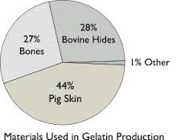
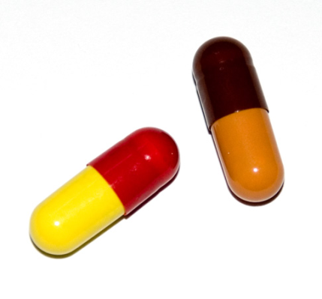
Animal Uses-by-products
Collagen - (connective tissue in joints, skin, bone) makes glue & gelatin

Slide 13
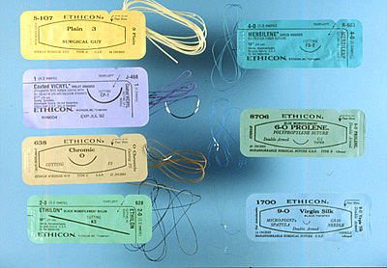
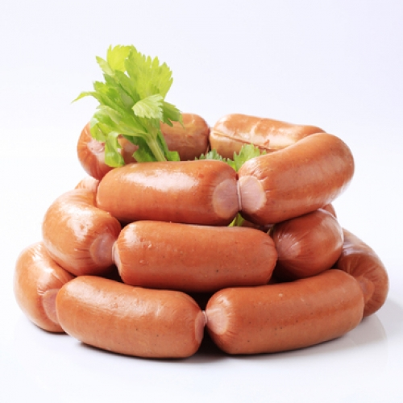
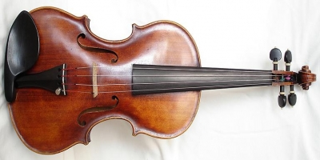
Animal Uses-by-products
Intestinal & Stomach tissue –”Catgut” surgical sutures, strings for musical instruments & sports equipment, natural casings for hotdogs/sausage

Slide 14
Unit 1 Main Concepts
History of Animals- first forms of life, vertebrates, how small mammals survived the extinction
Domestication-What, when, how, why-for all animals covered
Results of domestication-”We created monsters!”
Animal Uses-Food, fiber, labor, medicine, research, by-products, pets

Slide 15
Unit 1 Main vocab
Animal Science
Vertebrate/Invertebrate
Livestock
Wild
Feral
Tame
Raised in captivity
Raised commercially
Hybrid

