Slide 1
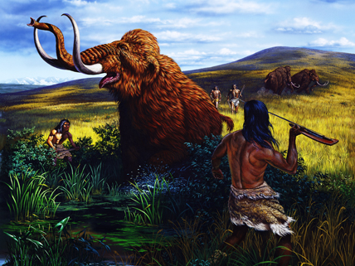
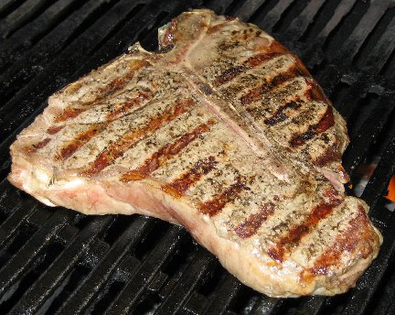
Animal Uses-Food
Meat- a source of protein
One of the five essential nutrients
Why did humans start eating meat?
How did domestication help this?

Slide 2
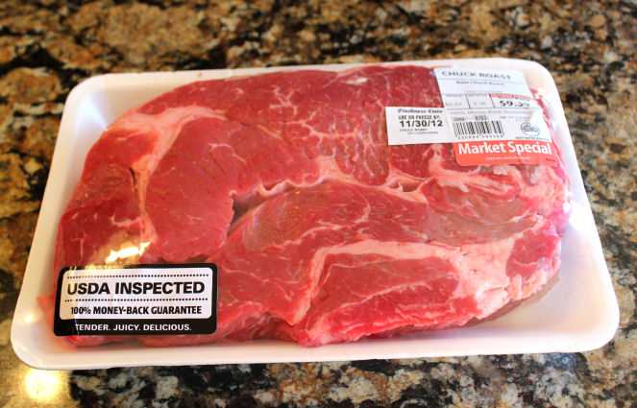
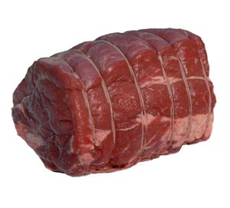
Animal Uses-Food
Meat- a source of protein
Do you know where that Chuck Roast comes from?
Notes:
Meat Scavenger Hunt Activity

Slide 3
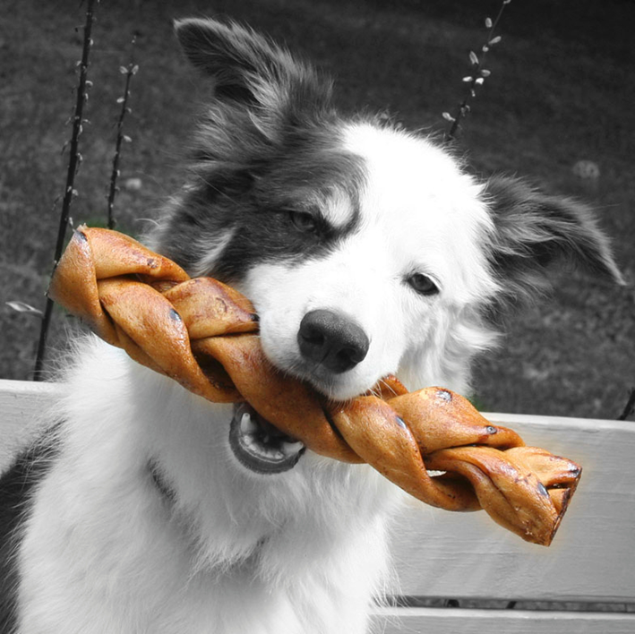
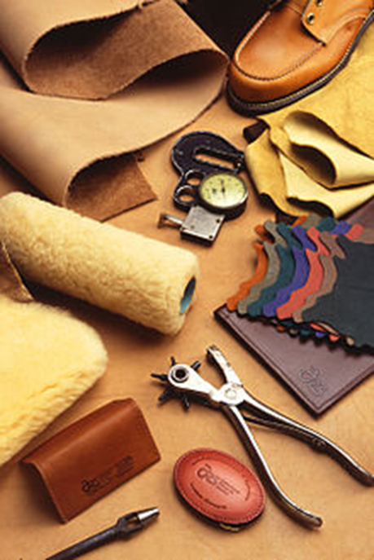
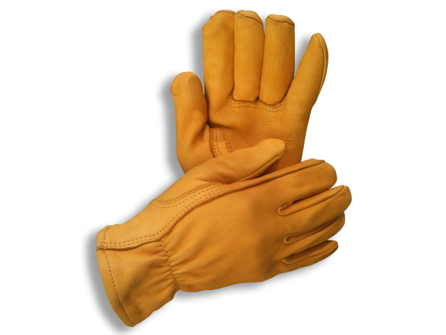
Animal Uses
Leather is the skin of animals.
Hides – leather clothing, dog treats, shoes, baseball gloves, ball coverings, gloves, etc.

Slide 4
Animal Uses-Food
Is there another way to get meat and leather?
Can we sustain the amount of animals we need for these products?
Meat and Leather without killing animals
http://www.ted.com/talks/andras_forgacs_leather_and_meat_without_killing_animals.html

Slide 5
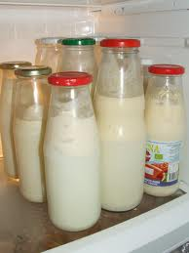
Animal Uses-Food
Milk-
a more efficient source of protein and also Calcium (Ca)

Slide 6
Animal uses-food
Milking Cows at Swain Dairy Farm

Slide 7
Animal uses-food
Milk. Is does a body good?
Read and respond: Milk article
Why is it strange that people drink milk throughout their lives?
2 reasons

Slide 8
How do animals help us?
Food
Fiber
Labor
Medicine/Research
Pets/Companionship

Slide 9
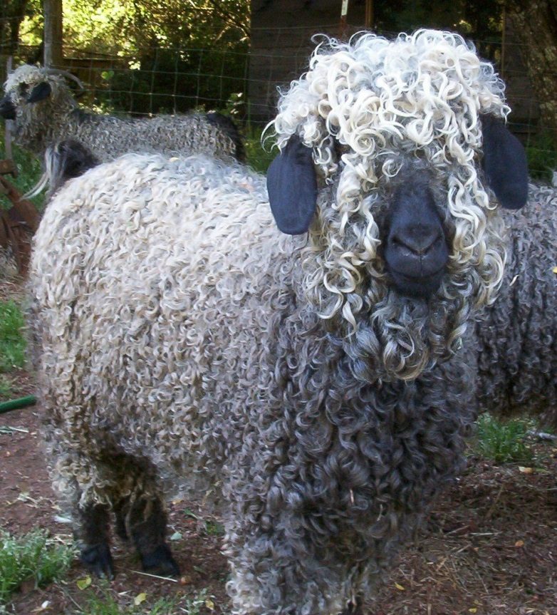
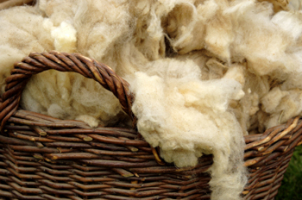
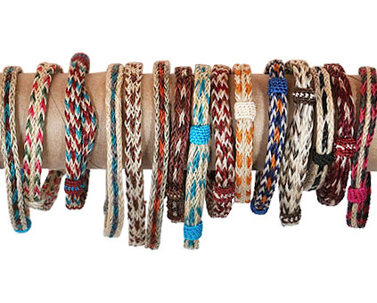
Animal Uses-fiber
Fibers - wool, mohair, horse hair, pig bristles
Clothing, tools (brushes), decoration
Wool
Horsehair bracelets
Angora Goat-mohair

Slide 10
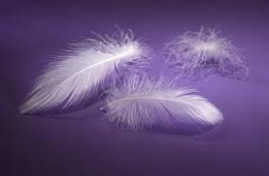
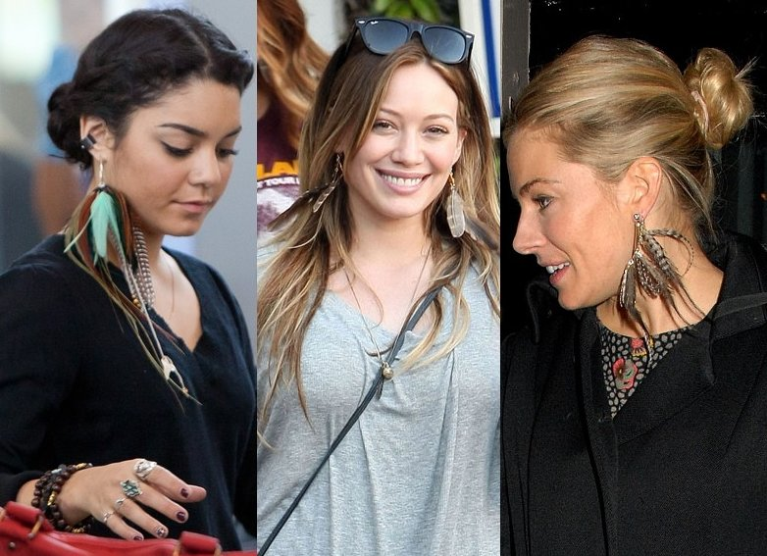
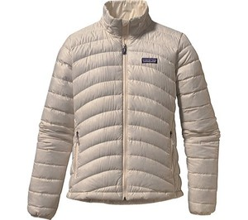
Animal Uses-feathers
Feathers- from 8 billion broiler chickens, 2-3 billion pounds of feathers
Used for-down, decorations, diapers, filters, biodegradable plant pots?

Slide 11
How do animals help us?
Food
Fiber
Labor
Medicine/Research
Pets/Companionship

Slide 12
Animal Uses-Labor
What are some areas in which we use animals for work?
Cultivate land
Transportation
Control other animals
Protection
Assistance

Slide 13
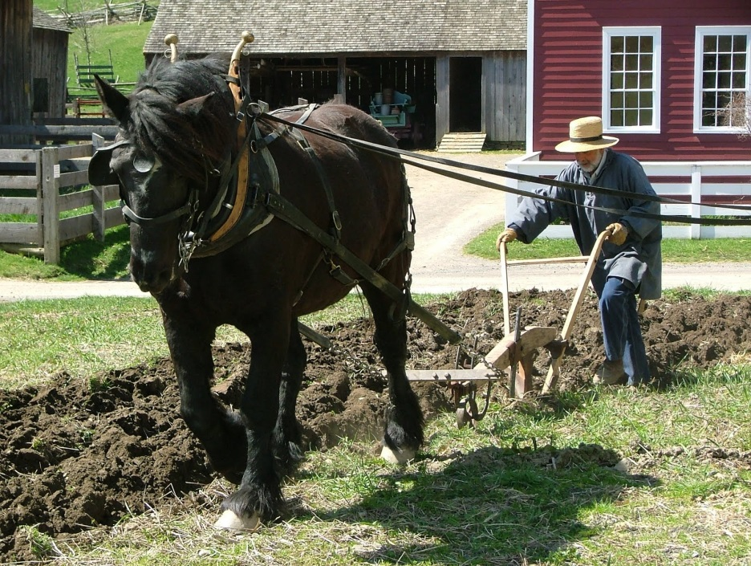
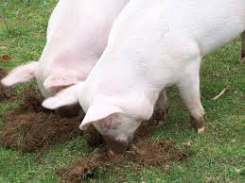
Animal Uses-Labor Cultivation
Goats at Work

Slide 14
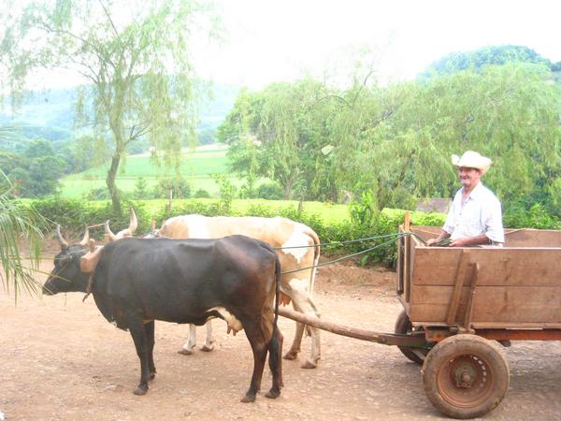
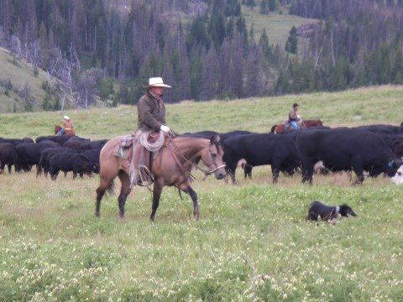
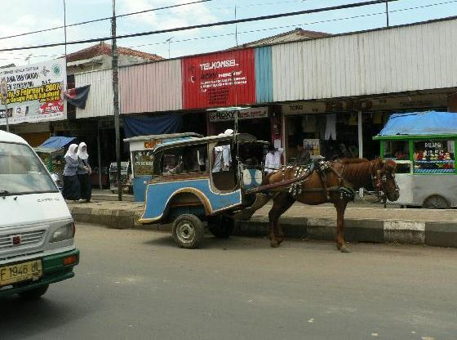
Animal Uses-Labor Transportation

Slide 15
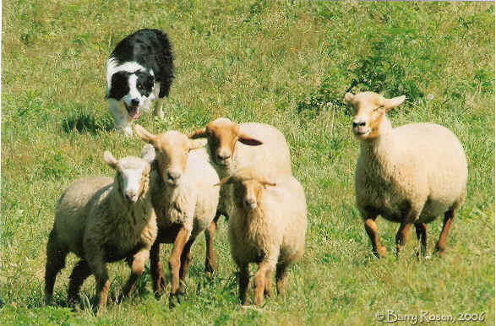
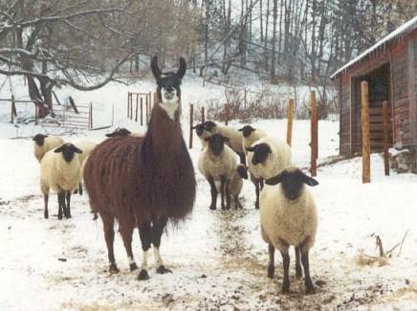
Animal Uses-Labor Controlling Animals
Guard Llama
Llamas guarding sheep.

Slide 16
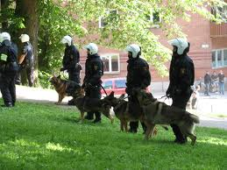
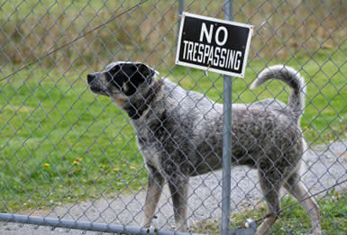
Animal Uses-Labor Protection
Rescued Pitbull Turned Police Dog

Slide 17
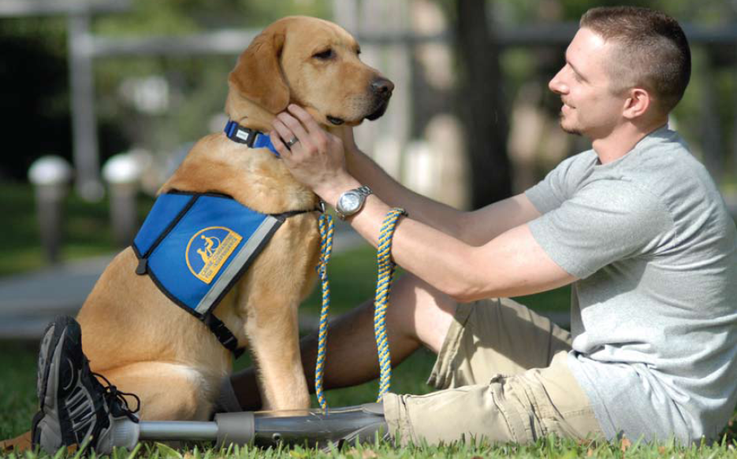
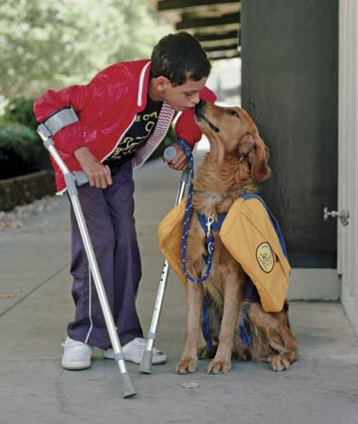
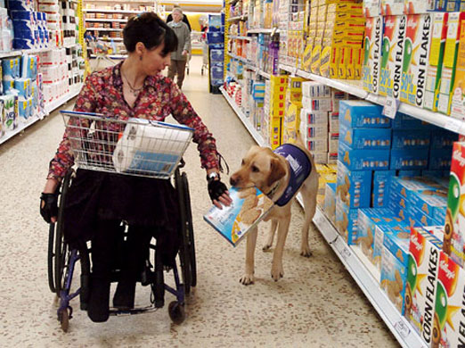
Animal Uses-Labor Assistance

Slide 18
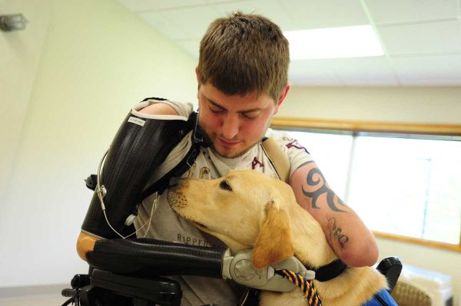
Animal Uses-Labor Assistance
Assistance Dogs in Action
Diabetic Service dogs

Slide 19
How do animals help us?
Food
Fiber
Labor
Medicine/Research
Pets/Companionship

