Slide 1
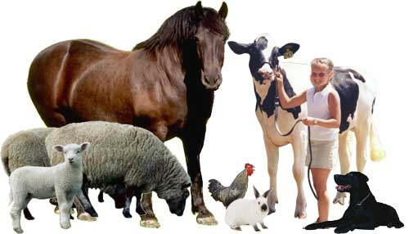
Animal Science
Animal Science

Slide 2
What is Animal Science?
DEF: the study of the biology of animals that are under the control of mankind (usually domestic animals)
Breeding
Care
Feeding
Management
Products
Processing
Marketing
Behavior
Welfare
Nutrition
Genetics
Biotechnology
Reproduction
Agribusiness

Slide 3
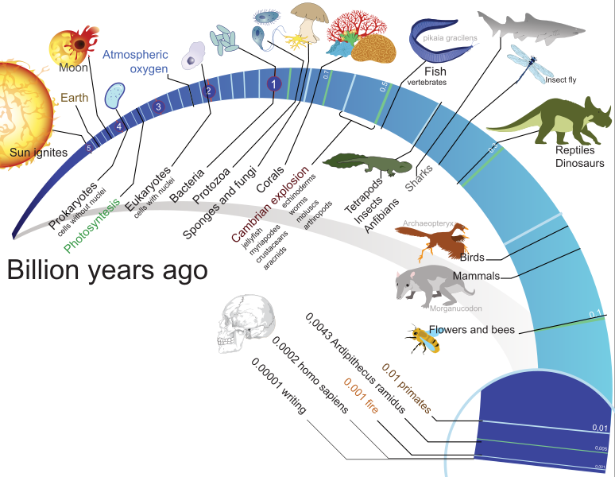
A Brief History of Animals
4.5
Notes:
Humans on earth for about 200,000 years….the world has been here for 5000 times that long

Slide 4
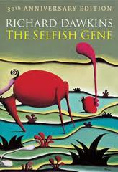
A Brief History of Animals
What was the first form of life? (as far as we can tell at the moment)
Notes:
Humans on earth for about 200,000 years….the world has been here for 5000 times that long

Slide 5
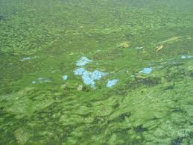
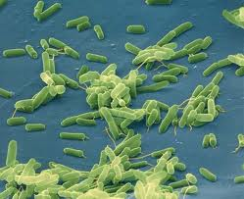
A Brief History of Animals
The oldest traces of life date back:
3.4 to 3.5 billion years.
  Blue-green algae and bacteria.
Notes:
Great mats of algae covered the primordial oceans when their dead bodies sank to the bottom and eventually became oil. “fossil fuels”

Slide 6

Flash forward a few Billion years…

Slide 7
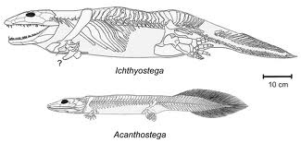
Vertebrates
DEF: Animals that have a back bone. (vertebrae)
  Can you name any animals that don’t have backbones?
Notes:
What about snakes?

Slide 8
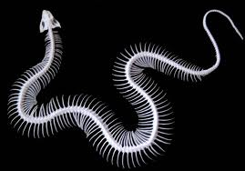
Vertebrates
Notes:
Humans have 12 pair (24 ribs)

Slide 9
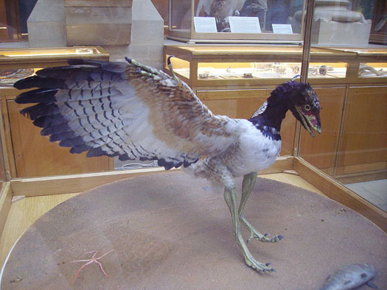
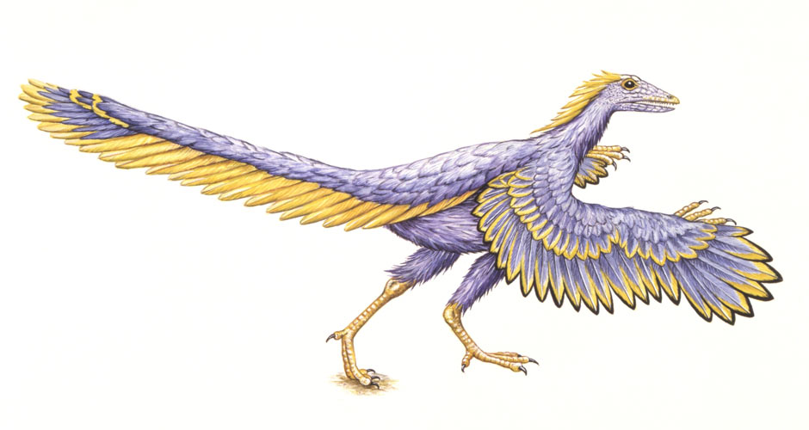
Triassic and Jurassic periods 180-135 million years ago
1st there were only dinosaurs, mammal-like reptiles, and sea creatures.
When dinosaurs were most abundant, the first birds and very small mammals were seen.
Archaeopteryx = ancestors of modern birds

Slide 10
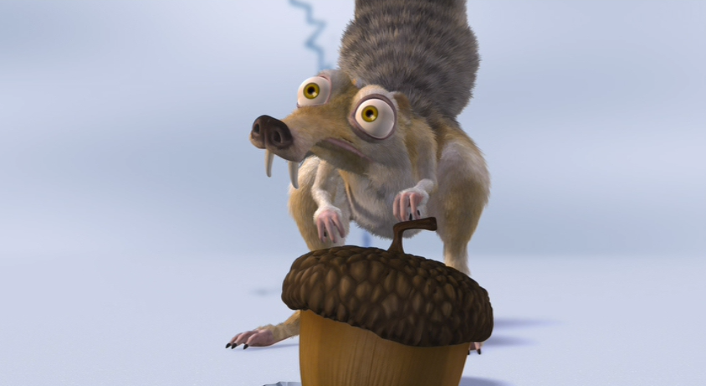
Triassic and Jurassic periods 180-135 million years ago
  Why were there birds and very small mammals when dinosaurs were the most large and numerous? Wouldn’t the dinos take up all the space and food?

Slide 11
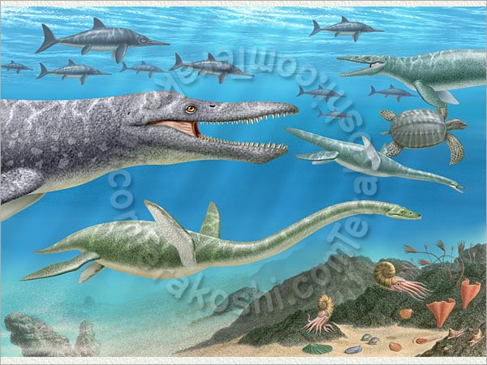
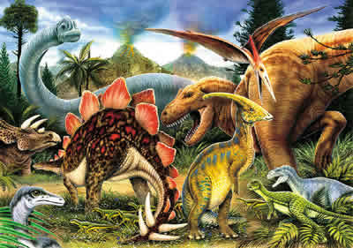
Cretaceous period 135 to 70 million years ago
Dinosaurs and marine reptiles reached their period of greatest abundance then…Disappeared.
The reason for their demise is still debated by scientists.

Slide 12
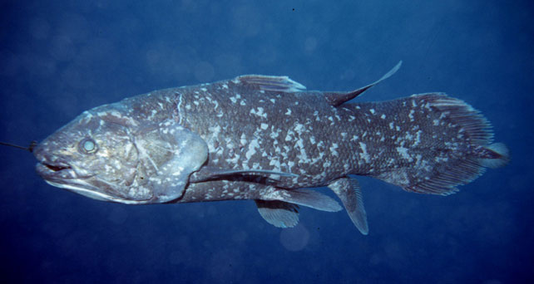

Slide 13
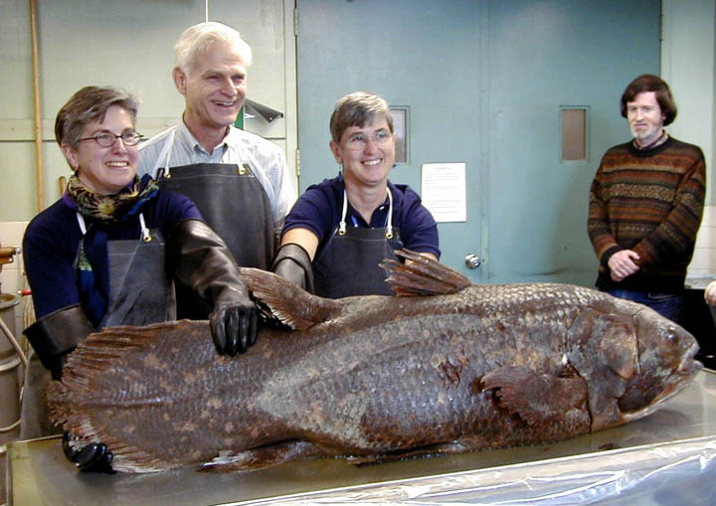
Ancient fish
Coelacanth: (cee-lo-can’t) “A living fossil”
Were here more than 400 million years ago!
Still around now, but critically endangered

Slide 14
Coelacanth

Slide 15
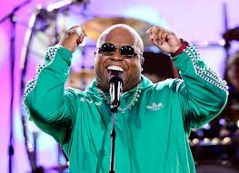
Ceelo…
Can’t.

Slide 16
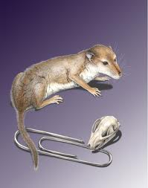
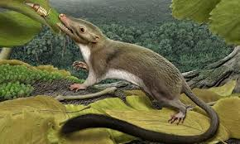
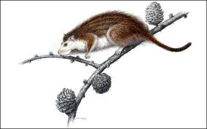
Paleocene and Eocene epoch 70 to 40 MILLION YEARS AGO
Dinosaurs are gone!! But, the small animals survived.
Mammals evolved, dispersed, and adapted to new environments. Why?

Slide 17
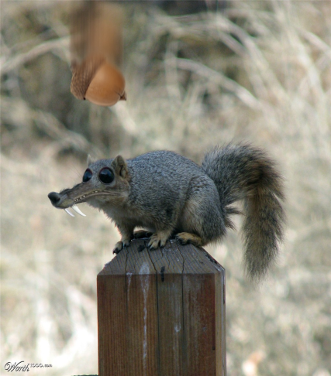
Summary
What is the definition of Animal Science?
What are some fields within AnSci?
What was the first life on earth?
What is a vertebrate?
How did mammals survive when dinos didn’t?

Slide 18
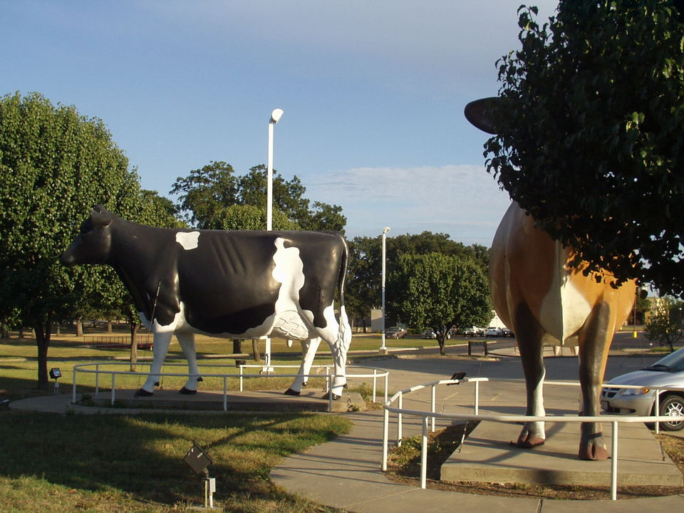
Why aren’t mammals giant like Dinosaurs?
Why no giant cows?

Slide 19
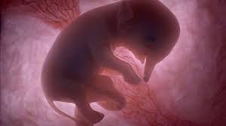
Placental mammals

Slide 20
Placental mammals
Placental mammals have a placenta (fluid filled sack inside the uterus of the animal) through which the embryo and fetus are nourished while in utero.
Most of the animals we will discuss are placental mammals and evolved during this period.
  How many non-placental animals can you name?

Slide 21
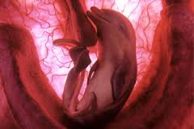
Placental mammals

Slide 22
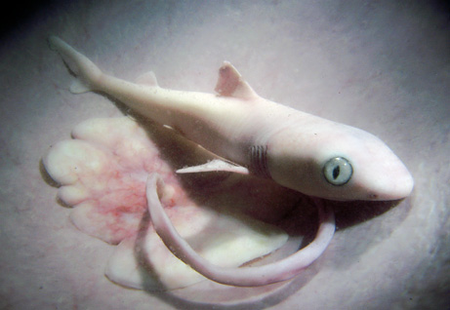
Placental mammals

Slide 23
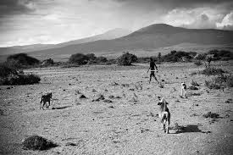
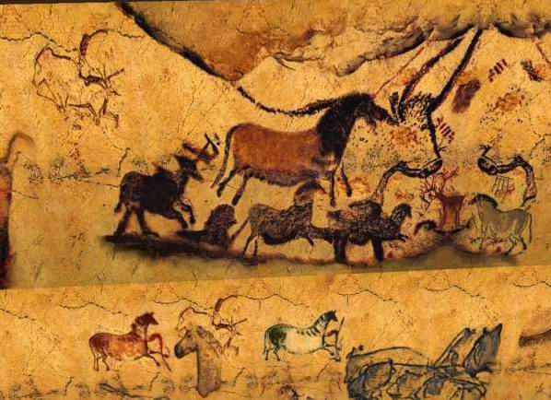
When did Animal Science Start?
With the beginning of the Domestication of animals.
Domestication = to tame for the use of humans. It takes thousands of years.

Slide 24
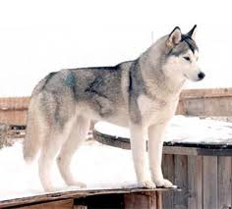
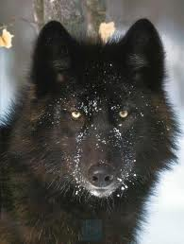
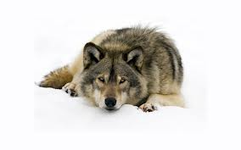
Domestication
What was the first domesticated animal?
  The Dog/Wolf was the first domesticated companion animal.
  A dogs jawbone was found in a cave in Siberia that dates back about 33,000 years ago.
  “Ancient dog skull unearthed in Siberia” (BBC News 2011)
  (http://www.bbc.co.uk/news/science-environment-14390679)
Notes:
When do you think people first had a domestic dog? How long ago?

Slide 25
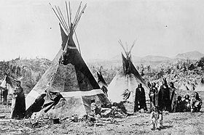
Domestication
Hunters and gathers: A nomadic lifestyle, no permanent settlements
  Domestication allowed them to settle down-they didn’t have to go look for animals and plants.

Slide 26
Domestication
Why was the wolf the first animal to be domesticated?
-Warning/Guarding, Protection, Work

Slide 27
Requirements to be considered domesticated
Breeding is controlled by humans for many generations.
Appearance and/or behavior is substantially different from wild ancestor.
Animals could not survive on their own.
“Taming” is a step of domestication, but a tamed animal is not completely domesticated.

Slide 28
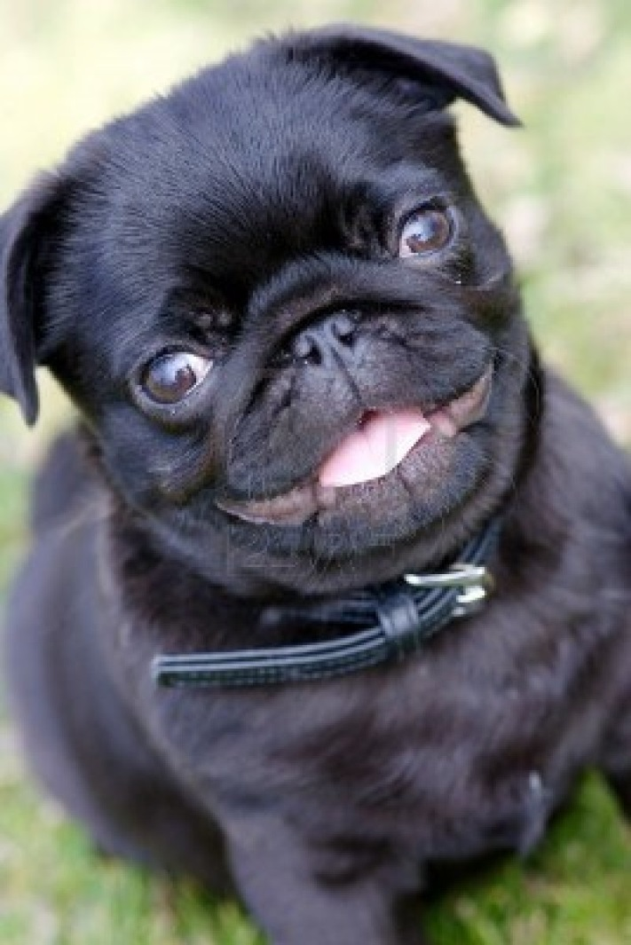
Domestication
Probably wouldn’t last long in the wild…

Slide 29
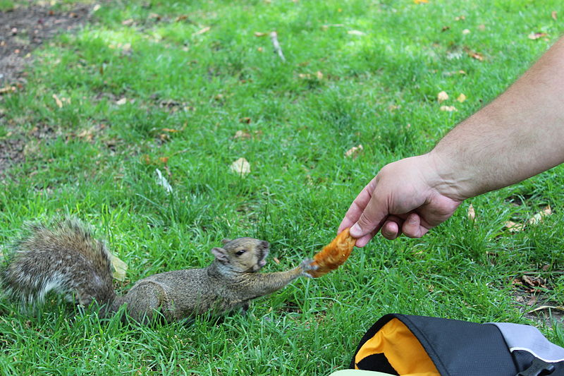
Domestication
A tame animal is an animal which tolerates the presence of humans.
Tameness is a degree to which an animal accepts humans.

Slide 30
Degrees of Domestication
Wild- Full life without human intervention
Raised in captivity/Captured from wild-Nurtured by humans but indistinguishable from wild relatives
  Ex. Cobras used for show, Asia elephants, Zoo animals
Raised Commercially/Captive or Semidomesticated-Ranched or farmed for profit but indistinguishable from wild relatives
  Ex. Ostrich, deer, buffalo, oysters

Slide 31
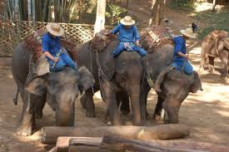
Degrees of Domestication
Raised in captivity/Captured from wild

Slide 32
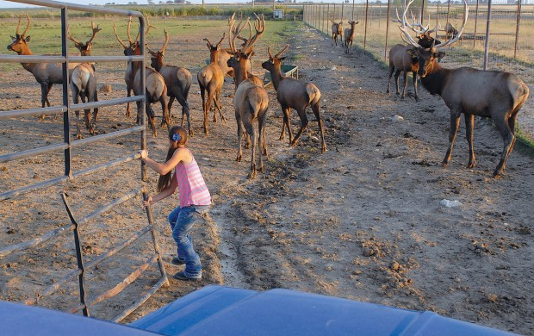
Degrees of Domestication
Raised Commercially/Captive or Semidomesticated

Slide 33
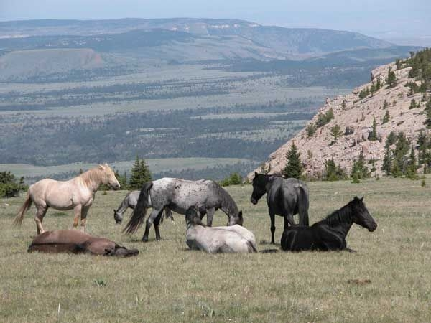
Domestication degrees
Feral-once were under human control but returned to the wild
  Ex. Mustangs, cats & dogs
Hybrid- a combination of two animals, can be wild, domesticated, or both.

Slide 34
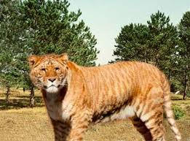
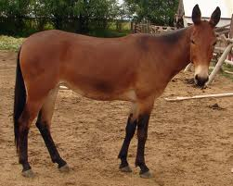
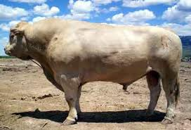
Hybrids

Slide 35
Key Questions
What were some reasons that dogs were domesticated?
What are the requirements to be considered domesticated?
What the difference between tame and domesticated?
What does wild, raised in captivity, captive/farmed, feral, and hybrid mean?
  What are some examples from each category?

