Slide 1
Hobbies

Slide 2
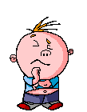
What is a hobby?
Hobby means….

Slide 3
Can you name these hobbies?

Slide 4
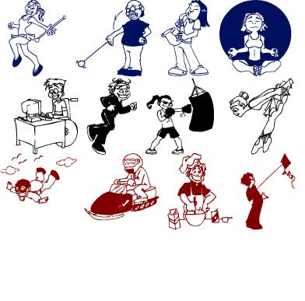
Do you think a hobby is different from a sport?

Slide 5
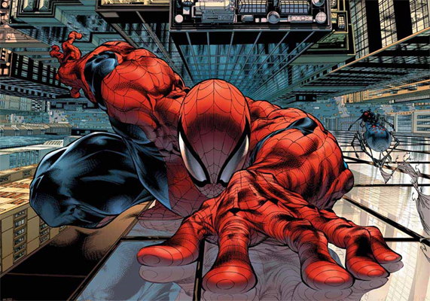
Why do people need hobbies?

Slide 6
What is your hobby?
How long have you had this hobby?
Why did you start your hobby? Punk!

Slide 7
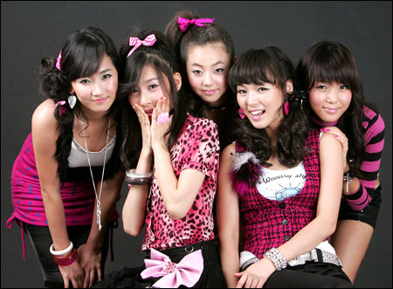
Which hobbies are the most expensive?
Which hobbies are the cheapest?
How much money do you spend on your hobby?

Slide 8
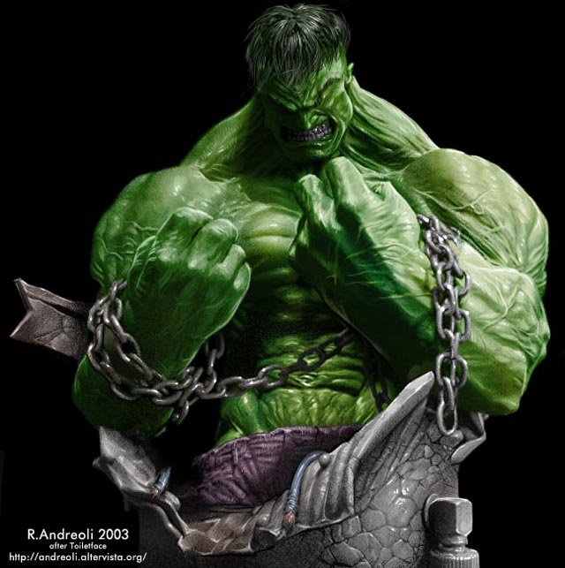
Does your hobby interfere with your study or personal life?

Slide 9
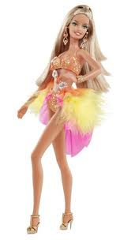
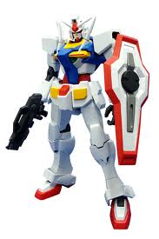
Some men and women collect toys.
Do you think they are too old for this?
Do you know any older people with a hobby?

Slide 10
It’s quiz time everyone!
Can you guess what hobby is behind the star?

Slide 11
QUESTION TIME
?
What hobby is it?

Slide 12
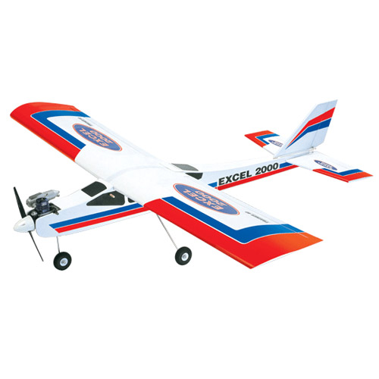
QUESTION TIME
?
What hobby is it?

Slide 13
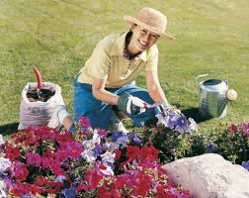
QUESTION TIME
?
What hobby is it?

Slide 14
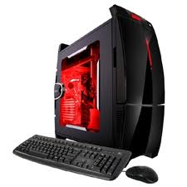
QUESTION TIME
?
What hobby is it?

Slide 15
QUESTION TIME
?
What hobby is it?

Slide 16
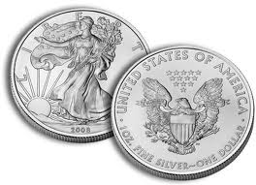
QUESTION TIME
?
What hobby is it?

Slide 17
QUESTION TIME
?
What hobby is it?

Slide 18
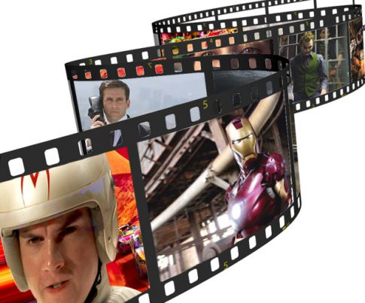
QUESTION TIME
?
What hobby is it?

Slide 19
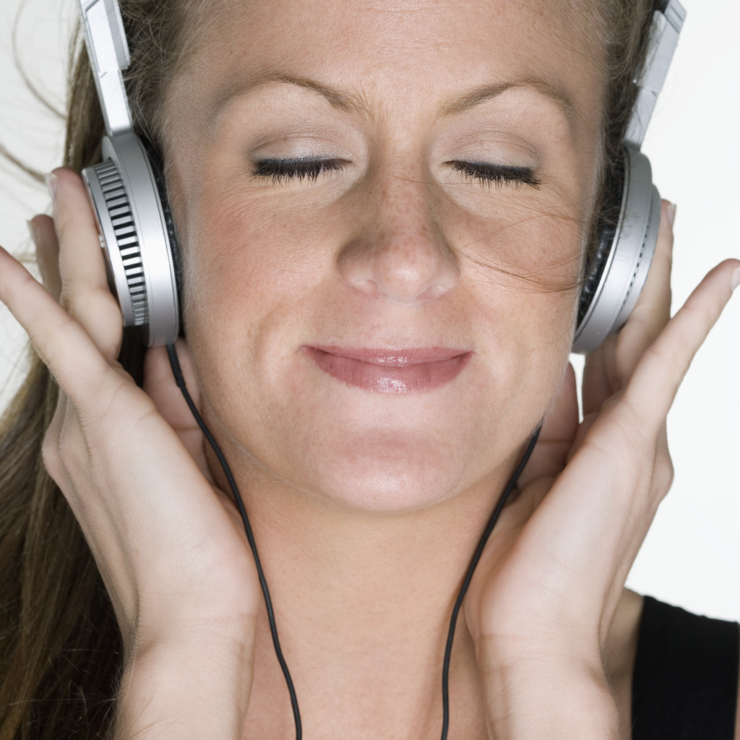
QUESTION TIME
?
What hobby is it?

Slide 20
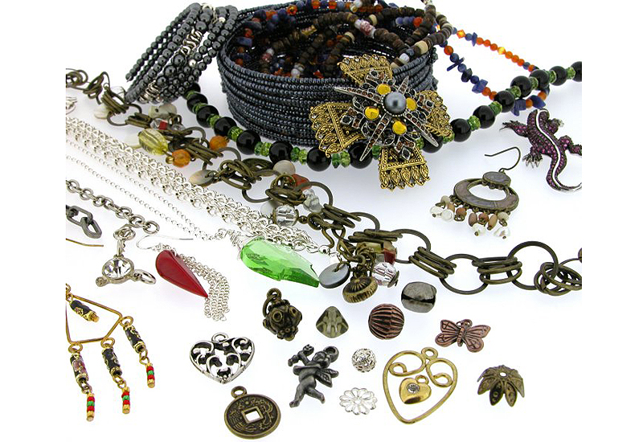
QUESTION TIME
?
What hobby is it?

Slide 21
Presentation Time
Pick one of the hobbies we spoke about.
Draw a picture and write a paragraph about it.

Slide 22
Good job everyone!

