Slide 1
汉语
English Only!

Slide 2
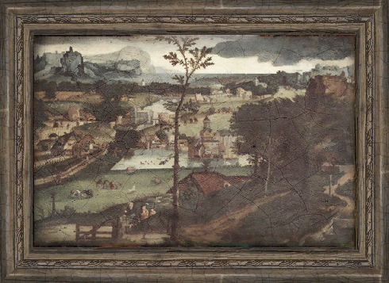
Graffiti
Art or Crime?

Slide 3
What is Graffiti?
When people draw on walls or other property without permission.

Slide 4
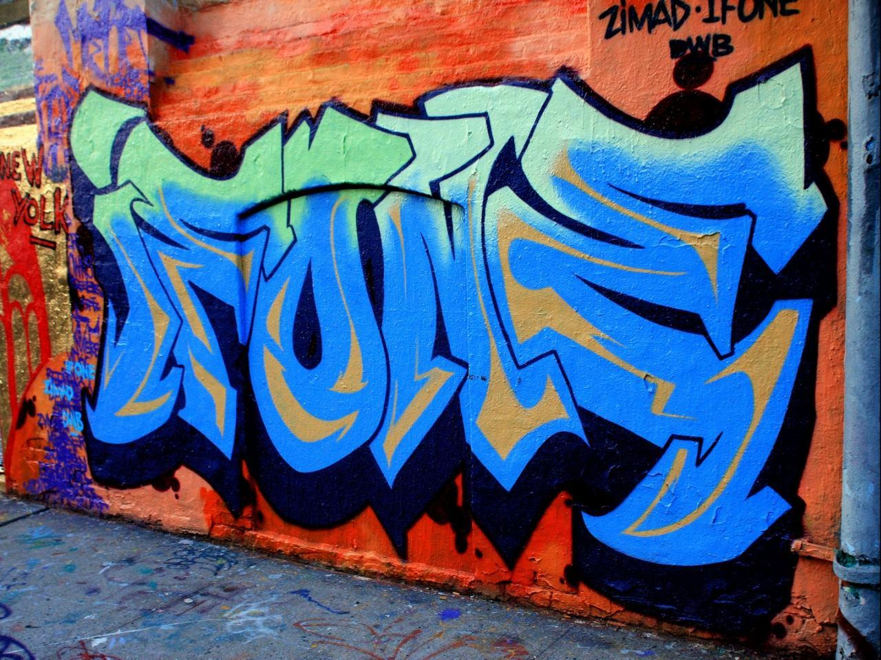

Slide 5
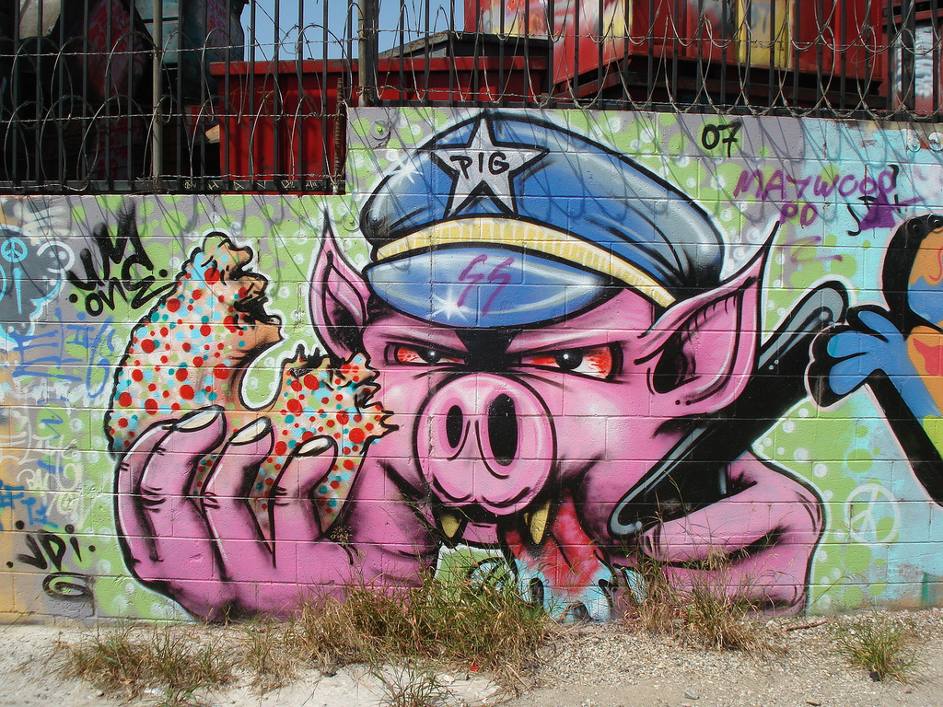

Slide 6
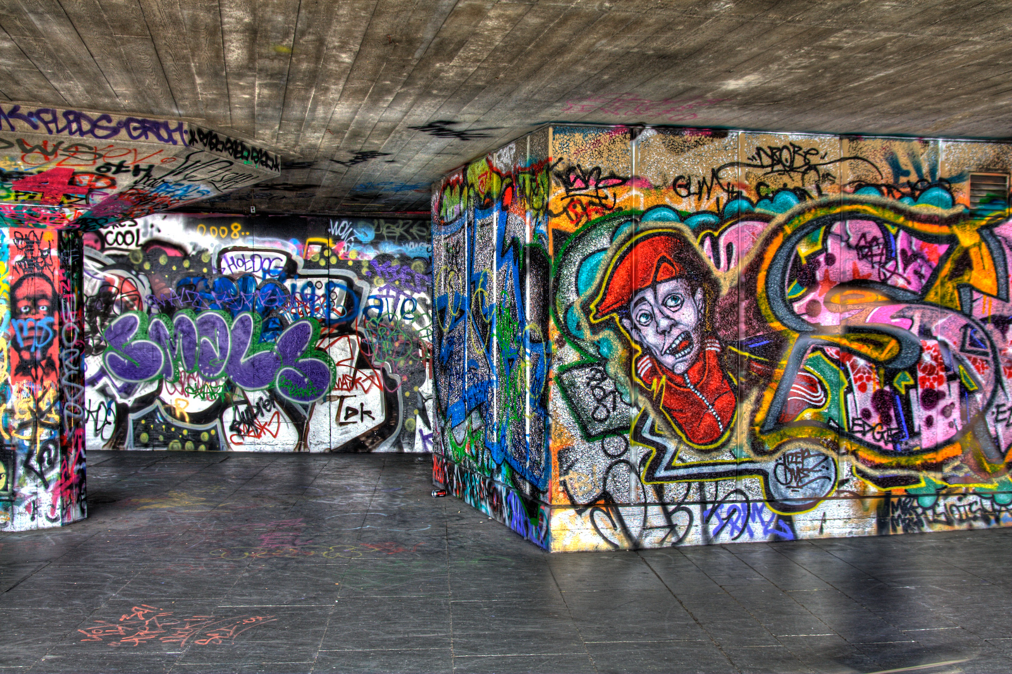

Slide 7
What is Graffiti?
When people draw on walls or other property without permission.
When people draw on walls or other property without permission.

Slide 8
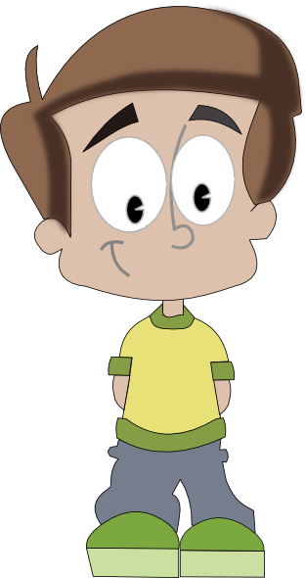
Property
1. Something that someone owns.
Uncountable Noun
“The computer is my property.”

Slide 9
Task 1
In groups, find out what the most expensive item of property each person owns.
“… is my most expensive item of property.”
“My most expensive item of property is…”

Slide 10
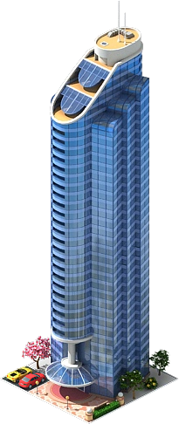
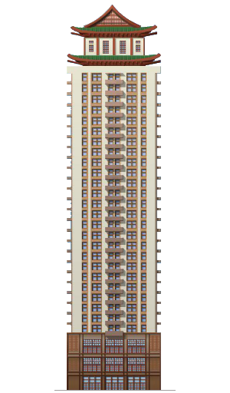
Property
2. A building / place you can buy.
Countable Noun
“He owns three properties.”

Slide 11
What is Graffiti?
When people draw on walls or other property without permission.
When people draw on walls or other property without permission.

Slide 12
Permission
1. To be allowed to do something.
Uncountable Noun
“I have permission to go to the cinema”
Father, can I go to the cinema?
Yes, you can.

Slide 13
Permission
1. To be allowed to do something.
Uncountable Noun
(to) have Permission
(to) ask for permission
(to) give permission

Slide 14
Permission
1. To be allowed to do something.
Uncountable Noun
permission to do sth
Ask for
Give
Have

Slide 15
Task 2
What things do you have permission to do at school?
What things do you not have permission to do?
Think of 5 examples of each.

Slide 16
Graffiti
Art or Crime?
Art or Crime?

Slide 17
Crime
vandalism
Uncountable Noun
(to) vandalize
Verb
(a) vandal
Person

Slide 18
Graffiti
Art or Crime?
Artist or vandal?
Banksy

Slide 19
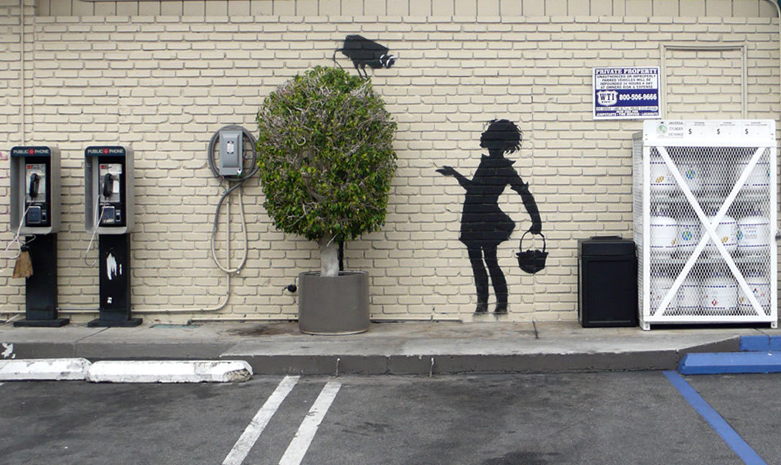
Banksy is a British-based graffiti artist.

Slide 20
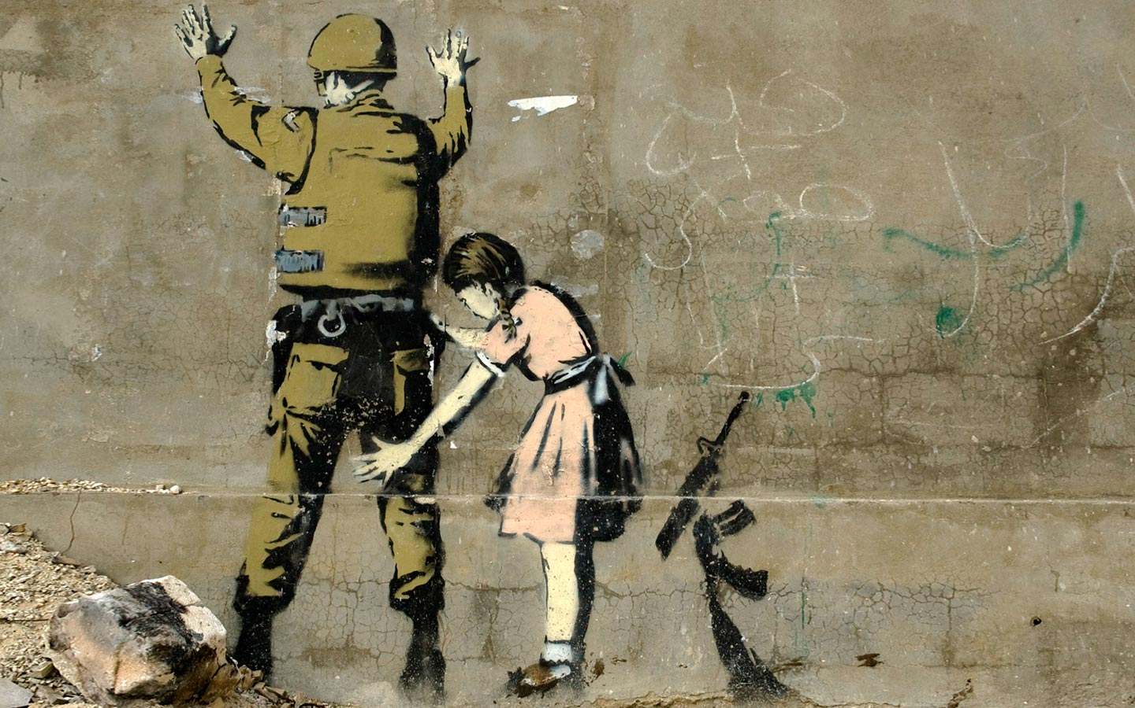
His true identity is unknown.

Slide 21
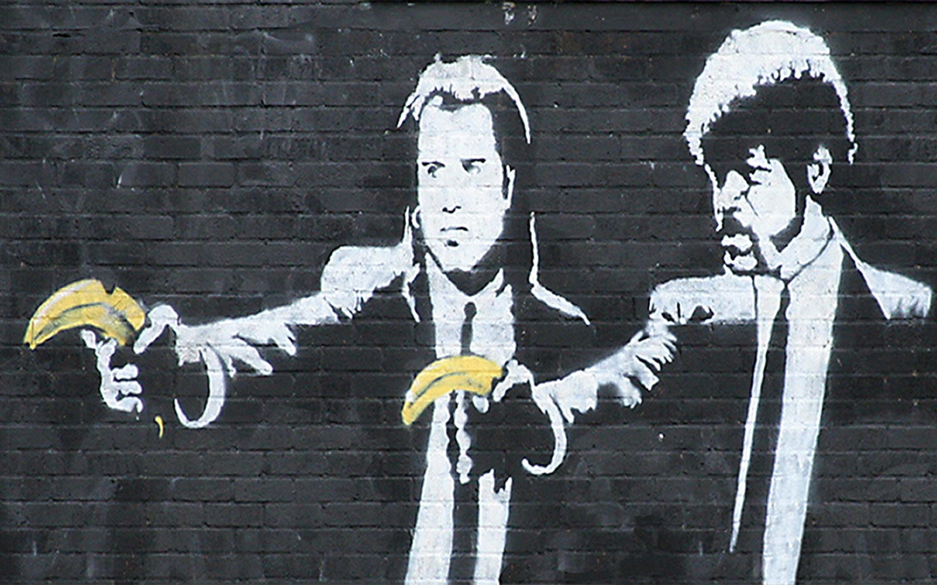
His art is shown in galleries.

Slide 22
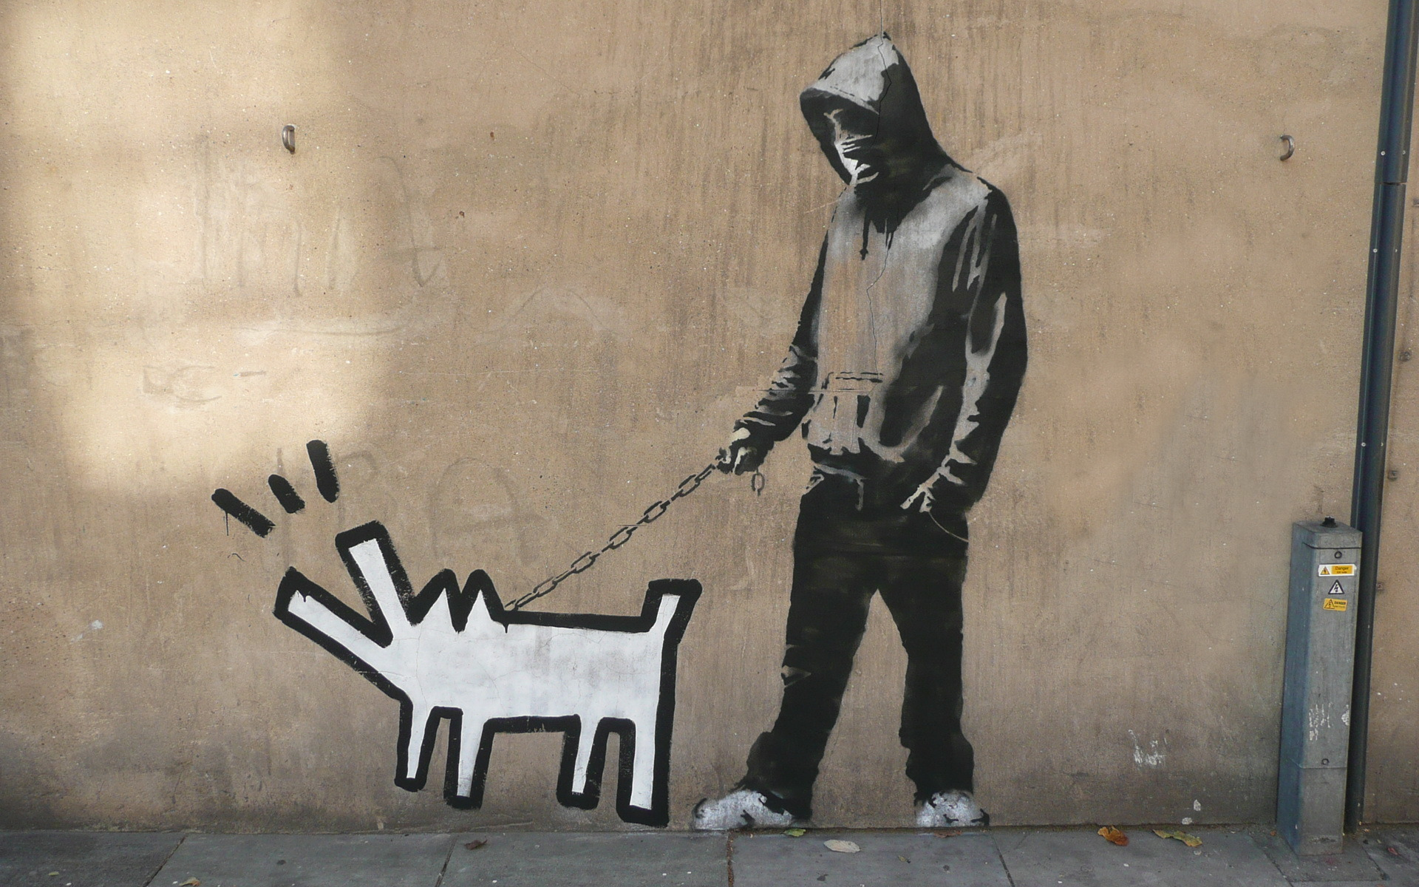
Many people think he is a vandal, not an artist.

Slide 23
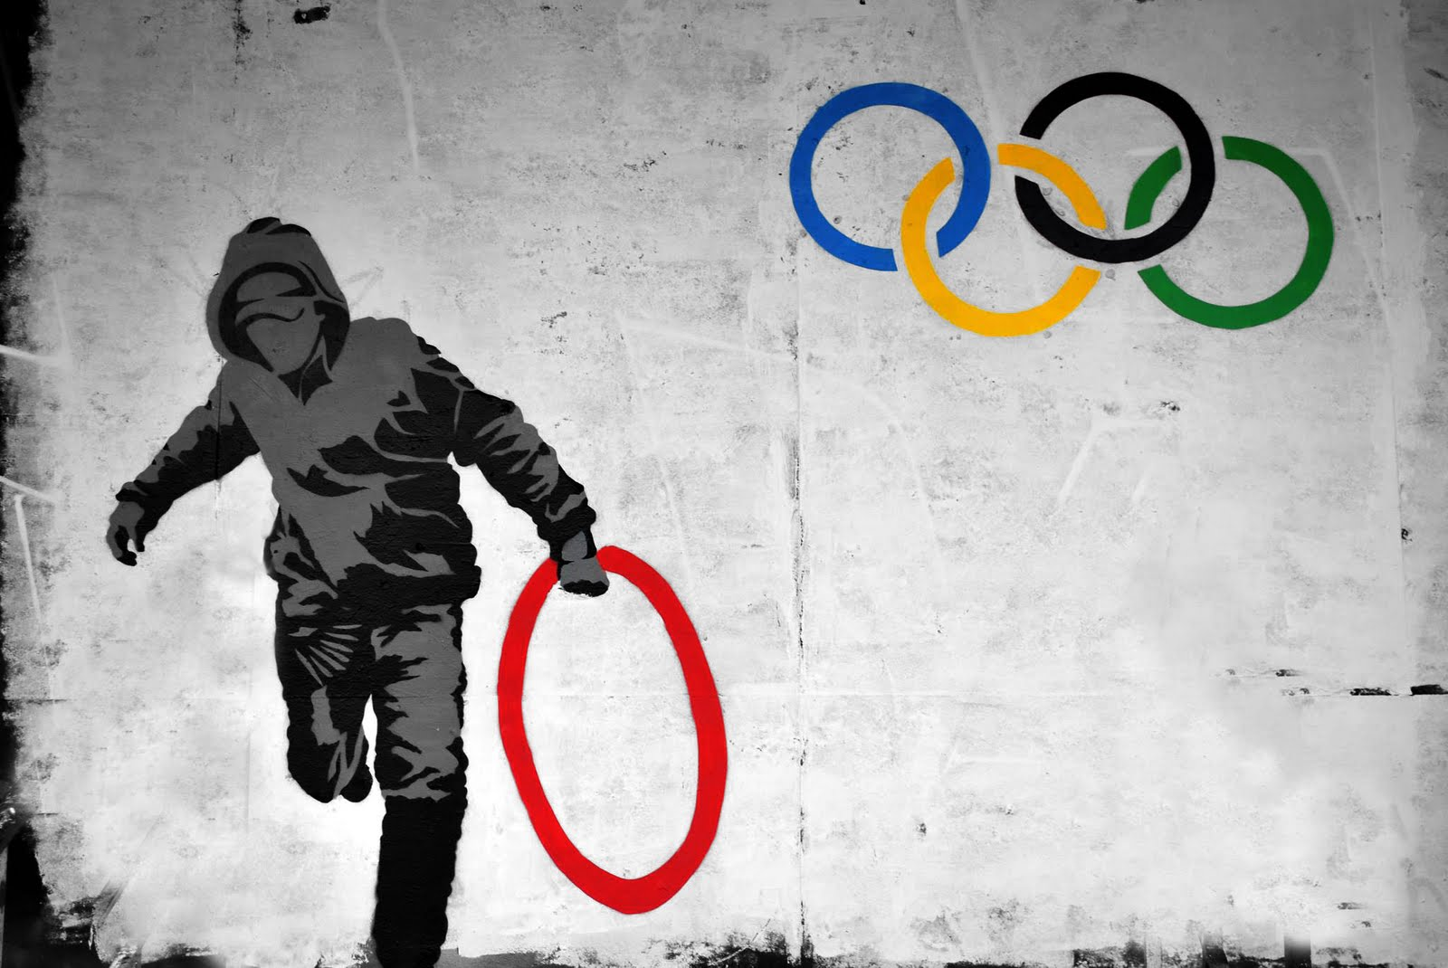
Banky’s art has been sold for 2,500,000元

Slide 24
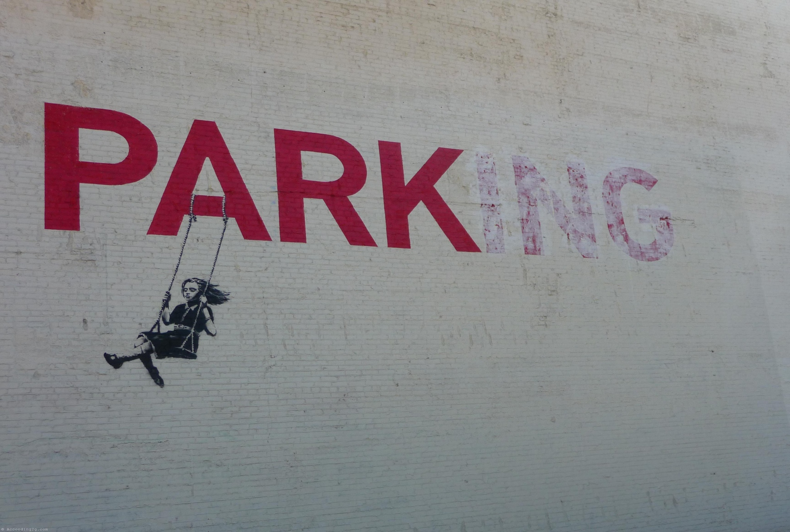
What do you think of graffiti?
Art or Crime?

Slide 25
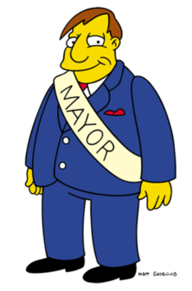
Mayor Quimby
Mayor of a small city.
Graffiti is a problem.
People are angry.
He wants a strategy to stop graffiti.

Slide 26
What is a strategy?
strategy
Too much graffiti
Do things to stop graffiti
No graffiti
What you will do
How you will do it

Slide 27
Mayor Quimby
Mayor of a small city.
Graffiti is a problem.
People are angry.
He wants a strategy to stop graffiti.

Slide 28
Task 3
Mayor Quimby asks you for help
What will you do?
How will you do it?
Design a strategy to stop graffiti.

