Slide 1

Feminism: Cure or Curse?
By
K.G. Swarnananda Gamage
English Language Teaching Unit
(ELTU)

Slide 2

What is Feminism?
“ Feminism is a collection of movements and ideologies aimed at defining, establishing, and defending equal political, economic and social rights of women. This also includes seeking to establish equal opportunities for women in education and employment”
Source: http://en.wikipedia.org/wiki/Feminism

Slide 3

Other related issues
Women’s struggle for freedom
Women’s struggle for equal opportunities
Women’s struggle for equal place in the social system
  Ex: Equal pay
Gender discrimination
Gender equality
Women’s emancipation

Slide 4
History
His Story

Slide 5
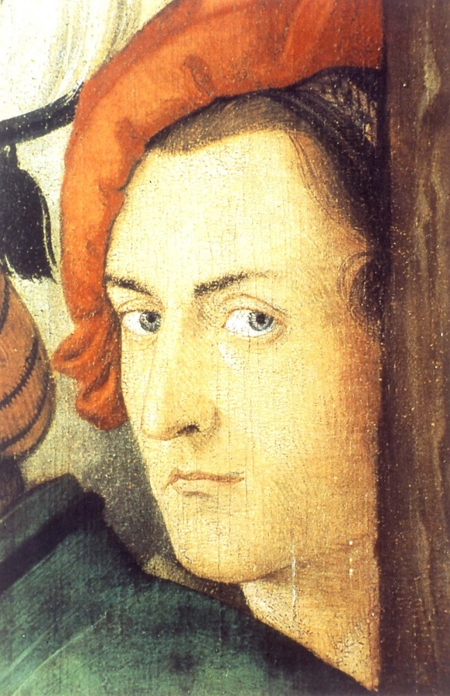
Established Areas of Feminism
Feminist Literature
Feminist theory
Gender studies

Slide 6
On the eve of the 101 st international Woman’s Day AMY DAWSON looks at its origins and investigates why it continues to be relevant today.
We live on a planet in which women perform 66 per cent of the world’s work and produce 50 per cent of its food but earn 10 per cent of overall income and own one per cent of property.
Women hold only 19 per cent of the world’s parliamentary seats and just 16 of the world’s 188 directly -elected leaders are female. Violence against women causes more deaths and disabilities among the global female population aged 15 to 44 than Cancer,Malaria,Road traffic accidents and War.
It is estimated that one in five women worldwide will become a victim of rape or attemped rape and ane in four will experience domestic violence.
METRO – March 7 th of 2012, UK

Slide 7
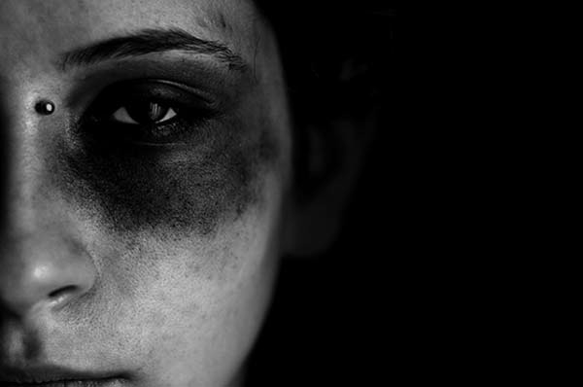
Should we take it seriously in Sri Lanka?
Mr. Maithripala Sirisena (MP) – “Approximately 65 percent of all court cases in the country had to do with rape, child abuse, and violence against women”
(The Island – 10/03/2013)
“Land like no other” – 5 women are raped in a day
(Sunday Times)

Slide 8
Stereo – typical roles

Slide 9
Famous Victorian Female Writers

Slide 10
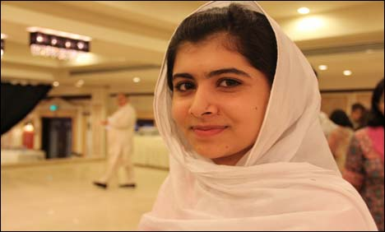
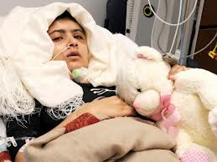
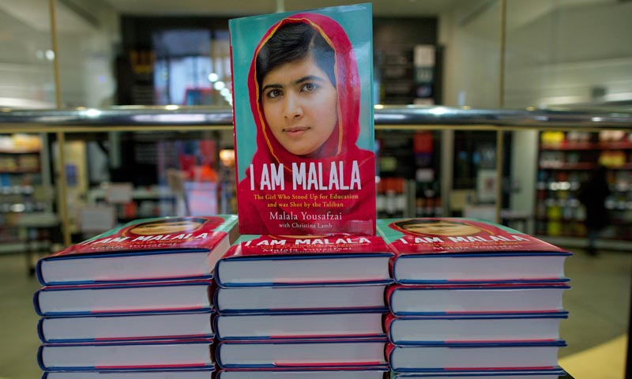
South Asian Situation
Malala Yousufzai Factor (Pakistan)

Slide 11
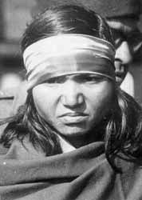
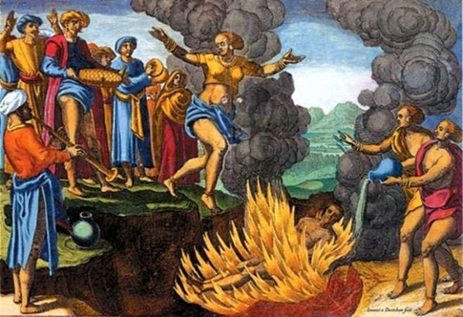
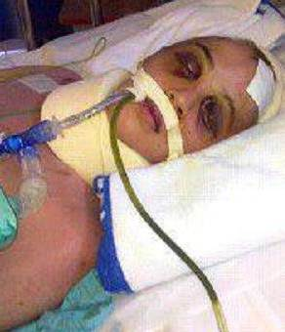
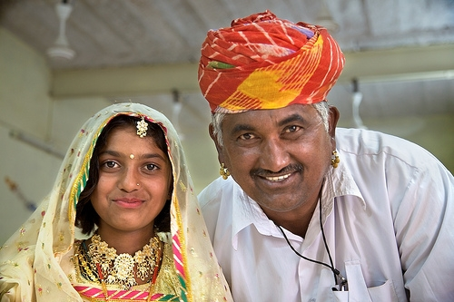
India
  “Sati puja” – Gayathri Spivak
  Delhi Gang rape
  Phoolan Devi
  Child marriage

Slide 12

Ezinma placed her mother’s dish before him and sat with Obiageli.
“sit like a women” Okonkwo shouted at her.
“He belongs to the clan” He told her “so look after her”
“Is he staying long with us?” She asked
“Do what you are told woman” Okonkwo thundered.
Things Fall Apart by Chinua Achebe

Slide 13
“From the very first, Ibsen was intent on writing a drama which would highlight the anomalous position of women in the prevailingly male-dominated society, ‘A woman (he wrote) cannot be herself in the contemporary society; it is an exclusively male society in which laws are drafted by men, and with counsels and judges who judge feminine conduct from the male point of view’”
Source: “Four Major Plays” by Henrik Ibsen

Slide 14

Anomalous position of women
Wife
Mother
Irregular Baby-sitter
House keeper
Bread winner
Anomalous Servant
Sex-object
Abnormal

Slide 15
Are women treated as sex objects?
  “sweet little thing”
  Nora: No Torvald, go away. Leave me alone – I don’t want –
  Helmer: What’s all this? So my little Nora’s playing with me! ‘Don’t want’? I’m your husband, aren’t I?

Slide 16
Feminist Poetry

Slide 17
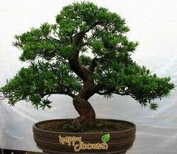
“A Work of Artifice”
The bonsai tree
in the attractive pot
could have grown eighty feet tall
on the side of a mountain
till split by lightning.
But a gardener
carefully pruned it.
It is nine inches high.
Every day as he
whittles back the branches
the gardener croons,
It is your nature
to be small and cozy,
domestic and weak;
how lucky, little tree,
to have a pot to grow in.
With living creatures
one must begin very early
to dwarf their growth:
the bound feet,
the crippled brain,
the hair in curlers,
the hands you
love to touch.
Marge Piercy

Slide 18
“ Sita Speak”
Sita, speak your side of the story,
We know the other too well.
Your father married you to a prince,
Told you to be pliable as the bow
In your husband’s hand.
Didn’t you note Ram broke the magic bow?
They say you-the ideal daughter –
Bowed your head in obedience
As you were sent away
With your husband you chose exile
Suffered privation, abduction
And then the rejection –
The chastity test on the scorching flames
The victim twice victimised.
Could those flames turn to flowers
Without Searing the soul?
They say you were the ideal wife
You questioned him not
And let him have his way
The poets who wrote your story
Said: a woman is not worthy of hearing
The Ramayana; like a beast she is fit only For being beaten
Could such poetry ever bring you glory?
Yet, they spoke their verses without challenge
And With such falsehoods got away.
Sita Speak
You who could lift the magic bow and play
With one hand Who could command the earth with a word
How did they silence you?
(Bina Agarwal 1985)

Slide 19
“Anger” by Linda Pastan
You tell me
that it's all right
to let it out of its cage,
though it may claw someone,
even bite.
You say that letting it out
may tame it somehow.
But loose it may
turn on me, maul
my face, draw blood.
Ah, you think you know so much,
you whose anger is a pet dog,
its canines dull with disuse.
But mine is a rabid thing,
sharpening its teeth
on my very bones,
and I will never let it go.

Slide 20
“ “Woman” by Nikki Giovanni
she wanted to be a blade
of grass amid the fields
but he wouldn't agree
to be the dandelion
she wanted to be a robin singing
through the leaves
but he refused to be
her tree
she spun herself into a web
and looking for a place to rest
turned to him
but he stood straight
declining to be her corner
she tried to be a book
but he wouldn't read
she turned herself into a bulb
but he wouldn't let her glow
she decided to become
a woman
and though he still refused
to be a man
she decided it was all
right

Slide 21
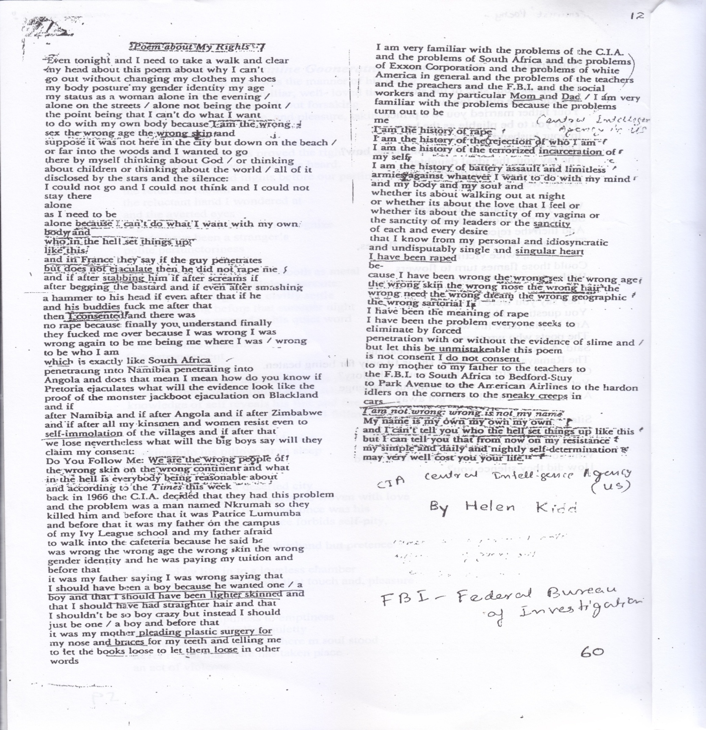

Slide 22
Feminist Plays
“A Doll’s House” By Henrik Ibsen (1879)
(Norwegian)

Slide 23
Beginning Climax Anti-climax
My little skylark
My little squirrel
My little song-bird
My little scatter brain
My little feather brain
Liar, hypocrite, criminal
My poor, frightened, helpless, little darling

Slide 24
Nora: “I’ve been your doll-wife here, just as at home I was Papa’s doll-child”
----------------------------------------------------------------
Nora: “What do you consider is my most sacred duty?”
Helmer: “Do I have to tell you that? Isn’t it your duty to your husband and children?”
Nora: “I have another duty, just as sacred.”
Helmer: “You can’t have. What duty do you mean?”
Nora: “My duty towards myself”

Slide 25
Short story
“The Divorcee” by Ken Saro Wiwa (Nigerian)
“A husband did a girl a favour by marrying her… And when he did Lebia the favour of seeking her hand in marriage, there was nothing to stop him from achieving his desire”
“Because she has not only married a man: she was a family property”
“He expected that she would bear children. It was for that primarily that he had married her. For everyman had reason to expect that he would be a father someday. Everyman was capable of being a father. If he did not become a father, there was something wrong with his wife”

Slide 26


Songs
“Ma sandata kamathi “Thatu kapanne ai”
bava dana oba…”

Slide 27

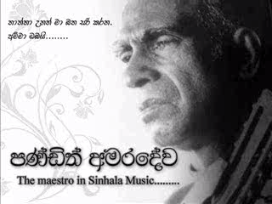
Appreciation of traditional female role
“Sanda kaluwara gala…” “Thaththa Unath”

Slide 28
Films
“Thani Thatuven Piya Banna”
“Dadayama”
“Suddilage Kathava”
“Loku Duwa”
“Water”

Slide 29
Positives of Feminism
Feminist campaigns have changed societies positively.
  Equal pay for women
  Rights to enter into contracts and own property
  Protection of women and girls from domestic violence and sexual harassment
  Workplace rights, maternity leave
  Decision-making rights
      Ex: Scandinavian countries: Norway and Sweden

Slide 30
Ill-effects of Feminism
Single parents
Smoking, drinking
Drop of birth rate
Decline in marriage institution

Slide 31
Decision up to you!
Is Feminism a Cure or Curse?
Thank You

