Slide 1
FEARS
Let’s talk!

Slide 2
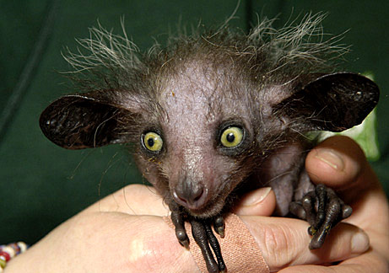
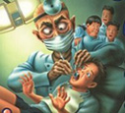

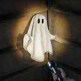
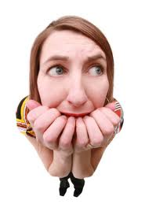
About You!
Are you afraid of flying?
Are you afraid of ghosts?
Are you afraid of giving a speech in public?
Are you afraid of going to the dentist?
Are you afraid of heights?
Are you afraid of scary movies?
Are you afraid of the dark?
Are you afraid to die? Why?
Are you afraid of getting old? Why?

Slide 3


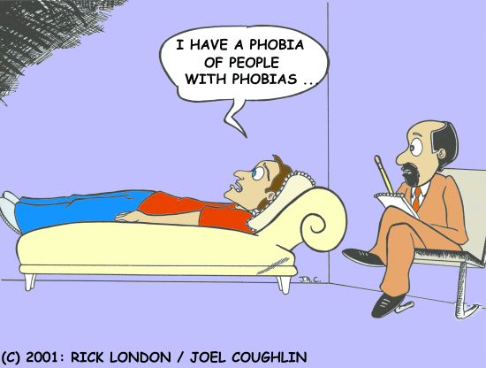
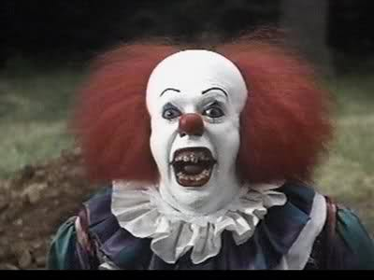
FEARS
Are you afraid of speaking English?
What is your biggest fear for yourself?
What is your biggest fear for yourself?
What is your biggest fear for the world?
Do you know anyone with a phobia?

Slide 4
Videos
http://www.youtube.com/watch?v=wXBXsvz4k2Q
http://www.youtube.com/watch?v=ZS8ohGye8wA
http://www.youtube.com/watch?v=oCqsscwnAHk
http://www.youtube.com/watch?v=N9oxmRT2YWw

