Slide 1
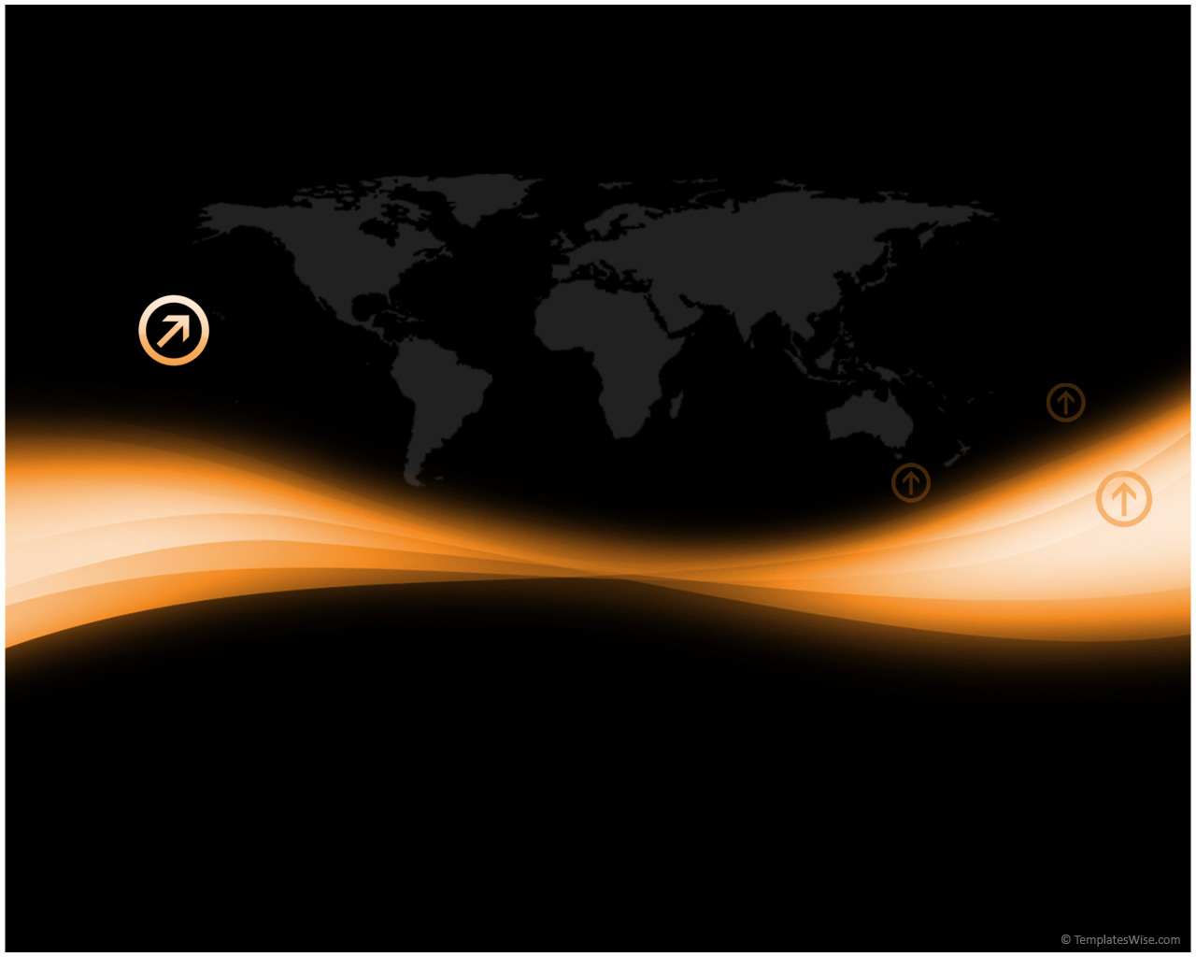
Culture and Energy Consumption

Slide 2
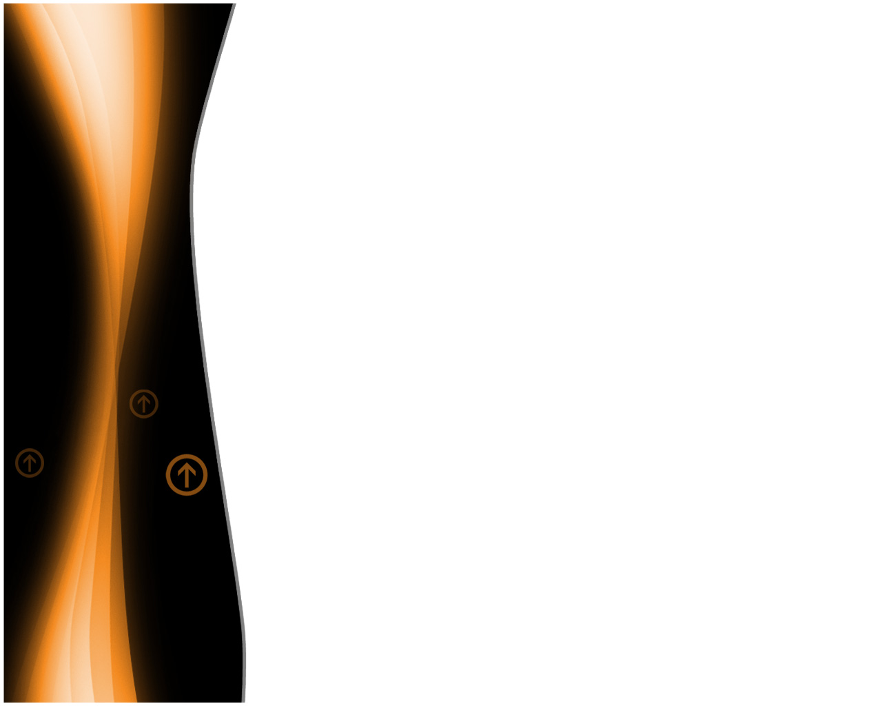
Introduction
We are all human beings, but by living in different places around the world, in our own unique struggle to survive, we learn different things, mostly dependent on where we live.
This learning of how to live, largely influenced by societies, also largely influences the use of energy per capita.

Slide 3


What is Culture?
Culture is the full range of learned human behavior patterns amongst social groups, influencing ideologies, languages, food, art, etc.
It is important in energy because how one lives is a facet of one’s culture.

Slide 4

Ideologies
These are belief systems; a set of ideas that constitutes one's goals, expectations, and actions; how one looks at things.
Depending on a society’s ideology, energy usage is affected.
e.g.: Native Americans frequently object to hydropower projects because they disrupt stream flow, which is of
great spiritual importance to Native American culture.

Slide 5

C O M F O R T
Homely feelings for individuals of a society influence how buildings are constructed and how energy is used, which is indeed a facet of culture.
Because Hawaiians are comfortable in and are used to generally cool weather , their homes utilize single wall construction and thus is not really concerned with heat-loss.
in Japan there is still widespread resistance to domestic space heating and cooling. Japanese people heat the space under a sunken dinner table and trapped the heat with a cloth around the edge of the table. They are genuinely comfortable this way.

Slide 6
Living Scales
Because of economies of scale, a large family living together in a house uses energy much more efficiently - on a per capita basis - than a small family.
The long-term decline in U.S. household size and the ever-increasing numbers of singles living alone are feeding a continuing rise in home energy consumption.

Slide 7
American vs. Bahamian Culture
American Culture
Bahamian Culture
Materialism, which is the belief that material possessions can bring personal happiness, exists heavily here (technologies & appliances that use more energy)
Citizens of U. S. A. prefer single living
Tend to be more reservative; tend to keep aside for future use in difficult times
Citizens of the Bahamas tend to bend towards group living

Slide 8
E V O L U T I O N A R Y LAW
Hypotenuse- “Every increase in available energy leads to an improvement in the human standard of living.”
For many centuries, the only immediate sources of energy were human and animal muscle, which progressed to today’s steam engine and nuclear energy.
However, as more energy became available, the yield in goods and services per unit of energy was in a steep decline as the world became more diverse and unequal in culture.
Natural Law – “Every increase in available energy leads to a decrease in the human standard of living.”

Slide 9
Thank you for Viewing…..
R. D. Bent - Energy: Science, Policy, and the pursuit of sustainability, 2002
Brendan Dooley – Perspectives on the Power to Work, 2006
Dennis O'Neil - What is Culture, 2006

