Slide 1
Unit: I Atmospheric Composition and Structure
General Characteristics
Composition- Gases, water vapour and dust particles
Structure: Layered structure, variation with altitude, latitude and seasons; Importance and characteristics of each layer.

Slide 2
General Characteristics
Definition of atmosphere
Earth’s atmosphere
Characteristics: This includes the study of :evolution, physical properties of the Earth’s atmosphere, optical properties, layers and composition ; significance

Slide 3
An atmosphere is a layer of gases that may surround a material body of sufficient mass and that is held in place by the gravity of the body.
The atmosphere of Earth is a layer of gases surrounding the planet Earth that is retained by Earth's gravity.

Slide 4
Characteristics
The Earth’s atmosphere is a layer of gases and has evolved during the course of Earth's history particularly with regards to its composition. Many natural and currently human activities have influence d the earth’s climate.
The atmosphere is composed of gases which are collectively called air and is comprised of layers in its vertical structure; with each layer having specific characteristics.
The earth’s atmosphere also interacts with other layers of the Earth- lithosphere, hydrosphere and biosphere to form the Earth system. This is through the processes.
The atmosphere finally merges with space.

Slide 5
Climatology can be explained as the scientific study of the behaviour of the atmosphere- the gaseous layer surrounding the Earth’s surface.
The atmosphere has physical properties. It is believed to represent a form of the second law of thermodynamics. Thus, it represents a place where a balance is generally achieved between the downward directed gravitational force and the upward directed force of buoyancy. This is called the hydrostatic equilibrium.
Origin- The processes operating in space in the initial phases and the ones operating on the earth’s surface are believed to have created the atmosphere.

Slide 6
Physical properties- The atmosphere has mass and density and is composed of layers. These layers have properties. The exact height Is not known but through studies it has been estimated that approximately 700 km from the sea level, the atmosphere starts merging with outer space. The average atmospheric pressure at sea level is 14.7 pounds per square inch. Total atmospheric mass is 5.1480×1018 kg. Density decreases with height and temperature and pressure also vary with height in the layers of the atmosphere. Also, height variations in the layers of the atmosphere is also observed with changes in atmospheric phenomena and temperature.
50% of the atmosphere by mass is below an altitude of 5.6 km (18,000 ft); 90% of the atmosphere by mass is below an altitude of 16 km (52,000 ft). The modern atmosphere is also termed as the ‘third atmosphere’ in accordance with its evolution.

Slide 7
Functions and significance
Protection of all life from hazardous or deadly radiation from space (filter for UV- and x-rays from sun).
Letting pass the vitally important sunlight to the surface of the continents and oceans (energy source).
Protections from rapid cooling at night and heating at day.
Makes possible a mean temperature on Earth's surface for life sustenance. Transport of energy (warmth of air that can be felt and latent warmth of water vapour) from the equatorial regions to medium and higher latitudes.
Transport of water vapour through dynamic processes of general air circulation that determines precipitation.
Storage of huge amounts of nitrogen (important for plants).
Reservoir for carbon dioxide and oxygen.
Is part of different vital cycles of matter.
Dissipation and decomposition (oxidation, reaction with radicals, photolysis) of natural and anthropogenic (man-made) emissions.
Protection from smaller meteorites that burn up by heating from the friction when entering the Earth's atmosphere and can not reach the surface.

Slide 8
Composition
The atmosphere is composed of the following:
Gases (variable and invariable), water vapour, aerosols and particulate matter
Gases- Nitrogen with 78 % and Oxygen with 21% approximately comprise of 99% of the total atmosphere’s gaseous composition. The remaining 1% is represented by argon (0.93%), Carbon dioxide (0.03%), neon (0.0018%), helium (0.0005%), ozone (0.00006%), hydrogen(0.00005%), and traces of krypton, xenon, methane and other gases. The role of oxygen is the most significant for living organisms (except plants) as they inhale. It is also required for the combustion of burning matter. CO2 is used by plants for the process of photosynthesis. It also absorbs most of radiant energy and form the earth and reradiates it back to the earth. Thus, it is a green house gas. Its concentration is increasing gradually due to the burning of fossil fuels. Nitrogen is generally inactive. Ozone absorbs most of the ultra violet rays radiated from the Sun and thus prevents the earth from becoming too hot. These rays are also harmful for human beings.

Slide 9
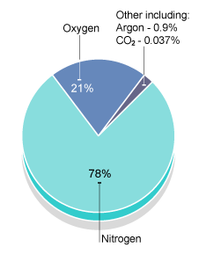

Slide 10
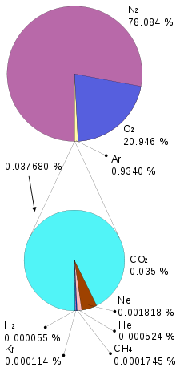

Slide 11
Water vapour-The content of water vapour in the atmosphere ranges between 0-5% by volume. It is a very important component as it is received from the water bodies on the earth’s surface. It depends on temperature and hence its content varies from the equator to the pole. The content also decreases upwards. It is responsible for various kinds of weather phenomena. For eg. Precipitation. It also acts as a green house gas as it is less transparent for outgoing shortwave terrestrial radiation and hence causes heating of the earth’s surface and lower layer of the atmosphere.
Particulate matter and aerosols- The solid particles present in the atmosphere include dust particles, salt particles, pollen, smoke and soot, volcanic ashes. These are also called aerosols that are derived from natural and man made processes. Most of these particles are suspended in the atmosphere and help in scattering of solar radiation which adds varied colours to the sky during sunrise and sunset. Salt and dust particles become hygroscopic nuclei and help in the formation of water drops, clouds and various forms of condensation and precipitation.

Slide 12
Chemical composition
It is also a layered classification. In this category, the atmosphere is divided into two broad zones- Homosphere and heterosphere.
Homosphere- It represents the lower portion of the atmosphere and extends upto a height of 90km form sea level. The main constituent gases are nitrogen and oxygen. Other gases are trace gases such as argon, krypton, methane and xenon. It is called homosphere because of the homogeneity of different gases which are uniform at different levels in the zone in their proportion. Human activity is largely responsible for disturbing the balance of this zone.
Heterosphere- It extends from 90-10, 000km. Different layers in this layer vary in their chemical and physical properties. There are four distinct layers of gases here- Molecular nitrogen layer- dominated by molecular nitrogen and extends from 90-200km; atomic oxygen layer from 200-1100km; helium layer- upto 3500km, and atomic hydrogen layer- topmost layer extending upto the outer most limit of the atmosphere.

Slide 13
Structure of the atmosphere
It can be analysed on two broad basis-
Vertical and on the basis of chemical composition
The knowledge about the structure is derived from the information from rockets, radars and satellites. The effective height of the atmosphere is estimated between 16000-29000 km and about 50% of the atmosphere is contained between 5.6 km and about 97% between 29km. The upper limit of the atmosphere is estimated to be 10, 000km from sea level. On the basis of temperature variations, the classifications are- troposphere, stratosphere, mesosphere and exosphere.

Slide 14
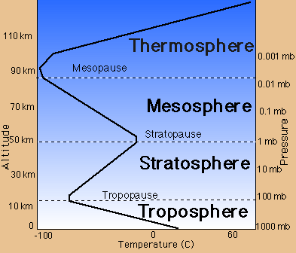
TEMPERATURE REGIME IN THE ATMOSPHERE
Heterosphere
Homosphere

Slide 15
1. Troposphere- The word troposphere derives from the Greek: tropos for "turning" or "mixing," reflecting the fact that turbulent mixing plays an important role in the troposphere's structure and behavior. Most of the phenomena we associate with day-to-day weather occurs in the troposphere. It is of utmost significance as all the life forms are concentrated in this lower most part. Temperature decreases with height .The average height of the troposphere is about 16km over the equator and 6km over the poles. The upper limit of the troposphere is called tropopause which is about 1.5km thick. The height of tropopause is 17 km over the equator and 9-10 km over the poles.
There is also seasonal variation in the height of tropopause which is 17km during January and July over equator and the temperature at this height is -70 degree celsius. Over 75 degree North latitude the height is 15 km. Over poles, the height is 9 km during January with temperature -45 degree celsius. The temperature in the troposphere decreases at the rate of 6.5 degree C per 1000m and hence it is the lowest at the equator than on the poles. The chemical composition of the troposphere is essentially uniform, with the notable exception of water vapour. The word tropopause means the zone where mixing stops. This decrease in temperature is called the ‘Normal Lapse Rate’.

Slide 16
Stratosphere- The stratosphere is the second major layer of Earth's atmosphere, just above the troposphere, and below the mesosphere. It is stratified in temperature, with warmer layers higher up and cooler layers farther down. This is in contrast to the troposphere near the Earth's surface, which is cooler higher up and warmer farther down. The border of the troposphere and stratosphere, the tropopause, is marked by where this inversion begins, which in terms of atmospheric thermodynamics is the equilibrium level.
The stratosphere is situated between about 10 km (6 mi) and 50 km (30 mi) altitude above the surface at moderate latitudes, while at the poles it starts at about 8 km (5 mi) altitude. The upper limit is called stratopause. It is devoid of major weather phenomena but light winds and cirrus clouds are observed. The stratosphere is layered in temperature because ozone (O3) here absorbs high energy UVB and UVC energy waves from the Sun and is broken down into atomic oxygen (O) and diatomic oxygen (O2).

Slide 17
The scientists are not sure about the fact that whether temperature increases with height in this zone or not. The lower portion of the stratosphere having maximum concentration of ozone is called ozonosphere, which is confined between 15-35km from sea level with upper limit at 55km. Ozone, defined as a three atom isotope of oxygen is a faintly blue irritating gas with a pungent odour. It is unstable because its creation and destruction is a constant process. It acts as a protective layer for living communities in the biosphere because it absorbs almost all of the ultra violet radiation and hence protects the earth from becoming too hot.
But human activities have gradually reduced the ozone layer’s thickness through the generation of halogenated gases such as CFC’s, halons and nitrogen oxides. This is responsible for causing global warming, acid rain, melting of glaciers, sea level rise, poisonous smogs, decrease in photosynthesis, skin cancer to white skinned people and ecosystem instability.

Slide 18
Mesosphere- It extends between 50-80 km. temperature again decreases with height here. At the uppermost limit of mesosphere at 80 km, it becomes -90degree C. This is called mesopause.Temperature decreases with height throughout the mesosphere. The coldest temperatures in Earth's atmosphere, about -90° C (-130° F), are found near the top of this layer.The mesosphere is difficult to study, so less is known about this layer of the atmosphere than other layers. Weather balloons and other aircraft cannot fly high enough to reach the mesosphere.
Most meteors vaporize in the mesosphere. Some material from meteors lingers in the mesosphere, causing this layer to have a relatively high concentration of iron and other metal atoms. Very strange, high altitude clouds called "noctilucent clouds" or "polar mesospheric clouds" sometime form in the mesosphere near the poles.

Slide 19
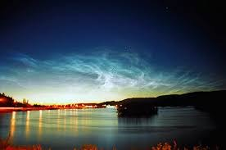
Noctilucent clouds

Slide 21
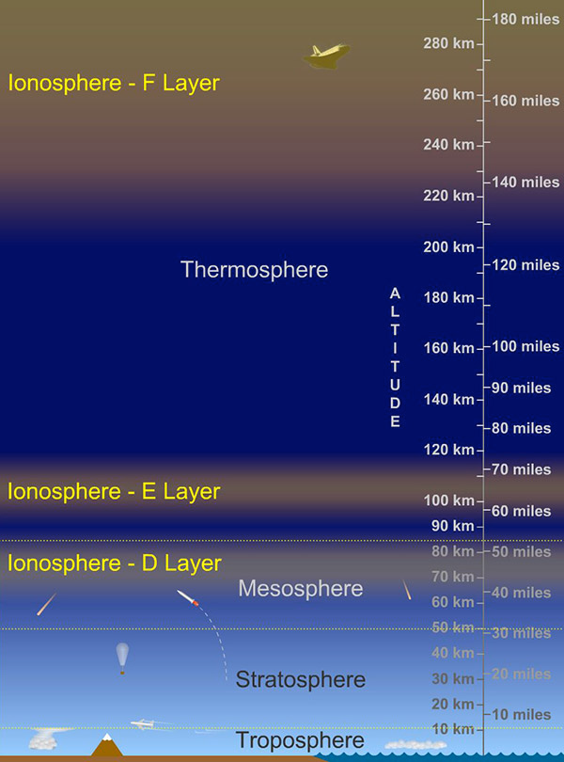
Ozonosphere

Slide 22
Auroras occur in this layer.
Typically the aurora appears either as a diffuse glow or as "curtains" that approximately extend in the east-west direction. An aurora or aurorae is/are a natural light display in the sky, particularly in the high latitude (Arctic and Antarctic) regions, caused by the collision of energetic charged particles with atoms in the high altitude atmosphere (thermosphere). The charged particles originate in the magnetosphere and solar wind and are directed by the Earth's magnetic field into the atmosphere. Aurora is classified as diffuse or discrete aurora. At some times, they form "quiet arcs"; at others ("active aurora"), they evolve and change constantly. Each curtain consists of many parallel rays, each lined up with the local direction of the magnetic field lines, suggesting that auroras are shaped by Earth's magnetic field. Indeed, satellites show electrons to be guided by magnetic field lines, spiraling around them while moving towards Earth.
The similarity to curtains is often enhanced by folds called "striations". In northern latitudes, the effect is known as the aurora borealis (or the northern lights), named after the Roman goddess of dawn, Aurora, and the Greek name for the north wind, Boreas. Its southern counterpart, the aurora australis (or the southern lights), has almost identical features to the aurora borealis and is visible from high southern latitudes in Antarctica, South America and Australia.

Slide 23
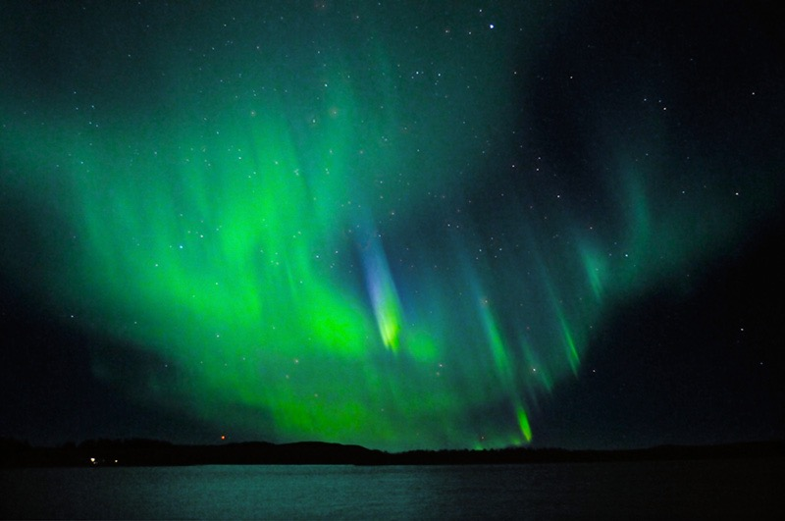
aurora australis
Northern lights with very rare blue light Lapland in Sweden

Slide 24
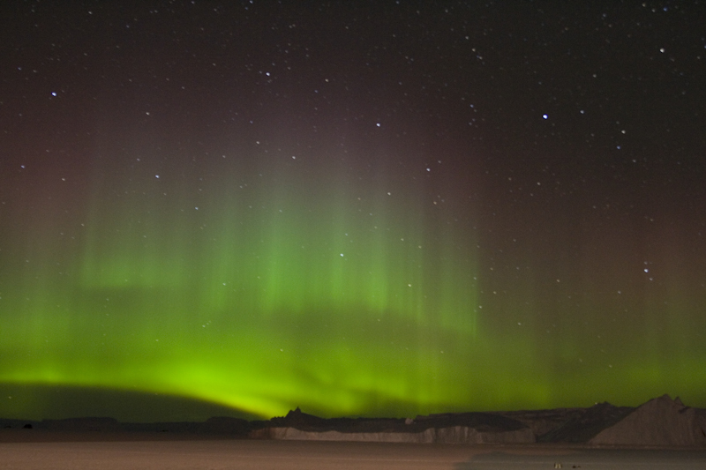
Aurora australis

Slide 25
Exosphere- It represents the uppermost layer of the atmosphere and very little is known about it. The density is extremely low and the atmosphere resembles a nebula. The temperature becomes 5568 degree C at its outer limit.The Earth’s atmosphere here merges with the outer space of the solar system.
Chemical composition and structure of the atmosphere- discussed earlier; to be added again.

Slide 26
