Slide 1
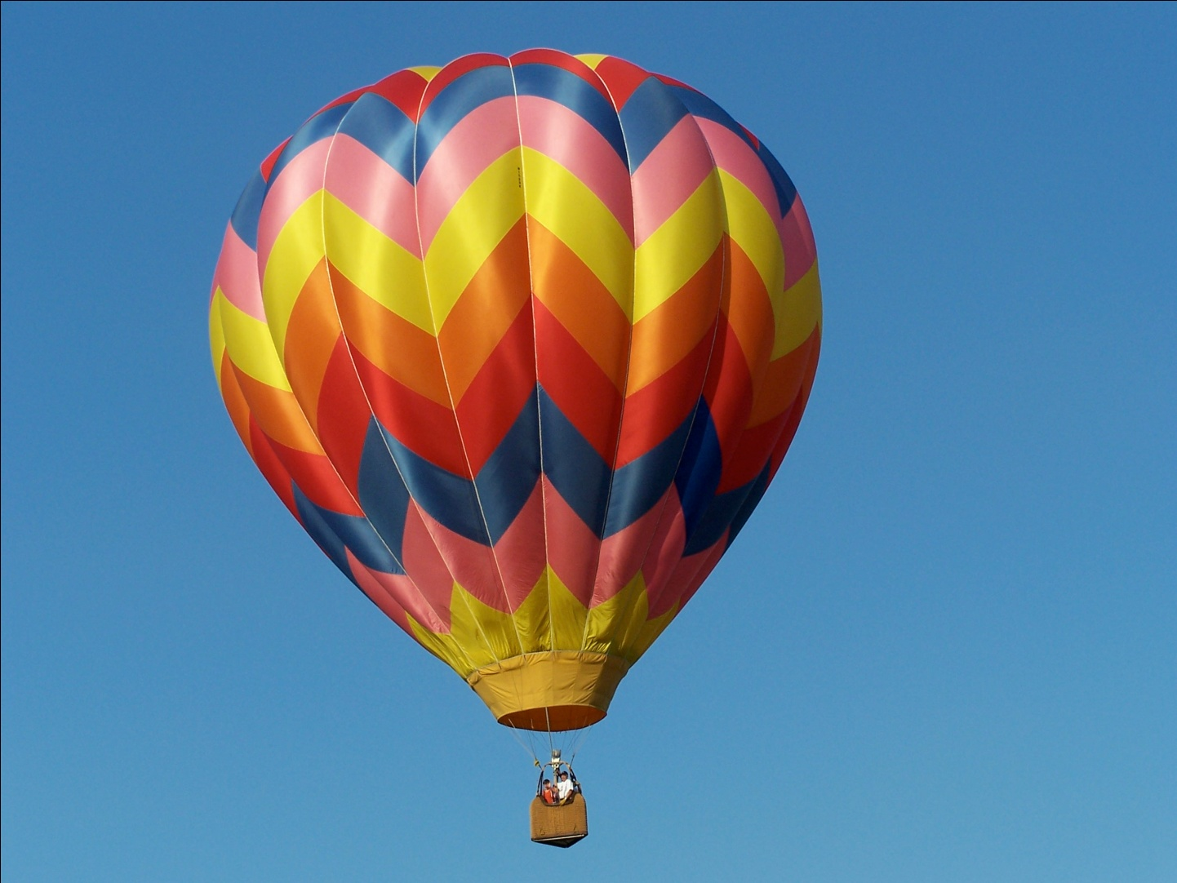
Fluids
This hot air balloon has a fluid in it: a gas

Slide 2
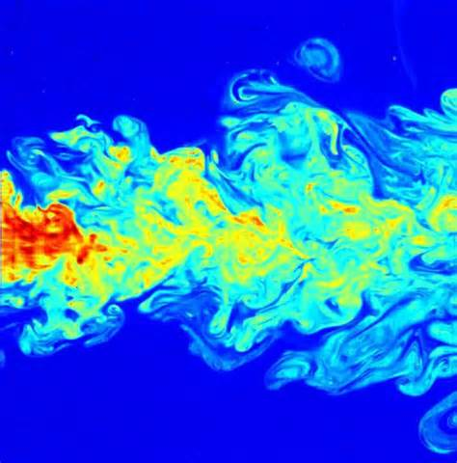
Fluids
A fluid is a liquid or a gas
As you know, fluids do not have a definite shape, unlike solids
Fluids can “flow,” which is how they move
This picture shows one fluid flowing into and mixing with another fluid

Slide 3
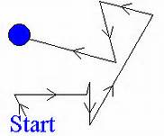
Random movement
Fluid particles move around randomly, hitting other particles
This means that we cannot predict where one particle of a fluid will be in the future
The fluid, however, which is made of many particles, doesn’t move randomly, and we can predict where it will move
This shows the random movement of one particle in a fluid

Slide 4
Concentration
In physics and chemistry, “concentration” means how much of something (mass, volume, or number of particles) there is in a unit volume (liters is most commonly used)
Brackets like this: [] around the name of a substance mean its concentration
mass of x vol. of x # of particles of x
tot. vol. total vol. total volume
For example, if I mix 10 g of salt into 2 L of water, what is the [salt]?
[x]= or or
[salt]=5g/L

Slide 5
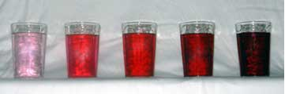
Dilute or Concentrated?
If something is “dilute,” it has a lower concentration than something else
If something is “concentrated,” it has a higher concentration than something else
These cups have different concentrations of a substance in water. Which is the most dilute and which is the most concentrated?

Slide 6
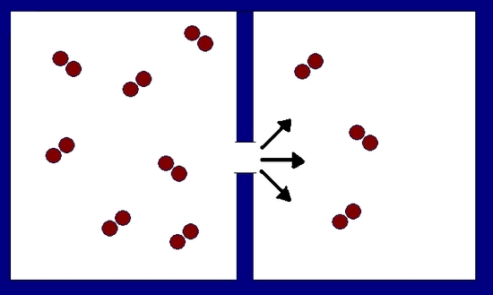
Diffusion
Diffusion is the spreading out of fluid particles in their container until their concentration is the same everywhere
The particles always move from high concentration (concentrated) to low concentration (dilute) in diffusion
In this picture, particles are diffusing from the more concentrated area on the left to the more dilute area on the right

Slide 7
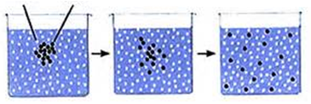
More about diffusion
Diffusion is caused by the random movement of the particles in the fluid
How fast diffusion happens can change with temperature and the mass of the particles that are diffusing
Diffusion happens faster at higher temperatures and with particles that have lower masses
water
sugar

