Slide 1
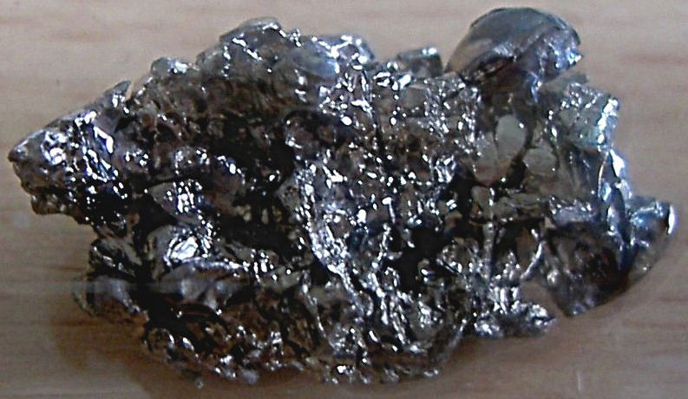
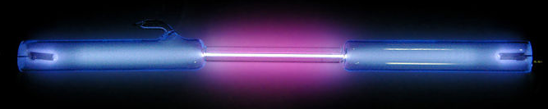
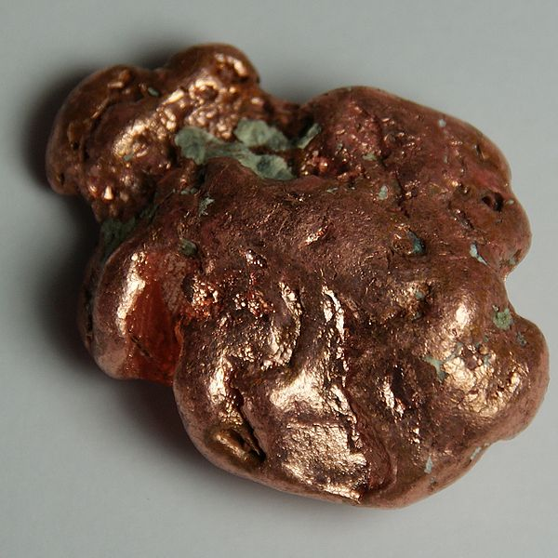
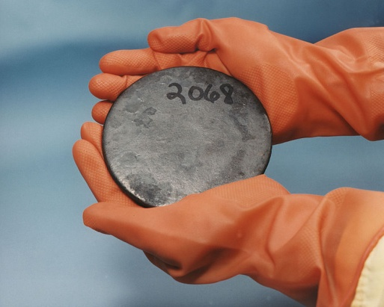
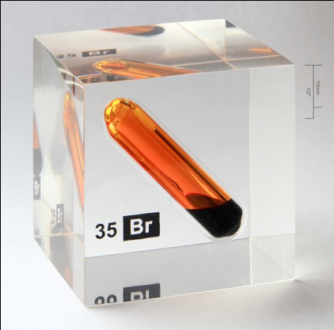

Elements
Examples of certain chemical elements. From left to right: hydrogen, barium, copper, uranium, bromine, and helium.

Slide 2
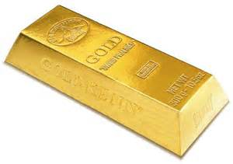
What is an element?
A element is a pure substance made of one type of atom
Elements are divided into metals and non-metals
Examples of non-metal elements include carbon, oxygen, hydrogen, and nitrogen
Examples of metal elements include aluminum, iron, copper, and gold
A gold bar

Slide 3
Atoms
All the matter we can see is made of very small particles called ‘atoms.’
They are not the smallest things we know of, but they are so small we can’t see them except with the most powerful microscopes. (A microscope is a tool for looking at very small things.)
There are about 5.07 x 10²⁴ or 5,070,000,000,000,000,000,000,000 atoms in a milliliter of water.

Slide 4
All atoms are made up of just 3 basic particles:
Name: Proton Charge: +1
Name: Neutron Charge: 0
Name: Electron Charge: -1
“Charge” causes objects to experience a force when near other electrically charged objects. It’s like a magnet.

Slide 5
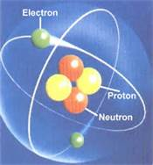
Inside an atom
An atom has a nucleus in the middle, and electrons around the nucleus
The nucleus is made of protons and neutrons
An atom has the same number of protons as electrons so the + and - charges cancel to equal 0 charge for the atom
Question: Is the nucleus’ charge positive or negative?
A helium atom

Slide 6
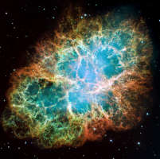
Where did the elements come from?
The elements on our planet were mostly made before the Earth was made
The simplest elements, hydrogen and helium, were created when the universe was created
The other elements were made inside stars which later exploded
Most of your body’s atoms were made inside stars billions of years ago

Slide 7
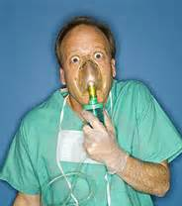
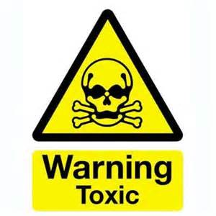
What can elements do?
Some elements we need to stay alive, like oxygen. Oxygen is in air, and we would die in minutes without it
Other elements are very poisonous and even a small amount would kill us, like arsenic

Slide 8
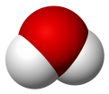
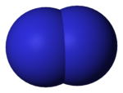

Molecules
A molecule is a group of atoms that have joined together into one piece.
Molecules have 2 or more atoms in them, and some molecules have thousands or more atoms in them.
Here are some common molecules:
Water: H₂O
Nitrogen: N₂
Carbon Dioxide: CO₂

Slide 9
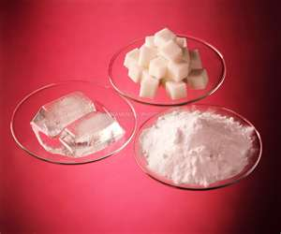
Pure substances
A pure substance can be a solid, liquid, or gas.
A pure substance has all the same atoms or molecules.
An example of a pure substance is pure water.
Here are some pure substances: sugar, ice cubes, and baking soda

Slide 10
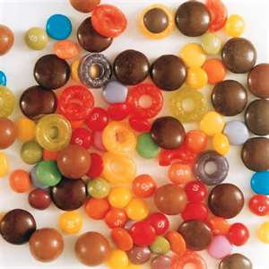
Mixtures
A mixture is matter made up of two or more different types of particles.
A mixture can be separated into its different types of particles.
An example of a mixture is salt water. You can separate the salt from the water if you evaporate the water.
This is a mixture of different candies.

Slide 11
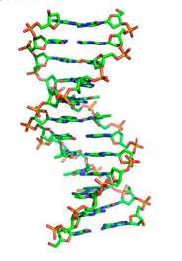
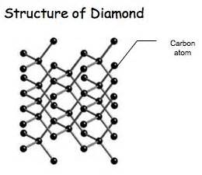
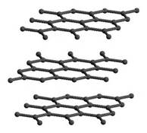
Carbon!
Carbon is the element most important to life because it is good at making very large molecules like DNA
Pencils use pure carbon (graphite) to write
Diamonds are also pure carbon
Structure of graphite
Structure of DNA

Slide 12
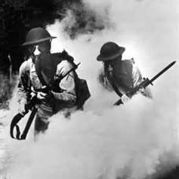
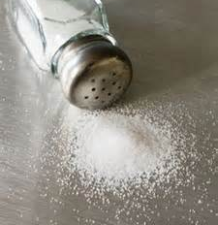
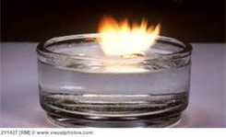
Table salt: Friend or enemy?
Some elements are safe sometimes and dangerous other times
Table salt is made of sodium and chlorine, but pure sodium will explode if it touches water and chlorine is a poisonous gas used in warfare.
+
=
A small piece of sodium exploding in water
Chlorine gas was used in battle in World War I
Table salt

