Slide 1
Three main types of lung disease
Airway diseases -- These diseases affect the tubes (airways) that carry oxygen and other gases into and out of the lungs. These diseases cause a narrowing or blockage of the airways. They include asthma, emphysema, and chronic bronchitis. People with airway diseases sometimes describe the feeling as "trying to breathe out through a straw."
Lung tissue diseases -- These diseases affect the structure of the lung tissue. Scarring or inflammation of the tissue makes the lungs unable to expand fully ("restrictive lung disease"). It also makes the lungs less capable of taking up oxygen (oxygenation) and releasing carbon dioxide. Pulmonary fibrosis and sarcoidosis are examples of lung tissue diseases. People sometimes describe the feeling as "wearing a too-tight sweater or vest" that won't allow them to take a deep breath.
Pulmonary circulation diseases -- These diseases affect the blood vessels in the lungs. They are caused by clotting, scarring, or inflammation of the blood vessels. They affect the ability of the lungs to take up oxygen and to release carbon dioxide. These diseases may also affect heart function.

Slide 2
The most common lung diseases include:
Asthma
Chronic bronchitis
COPD (chronic obstructive pulmonary disease)
Emphysema
Pulmonary fibrosis

Slide 3
Asthma is an inflammatory disorder of the airways, which causes attacks of wheezing, shortness of breath, chest tightness, and coughing.
Asthma is caused by inflammation in the airways. When an asthma attack occurs, the muscles surrounding the airways become tight and the lining of the air passages swell. This reduces the amount of air that can pass by, and can lead to wheezing sounds.
Most people with asthma have wheezing attacks separated by symptom-free periods. Some patients have long-term shortness of breath with episodes of increased shortness of breath. In others, a cough may be the main symptom. Asthma attacks can last minutes to days and can become dangerous if the airflow becomes severely restricted.
In sensitive individuals, asthma symptoms can be triggered by breathing in allergy-causing substances (called allergens or triggers).

Slide 4
Common asthma triggers include:
Animals (pet hair or dander)
Dust
Changes in weather (most often cold weather)
Chemicals in the air or in food
Exercise
Mold
Pollen
Respiratory infections, such as the common cold
Strong emotions (stress)
Tobacco smoke
Emergency symptoms:
Bluish color to the lips and face
Decreased level of alertness such as severe drowsiness or confusion, during an asthma attack
Extreme difficulty breathing
Rapid pulse
Severe anxiety due to shortness of breath
Sweating

Slide 5
CF
Cystic fibrosis is an inherited disease of the mucus and sweat glands. It affects mostly your lungs, pancreas, liver, intestines, sinuses and sex organs. CF causes your mucus to be thick and sticky. The mucus clogs the lungs, causing breathing problems and making it easy for bacteria to grow. This can lead to problems such as repeated lung infections and lung damage.

Slide 6
The symptoms and severity of CF vary widely. Some people have serious problems from birth. Others have a milder version of the disease that doesn't show up until they are teens or young adults.
Although there is no cure for CF, treatments have improved greatly in recent years. Until the 1980s, most deaths from CF occurred in children and teenagers. Today, with improved treatments, people with CF live, on average, to be more than 35 years old.

Slide 7
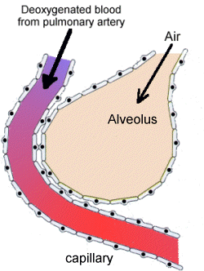
Rate of diffusion – 3 properties of gas exchange surface
Surface area – rate of diffusion is directly proportional.
Concentration gradient- rate of diffusion is directly proportional to the difference in concentration across the GE surface.
Thickness of the GE surface- rate of diffusion is inversely proportional to the thickness of the GE surface. Thicker surface, slower the diffusion.

Slide 8
Fick’s Law
Rate of diffusion ά surface area x difference in concentration
_______________________________
thickness of the gas exchange surface
Features to allow for rapid diffusion across the GE surface:
Surface area of the alveoli
Steep concentration gradient
Thin walls

Slide 9
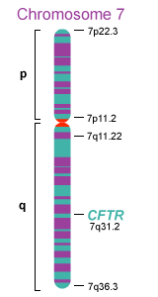
How sticky mucus affects gas exchange
Objective – CF caused by the expression of a gene mutation that impairs the functioning of the gas exchange, reproductive and digestive system.
(CFTR the gene associated with CF – cystic fibrosis transmembrane conductance regulator)
Genes are proteins

Slide 10
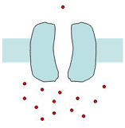
Why is CF mucus so sticky?
Mucus layer on the epithelial cells contain less water
Due to abnormal salt and water transport across the cell surface membrane caused by a faulty transport protein channel in the membrane.
Protein structure, function, structure of the cell membrane, transport of substances, how proteins are made and the protein channel is what we will study next.

Slide 11
This powerpoint was kindly donated to
www.worldofteaching.com
http://www.worldofteaching.com
Is home to well over a thousand powerpoints submitted by teachers. This a free site. Please visit and I hope it will help in your teaching
Notes:
11

