Slide 1
the
FOOD
Pyramid
Steps to a healthier you

Slide 2
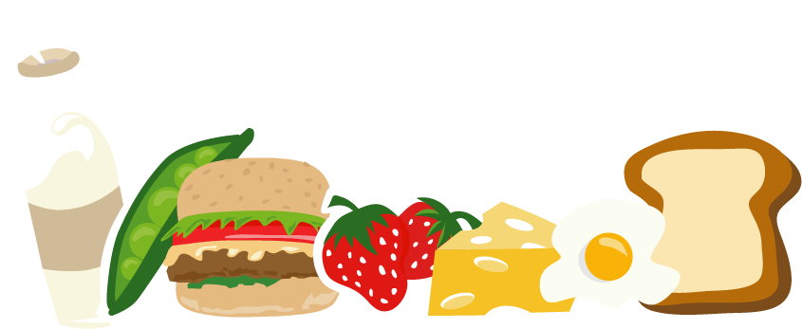
Eating Right Every Day
We will be learning about the relationship between good nutrition and health.

Slide 3
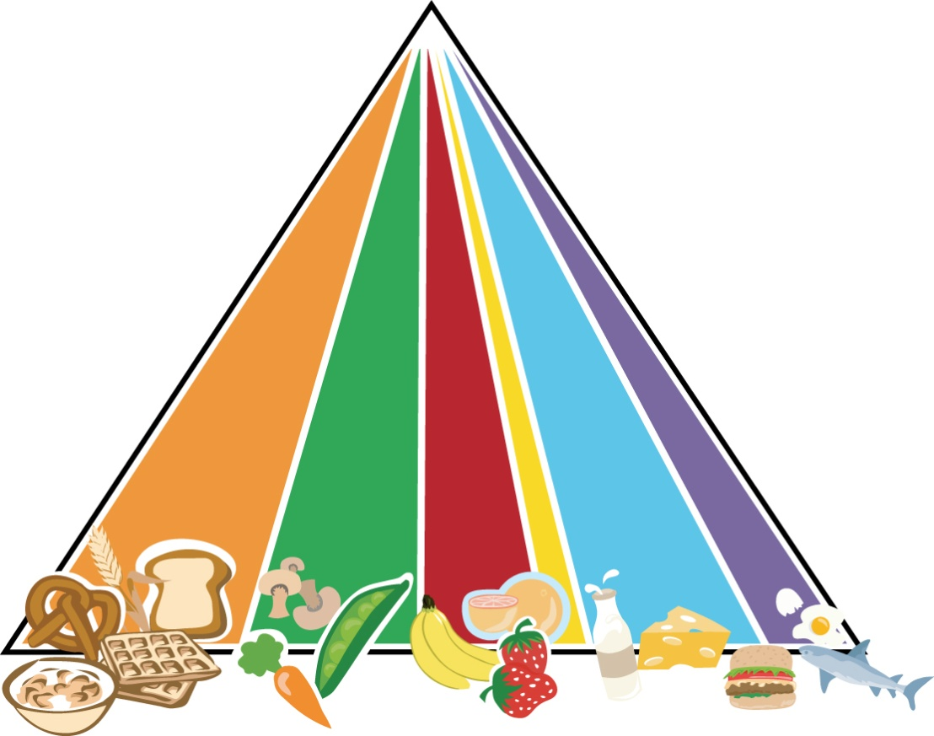
The Food Pyramid
Steps to a healthier you
GRAINS
VEGETABLES
FRUITS
OILS
MILK
MEAT & BEANS

Slide 5

Grains
Make half of your grains whole
Some examples of grains are: oatmeal, wheat, rye, and barley
Whole grain wheat bread is better for you than white bread
Cereals are grains, like Cheerios, Mini-Wheats, and Bran Flakes
Children should have 6 servings of grains a day

Slide 6

Vegetables
Vary your veggies
Vegetables include carrots, broccoli, beans, peppers, lettuce, and tomatoes
You need green, orange, and red – vary your colors for the best balance of vitamins and nutrients
Children need 2½ cups of vegetables a day

Slide 7

Fruits
Focus on fruits
Fruits contain a wide variety of vitamins
Fruits like pineapples, apples, oranges, peaches, apricots, and pears are readily available
Fresh is best, but canned or frozen are fine out of season
Children need 1½ cups of fruit every day

Slide 8

Oils
Know your fats
Oils and fats include fried food, butter or margarine, salad dressings, and milkfat in milk and cheese
You should limit your fat intake, as it is linked to blood vessel disease and heart attacks, and builds up in your body over time
Children need no more than 3 servings a day

Slide 9

Milk
Get your calcium rich foods
Calcium rich foods include milk and cheeses
Calcium builds strong bones and teeth, and helps your muscles become stronger
Children need 3 cups of milk or cheese a day

Slide 10

Meat and Beans
Go lean on protein
Meats and beans give you protein to grow strong muscles and improve brain function
Limit your meats to lean beef, chicken, and pork – you can get a lot of fat with meat
Children need 5 ounces of protein a day

Slide 11
Discretionary Calories
Extras for luxury foods
What are discretionary calories? Foods you would like to have that don’t fit in any of the other categories, or are above the recommended amounts – like birthday cake, ice cream, or candy.
You should limit these foods to NO MORE than 150 calories a meal or snack – make wise choices

Slide 12
Physical Activity
Strive for 60 minutes or more per day
What is physical activity?
Discuss moderate vs. vigorous activity.
Solicit class feedback for examples of moderate and vigorous activities.

Slide 13
Eat Well and Stay Healthy!
Encourage children to use the MyPyramid Worksheet, for a week, and to eat their favorite foods in each group to meet their daily requirements.
Download the worksheet here: MyPyramid Worksheet.
Discuss their findings at the end of the week.
How might each child eat more healthfully?

Slide 14
Conclusion
Summarize the health benefits of each food group.
Research on any new finding about food and health.
Continue keeping a food diary.
Strive for 60 minutes or more of physical activity every day.

Slide 15
This powerpoint was kindly donated to
www.worldofteaching.com
http://www.worldofteaching.com
Is home to well over a thousand powerpoints submitted by teachers. This a free site. Please visit and I hope it will help in your teaching

