Slide 1
Trees as Homes a presentation created by Carolyn Kinne
Animals need food, water, and a safe place to call home. Many animals use trees as their homes.

Slide 2
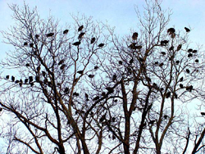
Trees can be home to birds.

Slide 3
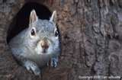
Trees can be home to squirrels.

Slide 4
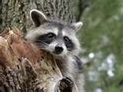
Trees can be home to raccoons.

Slide 5
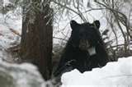
Trees can even be home for bears.

Slide 6
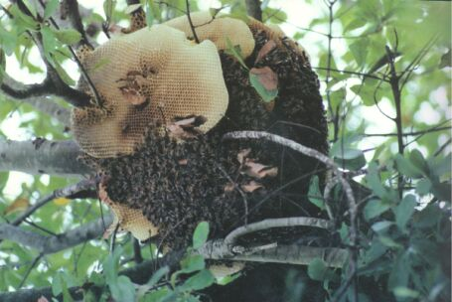
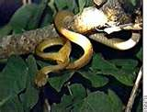
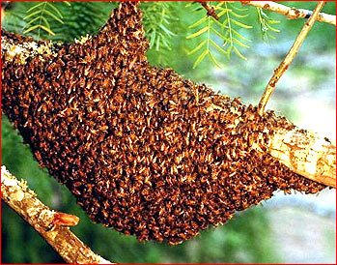
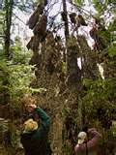
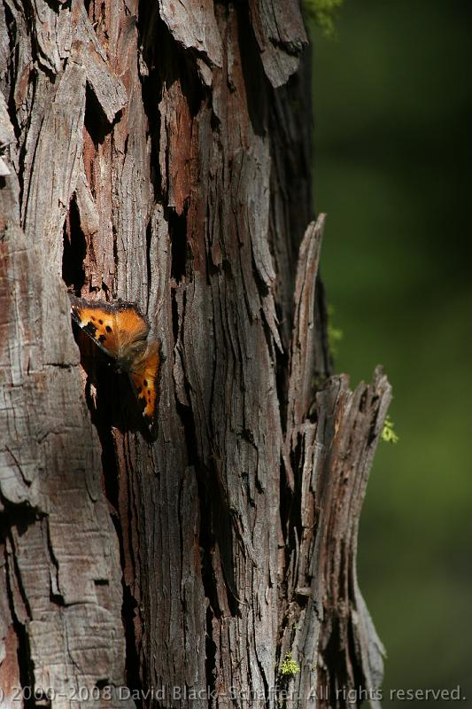
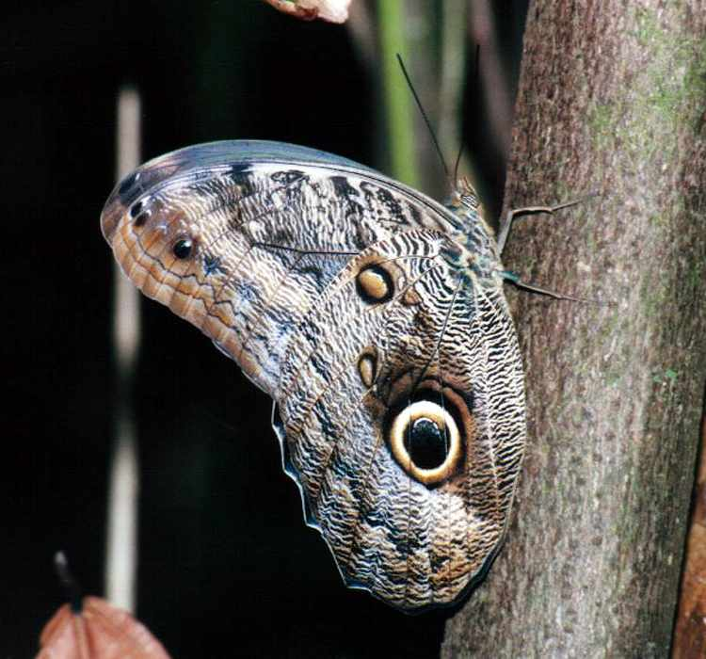
What other animals might use a tree for home?

Slide 7
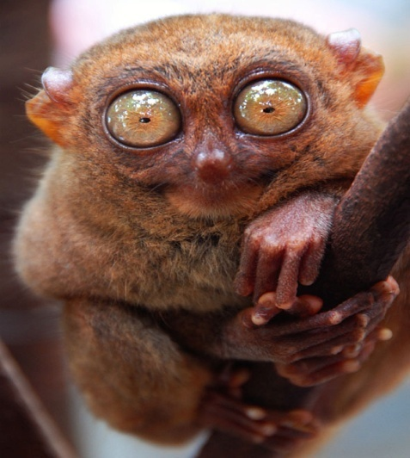
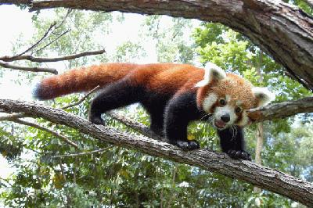
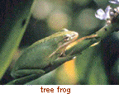

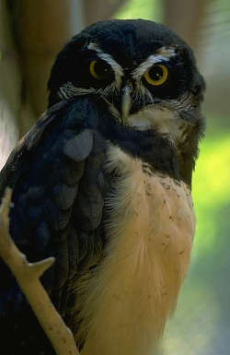
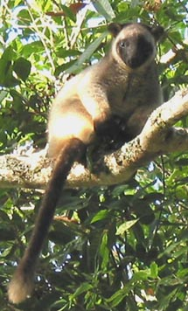
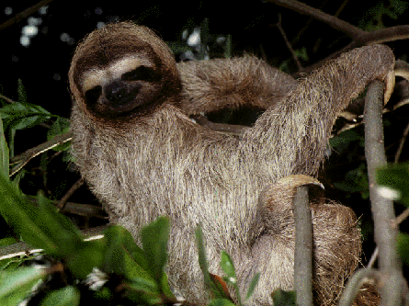
Can you think of more?

Slide 8
This powerpoint was kindly donated to
www.worldofteaching.com
http://www.worldofteaching.com
Is home to well over a thousand powerpoints submitted by teachers. This a free site. Please visit and I hope it will help in your teaching

