Slide 1
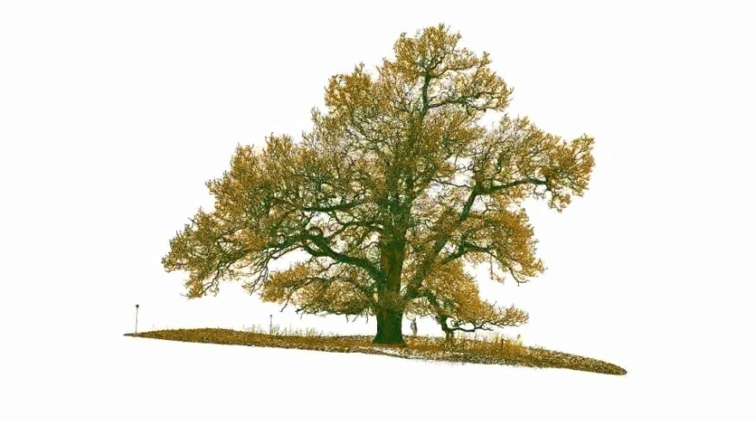
Study of Canopia structure of trees
Presented By Anshul Pandey

Slide 2
Certificate
This is to certify that this project has been made by (your name)of class ( which class) on the topic Study of Canopia structure of trees under the guidance of our Biology teacher (name of teacher) and HAVE BEEN completed it successfully.
Yours truely XYZ(YOUR NAME)

Slide 3
Acknowledgement
I would like to express my special thanks of gratitude to my teacher
(Name of the teacher)
as well as our principal
(Name of the principal)
who gave me the golden opportunity to do this wonderful project on the topic
“Study of Canopy structure of trees”
which also helped me in doing a lot of Research and i came to know about so many new things I am really thankful to them. Secondly I would also like to thank my parents and friends who helped me a lot in finalizing this project within the limited time frame.

Slide 4
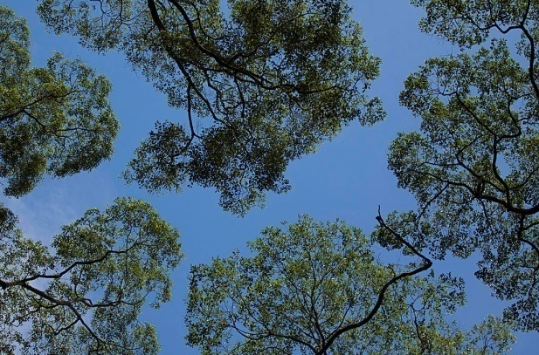
Introduction
In biology, the canopy is the aboveground portion of a plant community or crop, formed by the collection of individual plant crowns.
In forest ecology, canopy also refers to the upper layer or habitat zone, formed by mature tree crowns and including other biological organisms (epiphytes, lianas, arboreal animals, etc.)
Sometimes the term canopy is used to refer to the extent of the outer layer of leaves of an individual tree or group of trees. Shade trees normally have a dense canopy that blocks light from lower growing plants.

Slide 5
What Is Canopy?
In the rainforest most plant and animal life is not found on the forest floor, but in the leafy world known as the canopy.
The conditions of the canopy are very different from the conditions of the forest floor. During the day, the canopy is drier and hotter than other parts of the forest, and the plants and animals that live there are specially adapted for life in the trees. For example, because the amount of leaves in the canopy can make it difficult to see more than a few feet, many canopy animals rely on loud calls or lyrical songs for communication. Gaps between trees mean that some canopy animals fly, glide, or jump to move about in the treetops.

Slide 6
Canopy Structure
Canopy structure is the organization or spatial arrangement (three-dimensional geometry) of a plant canopy. Leaf Area Index (LAI), leaf area per unit ground area, is a key measure used to understand and compare plant canopies. It is also taller than the understory layer.

Slide 7
Species of Canopy Trees
Since as many as 70-90 percent of canopy tree species depend on animals for pollination and seed dispersal, numerous species are equipped with special mechanisms to ensure the proper species will take and deposit pollen in the proper plant species and disperse seeds in a suitable place.
Plants pollinated by certain animals often have certain characteristics. For example, flowers pollinated by birds have brightly colored, cup-shaped flowers, while flowers pollinated by bats are often white nocturnal blooms with copious amounts of nectar.
Flowers pollinated by flies often have a rotting or mildew-like smell just as "bee-flowers" have a sweet odor.
Butterfly flowers have a mild odor and are red or orange, since butterflies are one of few insects with good color vision. These flowers are most common in light-gap and forest-edge plants species, so butterflies tend to be most abundant in these areas.

Slide 8
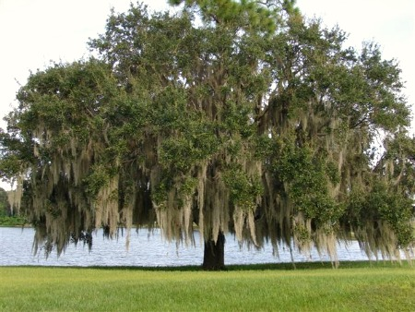
Types of Canopy Trees
Large Deciduous Shade Trees
Wide-spreading, tall deciduous trees are capable of shading a large area. Tall shade trees not only shade a yard, a patio, or a deck, but they also create an ecosystem for understory plants, such as dogwood trees (Cornus spp.), azaleas (Rhododendrons spp.) and other plants that grow in shade or partial shade.
Oaks (Quercus spp.), maples (Acer spp.), elms (Ulmus spp.) and ash trees (Fraxinus spp.) are among tall-growing deciduous species that impact the environment and local ecosystem. Considerations to take into account before planting large deciduous trees include lawn maintenance from leaf drop in autumn and sticks and limbs on the yard following storms. While leaf drop creates an annual lawn maintenance issue, leaf drop is an advantage, as it allows warming from the winter sun.

Slide 9
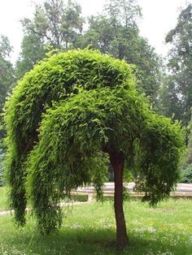
Types of Canopy Trees
Small Deciduous Shade Trees
Small deciduous trees often have ornamental value that goes beyond the shade provided by the tree canopy. The late-winter-blooming Acacia smallii grows in U.S. Department of Agriculture plant hardiness zones 8 through 10, blooming with clusters of puffy yellow, fragrant flowers. Japanese maple (Acer palmate) is a wide-spreading tree with green or red foliage, and golden chain tree (Laburnum spp.) grows to a height of 25 feet with an equal spread.
Both Acer palmate and Laburnum grow in United State Department of Agriculture plant hardiness zones 6 through 8. Crape myrtles (Lagerstroemia spp.) cast filtered shade, but are planted primarily for their ornamental features of bark and summer-blooming flower clusters in shades of purple, red, pink, lavender and white where they grow in USDA plant hardiness zones 7 through 10.

Slide 10
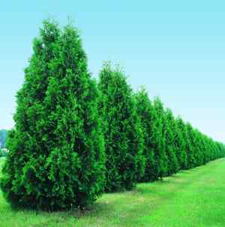
Types of Canopy Trees
Evergreens
Pine trees (Pines spp.) are needled evergreens often grown for their canopies. Foxtail pine(P. balfouriana) grows to 50 feet tall and 25 feet wide in California's USDA zones 5 through 8. Big-cone pine (P. coulter) reaches 80 feet tall with a spread of 25 to 30 feet in California and Baja California USDA plant hardiness zones 8 through 9.
Holly trees (Ilex spp.) can reach heights of 70 feet, such as Ilex aguifolium, which grows in USDA plant hardiness zones 7 through 9 where it tolerates pollution and thrives in coastal conditions. Evergreen canopy trees create maintenance issues, with pine cones or prickly holly leaves, but cleanup is generally less than the clean =up from deciduous trees.

Slide 11
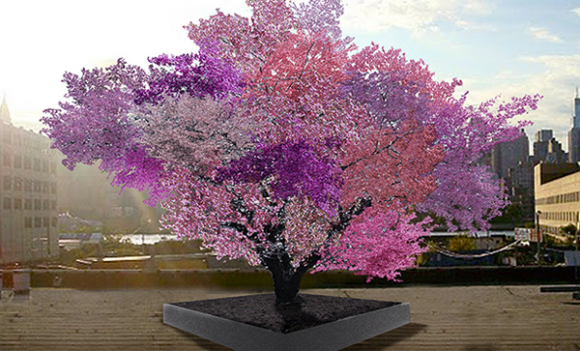
Types of Canopy Trees
Flowering Fruit Trees
Many fruit trees develop significant canopies, providing shade and blossoming branches. Flowering crabapple (Mauls spp.) blooms in spring with white or pink blossoms followed by clusters of small ovoid fruit. Leaves of crabapple are green, which can tolerate partial shade, or purple, which colors best in full sun. Grow crabapples as canopy trees in USDA plant hardiness zones 5 through 8.
Ornamental cherries, peaches and plums (Prunes spp.) are grown as evergreens or deciduous trees for shade and spring blossoms. Carolina laurel cherry (P. Carolinian) is a 25-foot evergreen tree that grows in USDA plant hardiness zones 7 through 10a. Glossy green leaves make a backdrop for 1-inch spikes of white flowers from mid-winter until spring.

Slide 12
Canopy layer of Forests
Dominant and co-dominant canopy trees form the uneven canopy layer. Canopy trees are able to photosynthesize relatively rapidly due to abundant light, so it supports the majority of primary productivity in forests. The canopy layer provides protection from strong winds and storms, while also intercepting sunlight and precipitation, leading to a relatively sparsely vegetated understory layer.
Forest canopies are home to unique flora and fauna not found in other layers of forests.
Forest canopies are home to unique flora and fauna not found in other layers of forests.
Many rainforest animals have evolved to live solely in the canopy, and never touch the ground.

Slide 13
Canopy walkway
Canopy walkways - also called canopy walks, treetop walks or treetop walkways

Slide 14
Canopy Walkways: Detailed
Canopy walkways - also called canopy walks, treetop walks or treetop walkways - provide pedestrian access to the forest canopy.
Early walkways consisted of bridges between trees in the canopy of a forest; mostly linked up with platforms inside or around the trees. They were originally intended as access to the upper regions of ancient forests for scientists conducting canopy research.
Eventually, because they provided only limited, one-dimensional access to the trees, they were abandoned for canopy cranes.
Today they serve as ecotourism attractions in places such as Dhlinza Forest, KwaZulu-Natal, South Africa, Taman Negara National Park, Malaysia, Sedim River, Kulim and Kakum National Park, Ghana.

Slide 15
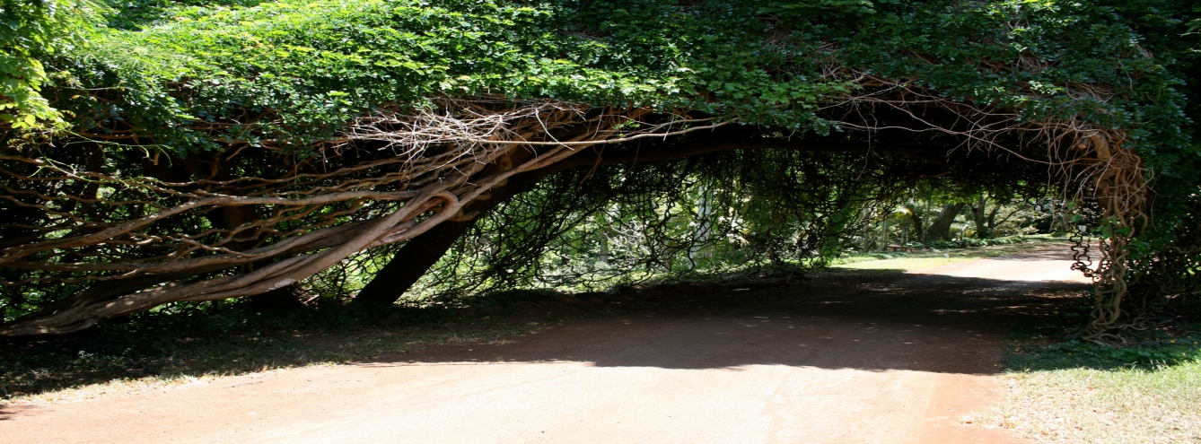
Rainforest Structures
In the rainforest most plant and animal life is not found on the forest floor, but in the leafy world known as the canopy. The canopy, which may be over 100 feet (30 m) above the ground, is made up of the overlapping branches and leaves of rainforest trees. Scientists estimate that 60-90 percent of life in the rainforest is found in the trees, making this the richest habitat for plant and animal life. Many well-known animals including monkeys, frogs, lizards, birds, snakes, sloths, and small cats are found in the canopy.

Slide 16
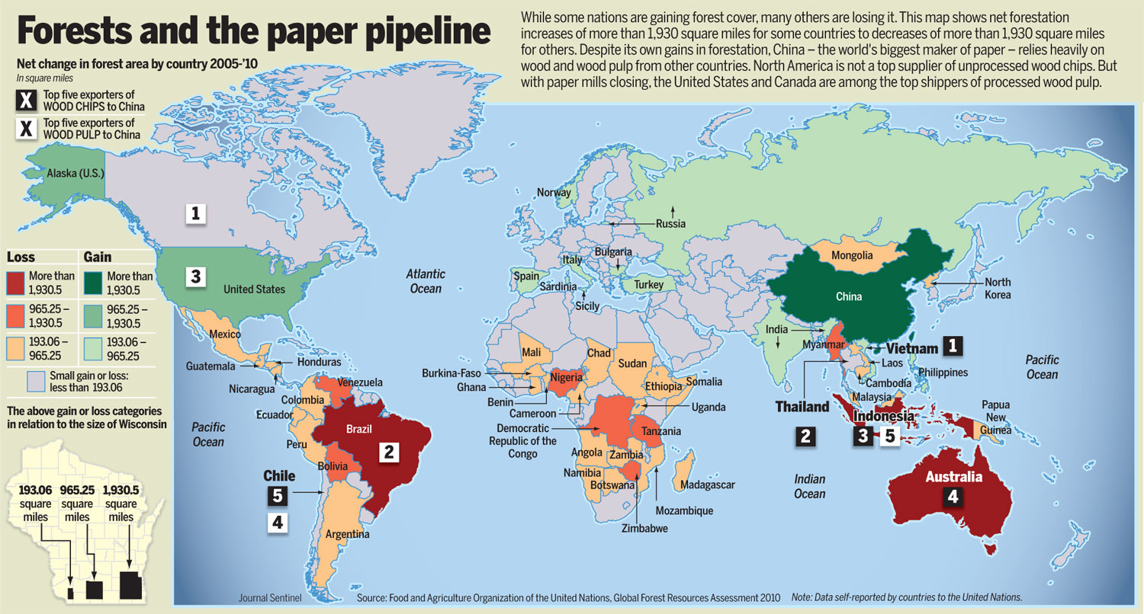
Canopy Forest Spread Worldwide

Slide 17
Reference
NCERT books
Wikipedia
Animal Kingdom
PlantsKnowledge.com
Canopy Structures by Danise
Internet

