Slide 1
Spiders and Insects
A Lesson for Kindergarten

Slide 2
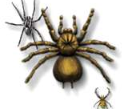
Spiders
Spiders have two body parts, the head and the abdomen.
Spiders do not have antennae.

Slide 3
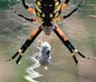
Spiders are not Insects
Although they are small, spiders are not insects.
Most insects fly, and spiders can’t.

Slide 4
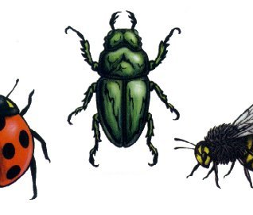
Insects
There are many different kinds of insects.

Slide 5
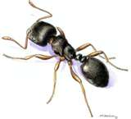
Ants
Ants are one of the most common insects.

Slide 6
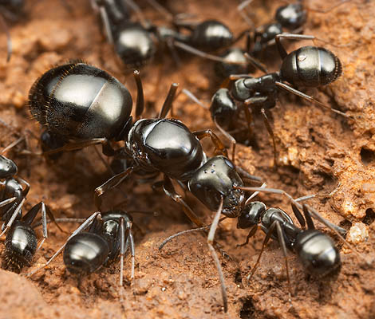
Ants are insects
Insects have three body parts and six legs.
Most insects do have antennae.

Slide 7
This powerpoint was kindly donated to
www.worldofteaching.com
http://www.worldofteaching.com
Is home to well over a thousand powerpoints submitted by teachers. This a free site. Please visit and I hope it will help in your teaching

