Slide 1
Geometry in Nature

Slide 2
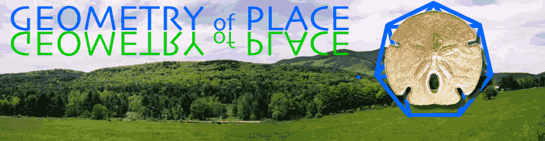
Geometry is a Greek word meaning earth measure.

Slide 3
Symmetry-a rotation or slide of a figure that leaves it unchanged although its position may be altered
Shapes-Many geometric shapes are found in nature
-
Proportion- a relationship between quantities such that is one varies the other varies in a manner dependant on the first
LOOK FOR:
Parallel Lines – same distance apart
Repeating patterns- some are the same size (congruent) and some are simply repeating patterns

Slide 4
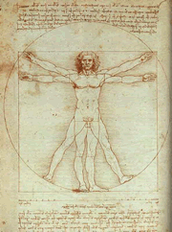
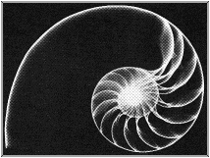
Geometry in Nature is Everywhere
.
Proportions of the human body
.
In the shape of a shell
.

Slide 5
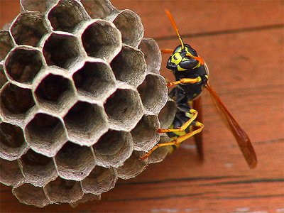
The bees make their hives into regular hexagons

Slide 6

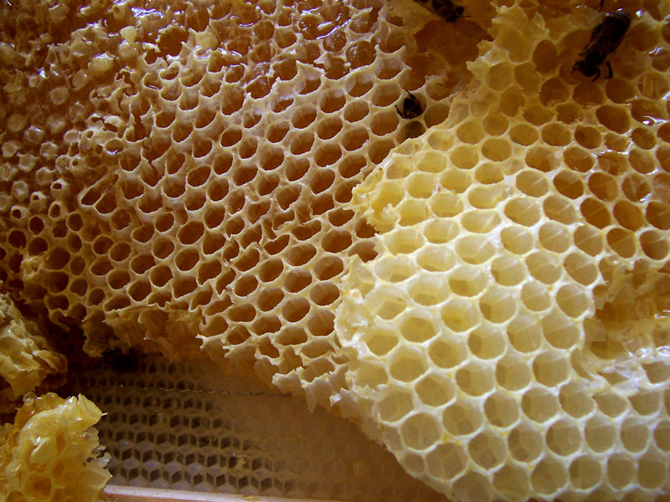
Honeycomb

Slide 7
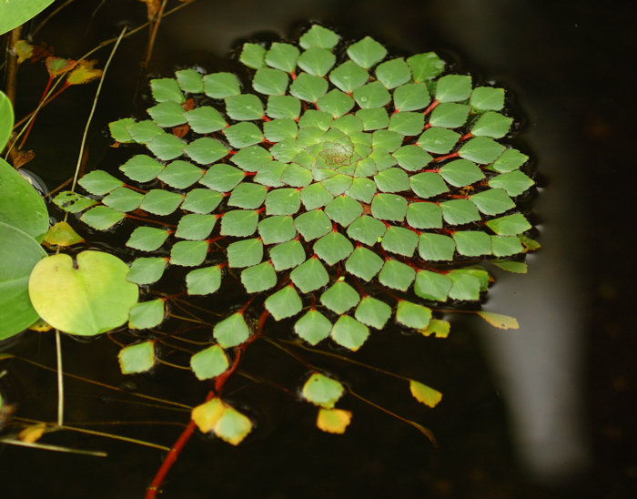
The following slides are some more examples of geometry in nature

Slide 8
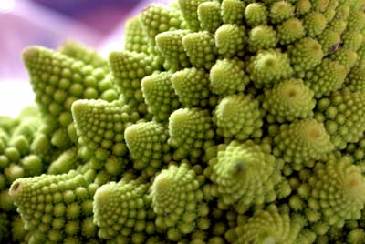

Slide 9
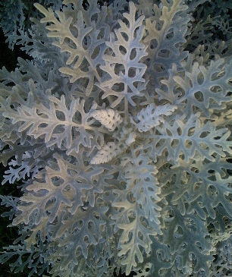

Slide 10
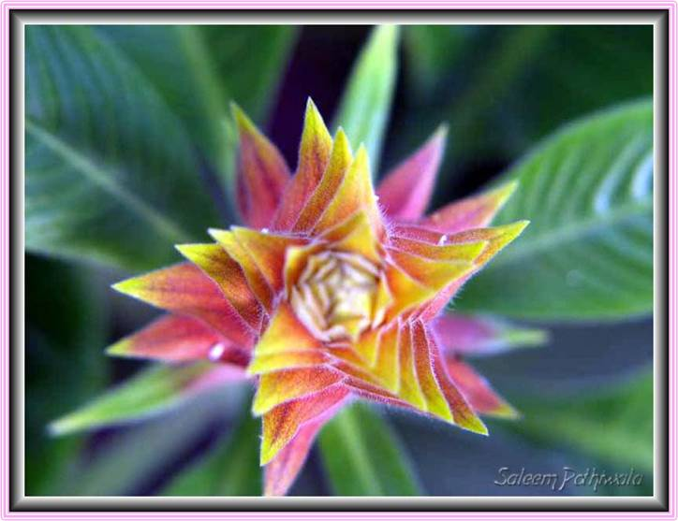
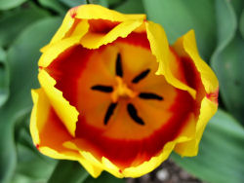
These flowers
illustrates
perfect symmetry
found in many of
natures plants.

Slide 11
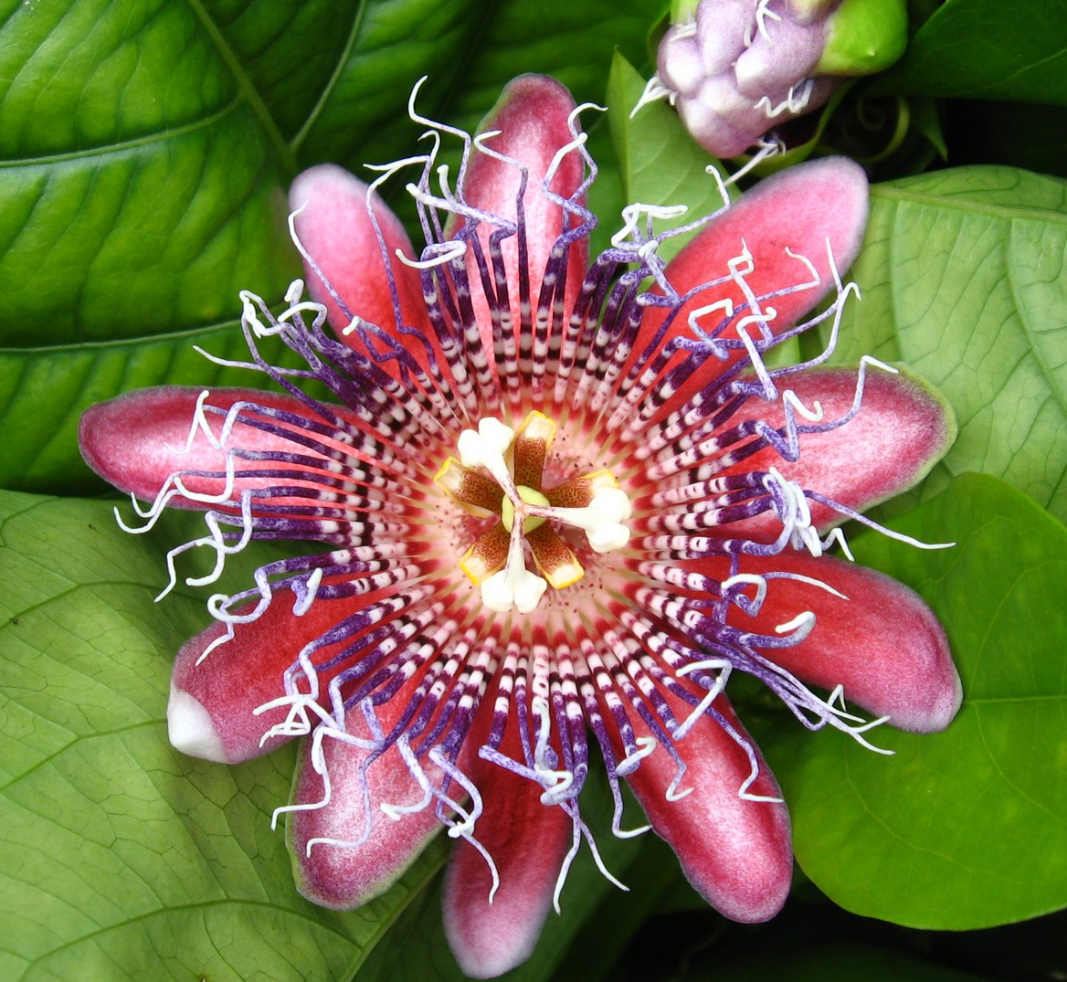
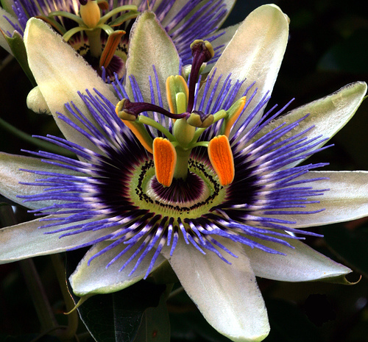
Passionfruit Flower

Slide 12
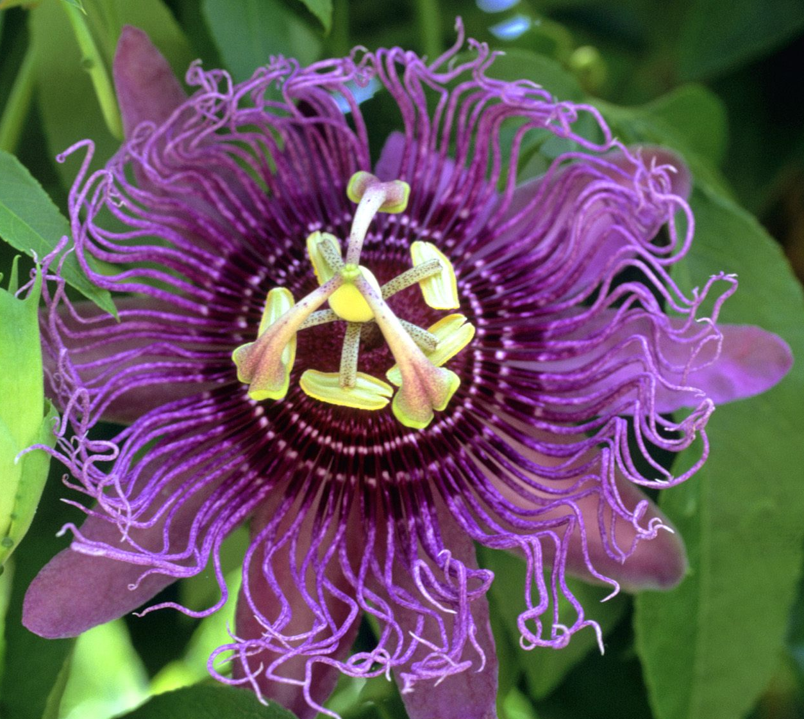
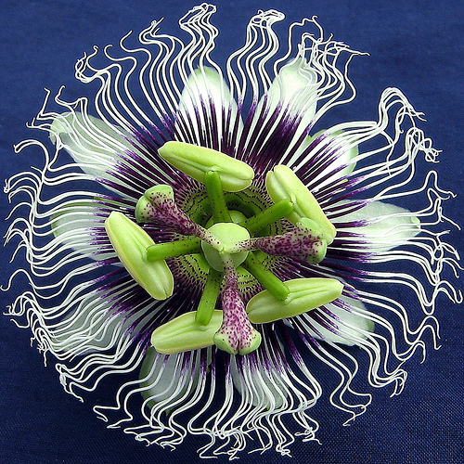
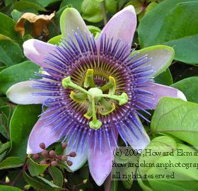
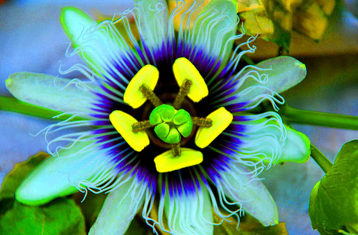

Slide 13
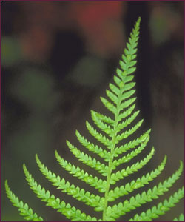
Symmetry in Leaves

Slide 14
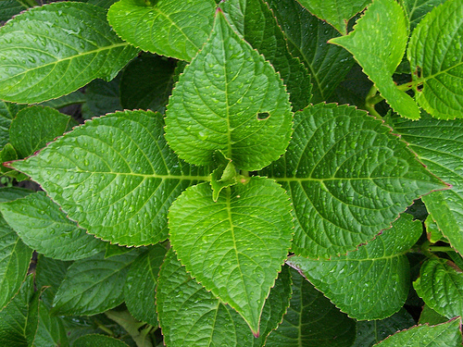
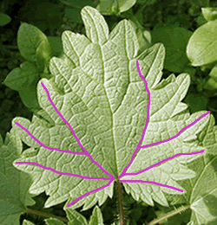
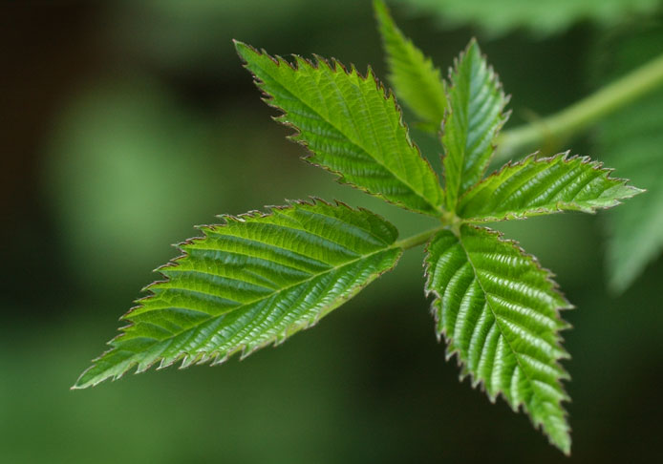

Slide 15
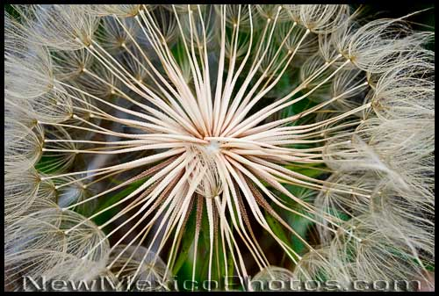
A salsify seed head displays Mother Nature's magnificent grasp of geometry.

Slide 16
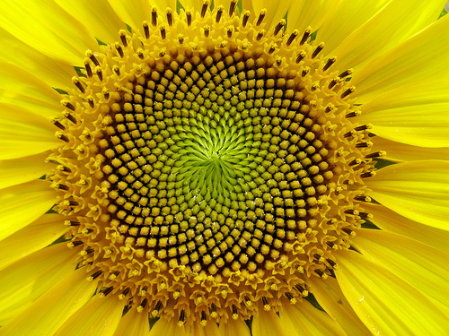

Slide 17
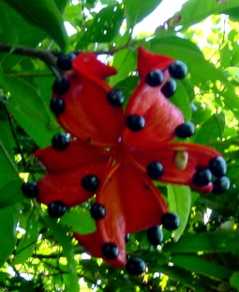
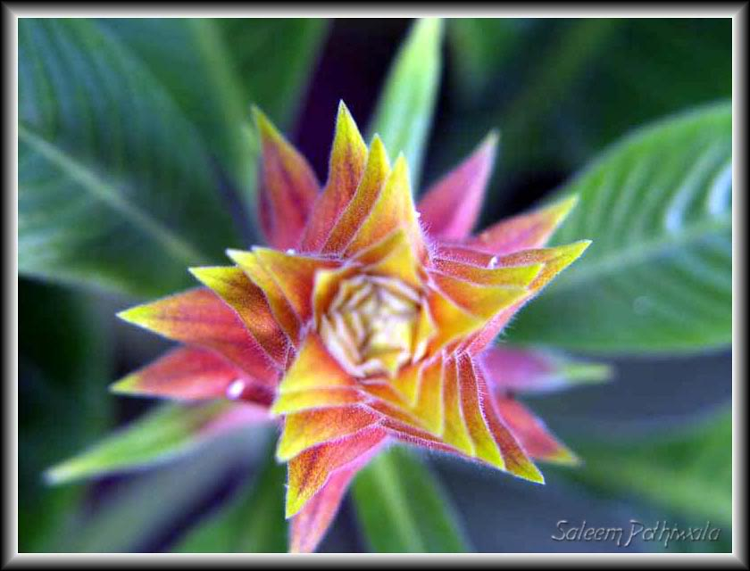

Slide 18

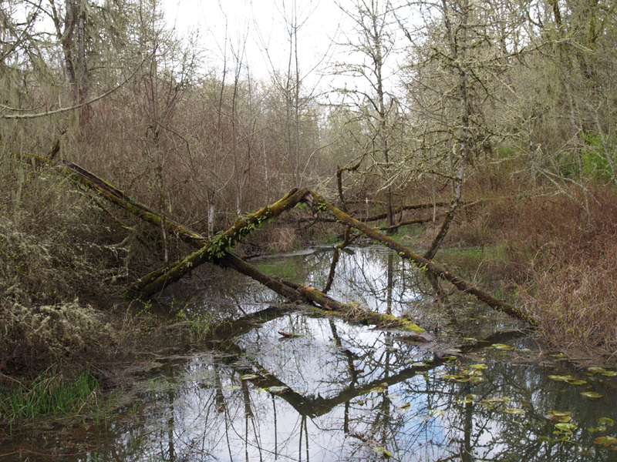
Mt. Pisgah - March 2006

Slide 19
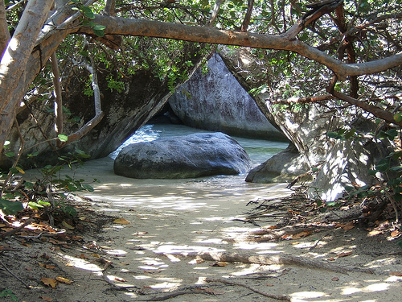

Slide 20
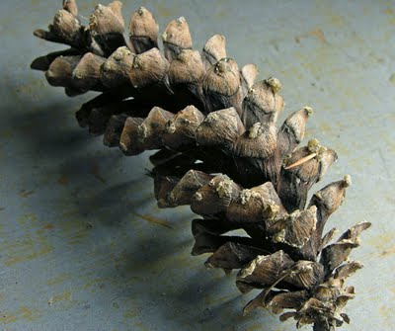
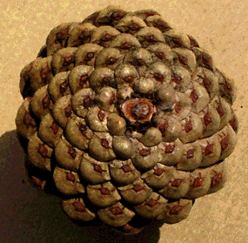
PINECONE

Slide 21

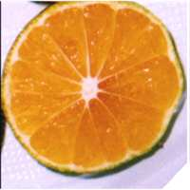
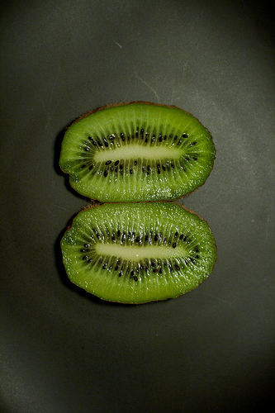
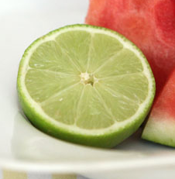
See the symmetry in each slice of fruit.

Slide 22
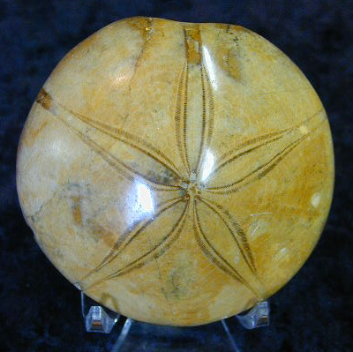
Fossil Sanddollar
This beautiful fossil sanddollar from Madagascar has incredible detail. The original shell consisted of small, thin, interlocking calcareous plates that have completely turned to stone. This fossil shows the 5 point "flower" symmetry common to the animal in the echinodermato phylum. This sanddollar is slightly less than 3" in diameter and protrudes 1" at its center high point.

Slide 23
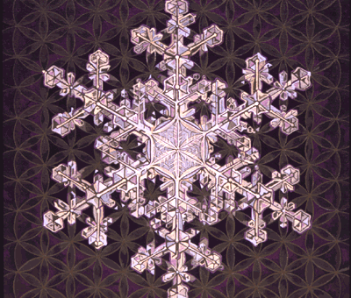
snowflake

Slide 24
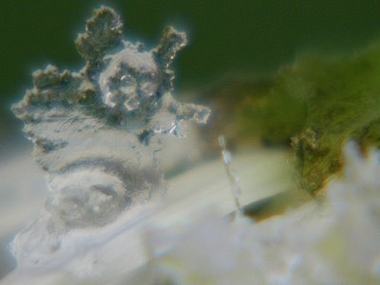
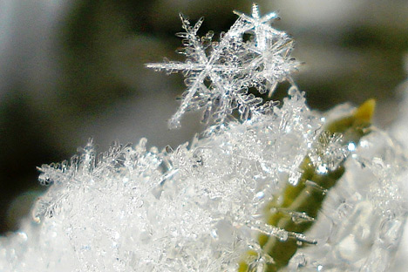
Ghost of a melting snowflake

Slide 25
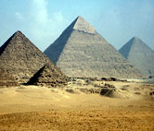
Pyramids
Twenty years were spent in erecting the pyramid itself: of this, which is square, each face is eight plethra, and the height is the same; it is composed of polished stones, and jointed with the greatest exactness; none of the stones are less than thirty feet." -Heroditus, Chap. II, para. 124.
A plethra is a measurement used in Ancient times, equal to 100 Greek feet
Notes:
A plethra is a measurement used in Ancient times equal to 100 Greek feet.

Slide 26
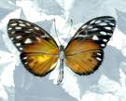


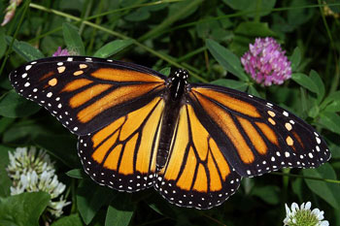
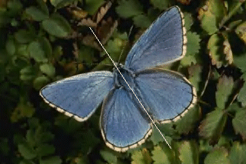
See the symmetry in the wings of the butterflies.

Slide 27
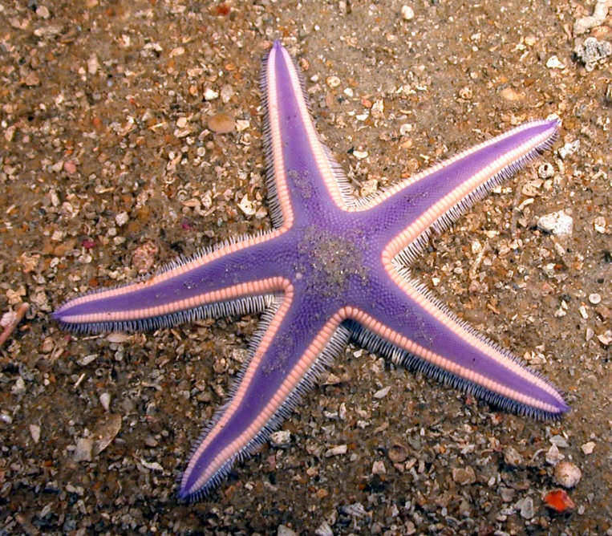
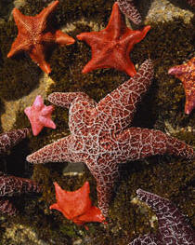
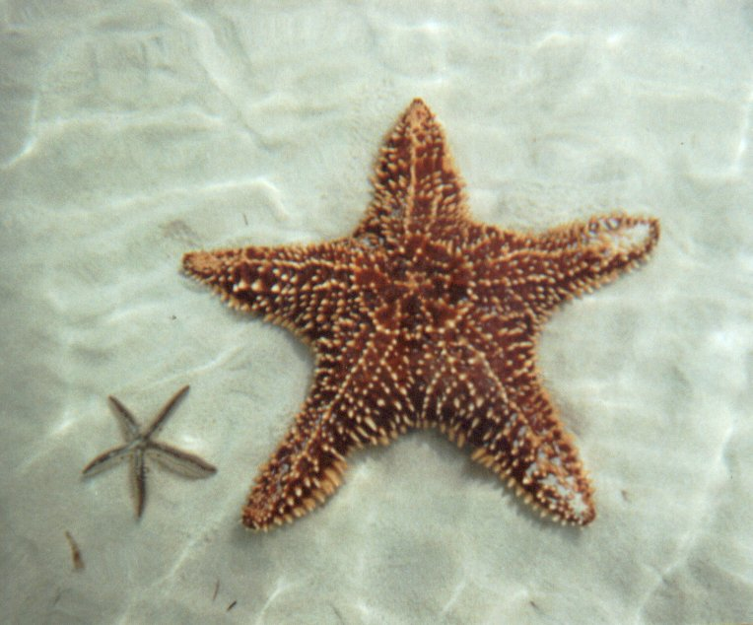
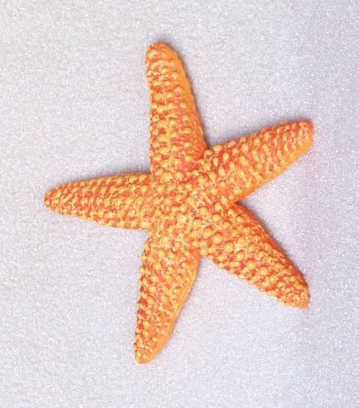
Starfish

Slide 28
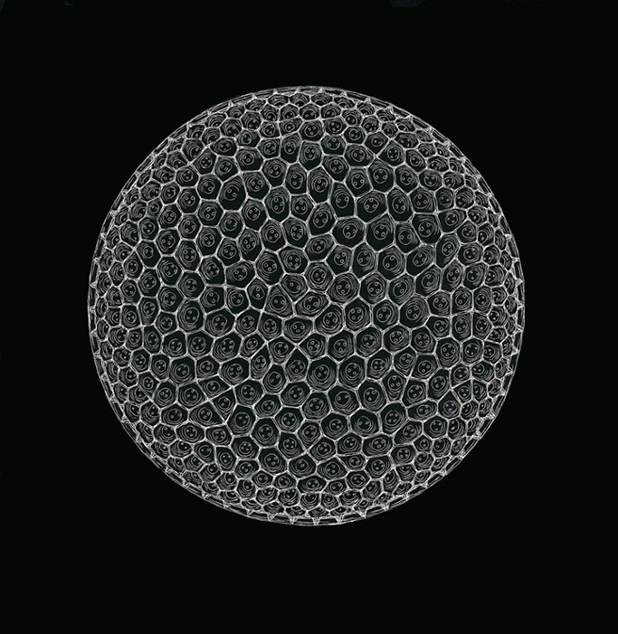
The holes in radiolarian and diatom shells respectively exist for differing reasons. Both types of skeleton are formed from silicon compounds.
In diatoms, the holes collectively take on the role of a sieve, a two-way filtration mechanism across which water and nutrient molecules permeate the cell.

Slide 29

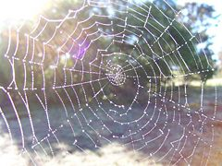
Just think about a spider's web. That is a complicated geometric design. And it is created, usually, in a perfect manner. Even though I majored in Drawing and Painting in college, and even though I am a Graphic Artist at work, I could not draw a design that perfectly, freehand. Yet a spider, using only his body, continually creates geometrically complex advanced shapes that few, if any, human adults could perfectly duplicate, without the aid of machines, or tools such as a pencil and ruler...and even with a pencil and ruler, it would be very complicated, and possibly even impossible, for most people to exactly duplicate.
(by Jeff Jenkins)

Slide 30

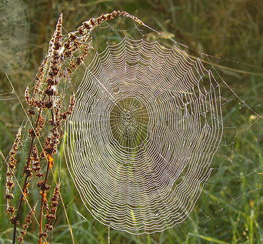
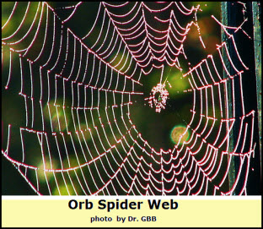
What geometric aspects do you see in each spider web?

Slide 31
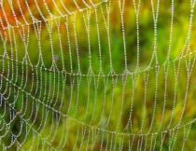
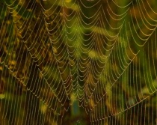

Slide 32
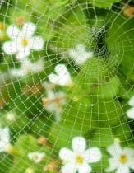


Slide 33
You can find geometry in many more things in nature. Look around and see what you can find. You will be amazed!

