Slide 1
Food Webs
Food Webs are Food Chains that intersect each other. Food webs are what really happens in nature.

Slide 2


All Food Chains and Webs start with the sun. The sun is the source of all the energy on the earth.

Slide 3

Plants are producers. They turn energy from the sun into sugars that animals can use.

Slide 4
Insects and other animals eat plants for energy. They are primary consumers. They are herbivores.

Slide 5

Secondary consumers are animals that eat other animals for energy. They are called carnivores.

Slide 6
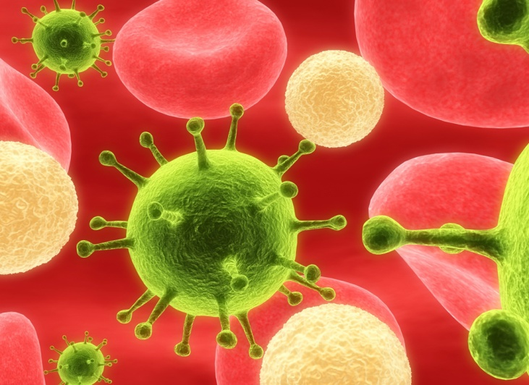
Decomposers are organisms that eat dead things for energy.

Slide 7

Summary
Combined food chains make food webs.
Food webs start with the sun
Food webs contain producers, consumers, and decomposers.
We are part of the food web, too!

Slide 8
This powerpoint was kindly donated to
www.worldofteaching.com
http://www.worldofteaching.com
Is home to well over a thousand powerpoints submitted by teachers. This a free site. Please visit and I hope it will help in your teaching

