Slide 1

FIVE KINGDOM CLASSIFICATION
THE COMPLETE WAY OF LEARNING ANIMAL CASSIFICATION

Slide 2
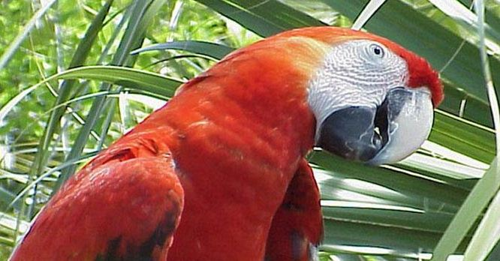
Five kingdom classification
1.Kingdom Monera
2.Kingdom Protista
3.Kingdom Fungi
4.Kingdom Plantae
5.Kingdom Animals
(Click on the Kingdom name)

Slide 3
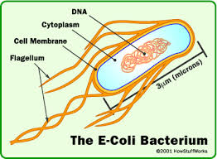
1.Kingdom monera
Unicellular and Prokaryotic.
True nucleus is absent.
Monerans are mainly Bacterias.
Mostly have a rigid cell wall.
Microscopic organisms.
Have various modes of nutrition,could be Autotropic(make their own food)
or Hetetopic(depending on other organisms for food)
Have two Major groups-
1. Eubacteria(true bacteria).It includes bacteria and cynobacteia
2.Archaebacteria (ancient bacteria)
Examples- E.coli
Go to homepage-

Slide 4
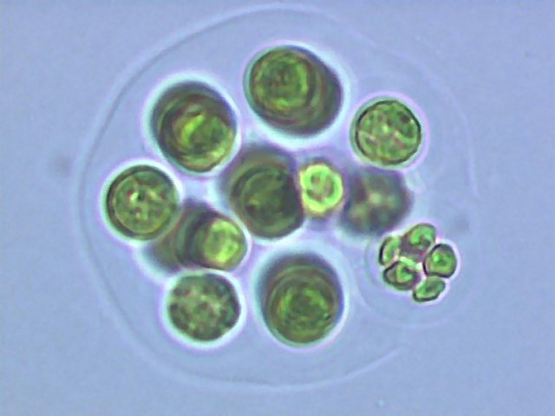
2.Kingdom Protista
Unicellular and Eukaryotic.
True nucleus is Present.
Protista are mainly Protozoans.
Microscopic organisms.
Have various modes of nutrition,could be Autotropic(make their own food)
or Hetetopic(depending on other organisms for food)
Examples – Diatoms and amoeba
Go to homepage-

Slide 5
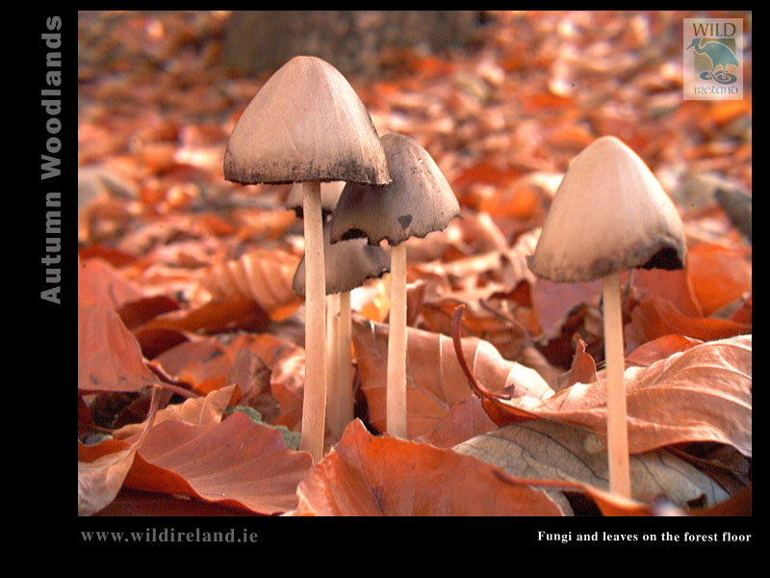
3.Kingdom Fungi
Mainly have Multicellular body with the exception of yeast which is unicellular fungi.
True nucleus is Present.
Their cell wall is made up of chitin ( a tough complex sugar ).
Their body is in the form of interwoven mass of fine thread like structures called Mycelium (a bunch of fine thread structures are called Mycelium)
The particular or individual thread structure is called Hyphae.
They have saprophytic nutrition i.e. live on the dead and decaying matter. Hence they are also called Saprophytes.
Examples- Yeast , Penicillium
Go to homepage-

Slide 6
4.Kingdom Plantae
They are Eukaryotic and Multicellular.
They have an additional covering on plasma membrane called Cell membrane.
Their cell wall is made up of cellulose.
They are autotrophs.
Include Major groups-
Thallophyta
Bryophyta
Pteridophyta
Gymnosperms
Angiosperms
Next--

Slide 7


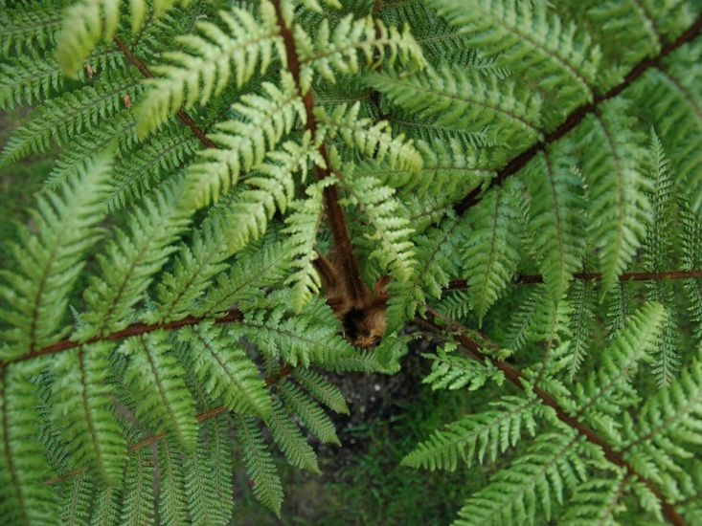
Kingdom Plantae
They are classified in 5 groups-
THALLOPHYTA
BRYOPHYTA
PTERIDOPHYTA
ANGIOSPERMS
GYMNOSPERMS

Slide 8
Thallophyta
Thallus-undifferentiated; phyta- plant
Their body is not differentiated (means not divided in stems, roots and leaves.
The undifferentiated body is called Thallus.
Their vascular system (means there is no xylem and phloem )is absent.
There is no embryo formation.
The plants in this group are mainly Algae.

Slide 9
Algae
You must have noticed a green scum in a pond , stagnant water (means water which has been stored for a long time) or on moist walls . These are generally Algae.
They are green Thallophytes containing chlorophyll. In many algae this green color is hidden by some other pigment. Thus there may be blue –green, brown , red or even purple algae.
Algae are autotrophic because they can make their own food with the help of chlorophyll.
Their cell wall is made up of Cellulose.
They are mainly aquatic.
Some forms of algae grow on the bark of trees, on the rocks and on the surface of moist soil.
They may be unicellular or multicellular.
The multicellular forms are generally ribbon like.
EXAMPLES- CHLAMYDOMONAS (unicellular algae) , Ulothrix etc.

Slide 10
bryophyta
You must have noticed that after the rain , the moist soil and bark of trees are often covered with a green carpet which looks like algae but when you go near , you will observe that it consist of tiny green plants.
These are mosses . Bryophyta includes Mosses and liverworts.
Bryophytes are small multicellular plants. They are called the amphibians of plant kingdom.
Plant does not have true leaves and roots but may show root-like and leaves-like structure.
They have thin root like structures which are called Rhizoids.(Rhizoids join plant to ground)
Mosses are just about an inch long.
They have no conducting tissues like xylem and phloem.(know more from page no.25)
Bryophytes are found in damp shady places.
I know you are a bit confused about mosses and liverworts.

Slide 11
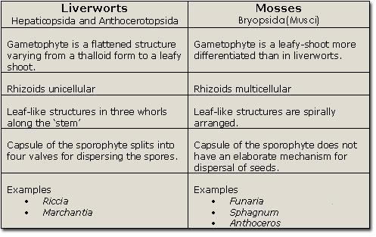
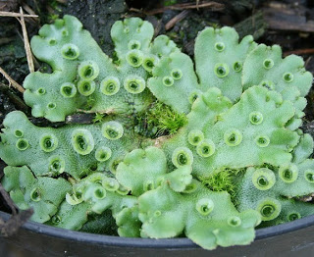
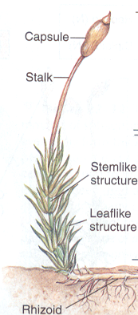
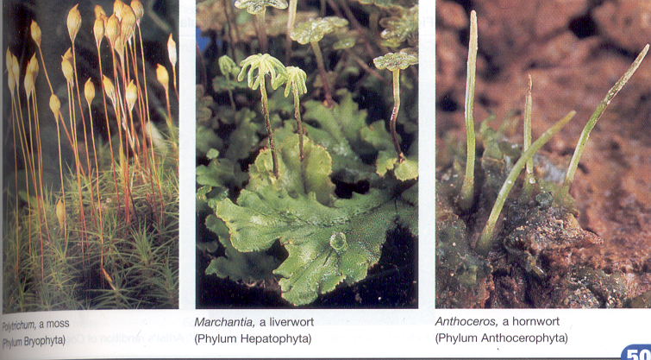

Slide 12
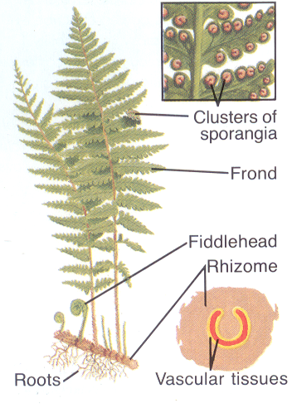
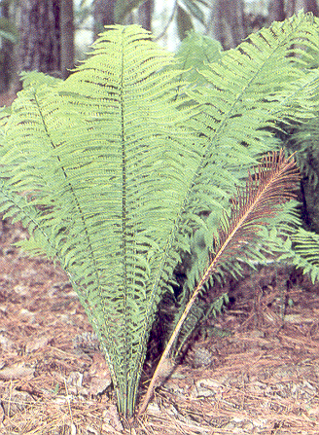
Pteridophyta
Pteridophyta includes Ferns.
They have pointed leaves.
They found in cool places like hill stations.
They are basically land plants.
The body is differentiated in stems , leaves and roots.
They have well developed tissue for conduction like xylem for water and phloem for food.
Ferns are used as Christmas trees.

Slide 13
Comparison of Thallophytes , Bryophytes , Pteridophytes
Thallophyta Bryophyta Pteridophyta
Plant body is thallus like.
No specialized system for conduction.
Includes algae.
Plant does not have true leaves and roots but may show root-like and leaves-like structure.
No specialized system for conduction.
Includes Mosses.
Plant have true roots and roots.
Have specialized system for conduction.
Includes Ferns.

Slide 14
gymnosperms
Gymnosperms includes plants in which seeds are not enclosed in the fruit.
They are known as lower flowering plants( means which do not bear too much flowers).
The seeds are not enclosed in fruits. Hence they are also called
naked-seeded plants.
Flowers are unisexual.
The plants are usually perennial , evergreen and woody.

Slide 15
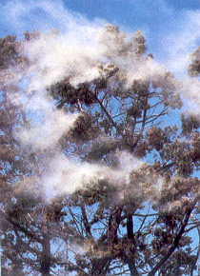
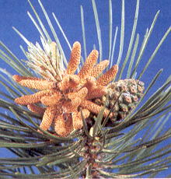
gymnosperms
Pollen
Seed Cone
Pollen Cone

Slide 16
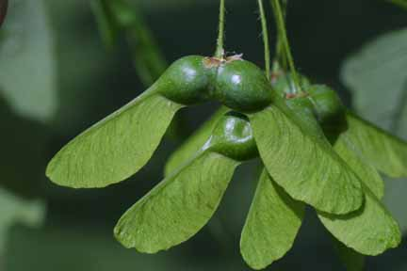
angiosperms
They are known as High flowering plants.
The seeds are enclosed in fruits. Hence they are also called
closed-seeded plants.
Seeds have structures which are called cotyledons. They store food for seed.
Cotyledons are also called seed leaves because in some cases hey emerge, become green when the seed germinates.
There are two major groups of angiosperms-
Monocotyledons
Dicotyledons
DICOTYLEDONS-They have two cotyledons. The flowers usually bear 5 or multiple of five petals.
MONOCOTYLEDONS-They have only 1 cotyledon. The flowers usually bear 3 or multiple of 3 petals.
Homepage
Maple seeds: Winged fruit

Slide 17
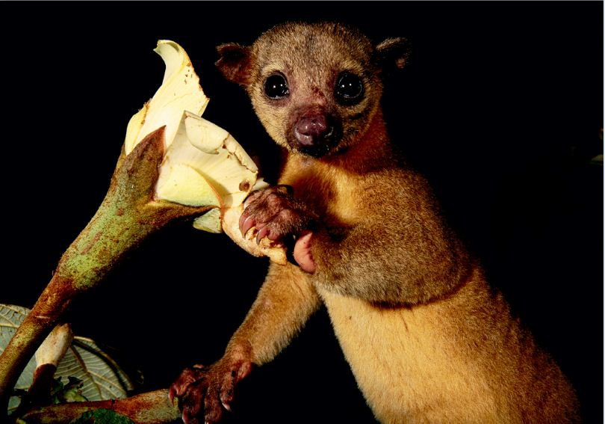
5.Kingdom Animalia
They are Eukaryotic and Multicellular.
They are Heterotrophs (means having heterotopic nutrition ).
Generally have locomotary organs.
This group contains all invertebrates and vertebrates.
Next page-

Slide 18
FIVE KINGDOM CLASSIFICATION
Organism
Prokaryotic Eukaryotic
KINGDOM MONERA
Unicellular Multicellular
KINGDOM PROTISTA
Cell wall Without cell wall
KINGDOM FUNGI KINGDOM PLANTAE
KINGDOM ANIMALIA

Slide 19

Quiz
What is meant by rhizoids?
Thallophyta have leaves? Yes or no?
What is meant by thallus?
Protozoans are unicellular or multicellular?
What is meant by eukaryotic and prokaryotic?

Slide 20
Created by-Mohit sahu
Contact him @-
generation6boy@gmail.com
Thanks

