Slide 1

Earthquake

Slide 2
Earthquake
An earthquake (also known as a quake, tremor or temblor) is the result of a sudden release of energy in the Earth's crust that creates seismic waves.
The seismicity, seismism or seismic activity of an area refers to the frequency, type and size of earthquakes experienced over a period of time.

Slide 3
Earthquakes are measured using observations from seismometers.
The moment magnitude is the most common scale on which earthquakes larger than approximately 5 are reported for the entire globe.
The more numerous earthquakes smaller than magnitude 5 reported by national seismological observatories are measured mostly on the local magnitude scale, also referred to as the Richter scale.
These two scales are numerically similar over their range of validity.

Slide 4
Magnitude 3 or lower earthquakes are mostly almost imperceptible or weak and magnitude 7 and over potentially cause serious damage over larger areas, depending on their depth.
The largest earthquakes in historic times have been of magnitude slightly over 9, although there is no limit to the possible magnitude.

Slide 5
The most recent large earthquake of magnitude 9.0 or larger was a 9.0 magnitude earthquake in Japan in 2011 (as of October 2012), and it was the largest Japanese earthquake since records began.
Intensity of shaking is measured on the modified Mercalli scale.
The shallower an earthquake, the more damage to structures it causes, all else being equal.

Slide 6
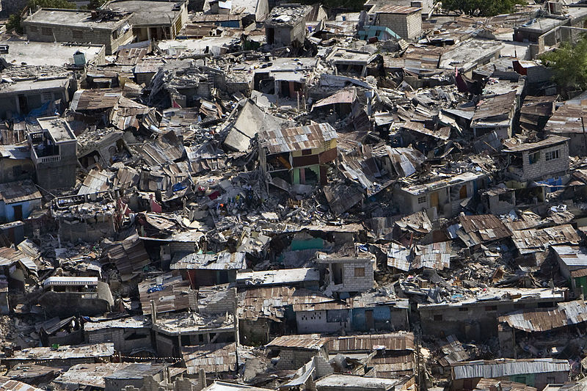

Slide 7
At the Earth's surface, earthquakes manifest themselves by shaking and sometimes displacement of the ground.
When the epicenter of a large earthquake is located offshore, the seabed may be displaced sufficiently to cause a tsunami.
Earthquakes can also trigger landslides, and occasionally volcanic activity.

Slide 8
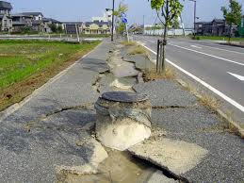

Slide 9
In its most general sense, the word earthquake is used to describe any seismic event — whether natural or caused by humans — that generates seismic waves.
Earthquakes are caused mostly by rupture of geological faults, but also by other events such as volcanic activity, landslides, mine blasts, and nuclear tests.
An earthquake's point of initial rupture is called its focus or hypocenter. The epicenter is the point at ground level directly above the hypocenter.

Slide 10
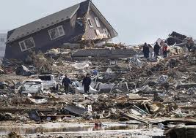

Slide 11
History
The ancient Chinese also used a device that looked like a jar with dragons on the top surrounded by frogs with their mouths open.
When an earthquake occurred, a ball fitted into each dragon's mouth would drop out of the dragon's mouth into the frog's. The position of the frog which received a ball indicated the direction of the earthquake.

Slide 12
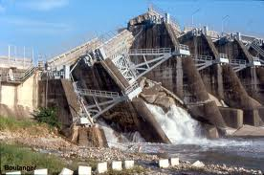

Slide 13
Causes of earthquakes
Earthquakes are caused by tectonic movements in the Earth's crust.
The main cause is that when tectonic plates collide, one rides over the other, causing orogeny (mountain building), earthquakes and volcanoes.

Slide 14
The boundaries between moving plates form the largest fault surfaces on Earth.
When they stick, relative motion between the plates leads to increasing stress.
This continues until the stress rises and breaks, suddenly allowing sliding over the locked portion of the fault, releasing the stored energy.

Slide 15
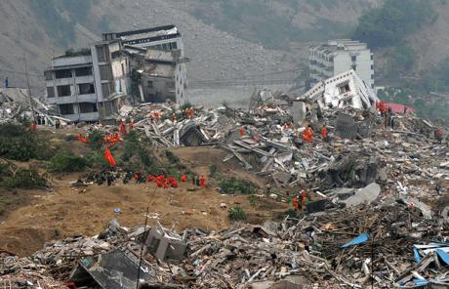

Slide 16
Earthquake clusters
Most earthquakes form part of a sequence, related to each other in terms of location and time.
Most earthquake clusters consist of small tremors which cause little to no damage, but there is a theory that earthquakes can recur in a regular pattern.

Slide 17
Earthquake fault types
There are three main types of fault that may cause an earthquake: normal, reverse (thrust) and strike-slip.
Normal faults occur mainly in areas where the crust is being extended. Reverse faults occur in areas where the crust is being shortened.
Strike-slip faults are steep structures where the two sides of the fault slip horizontally past each other.

Slide 18
Aftershocks
An aftershock is an earthquake that occurs after a previous earthquake, the mainshock.
An aftershock is in the same region of the main shock but always of a smaller magnitude.
Aftershocks are formed as the crust adjusts to the effects of the main shock.

Slide 19
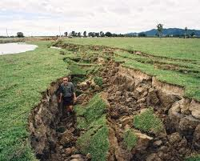

Slide 20
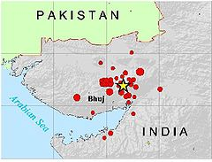
2001 Gujarat earthquake
Date | January 26, 2001
Magnitude | 7.7 M_{w}^{[1]}
Depth | 16 kilometres (10 mi)
Epicenter | Yellow star marks epicentre 23°25′08″N 70°13′55″E﻿ / ﻿23.419°N 70.232°E^{[2]}
Countries or regions | India, Pakistan
Max. intensity | X (Intense)
Casualties | 19,727 believed dead, 166,001 injured^{[3]}

Slide 21
The 2001 Gujarat earthquake occurred on January 26, 2001, India's 51st Republic Day, at 08:46 AM local time (3:16 UTC) and lasted for over two minutes.
The epicentre was about 9 km south-southwest of the village of Chobari in Bhachau Taluka of Kutch District of Gujarat, India.
The earthquake reached a magnitude of between 7.6 and 7.7 on the moment magnitude scale and had a maximum felt intensity of X (Intense) on the Mercalli intensity scale.
The quake killed around 20,000 people (including 18 in South eastern Pakistan), injured another 167,000 and destroyed nearly 400,000 homes.

Slide 22
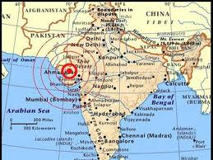

Slide 23
This was an intraplate earthquake, one that occurred at a distance from an active plate boundary, so the area was not well prepared.
The shock waves spread 700 km. 21 districts were affected and 600,000 people left homeless.

Slide 24
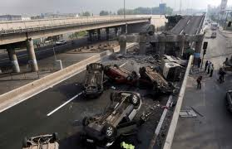

Slide 25
Relief poured in from all over the world and over a longer period of time, the affected area was re-equipped with all the basic facilities along with state-of-the-art upgrades.
The result being that Bhuj, along with several small towns and villages, is now complete with a better hospital, town and first-aid center.
Also, several guidelines and rules were put into place by the Gujarat government for real-estate and construction businesses in foresight of another such event

Slide 26
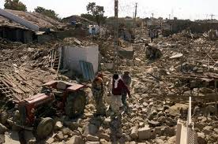

Slide 27
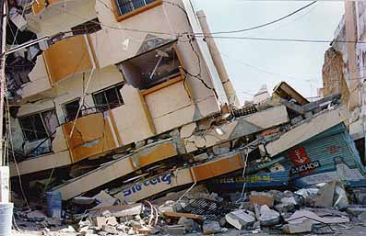

Slide 28
Thank you
By:
Lavanya Thammaiah .T.
Smart Class Co-ordinator
General Thimayya Public School
Madikeri.

