Slide 1
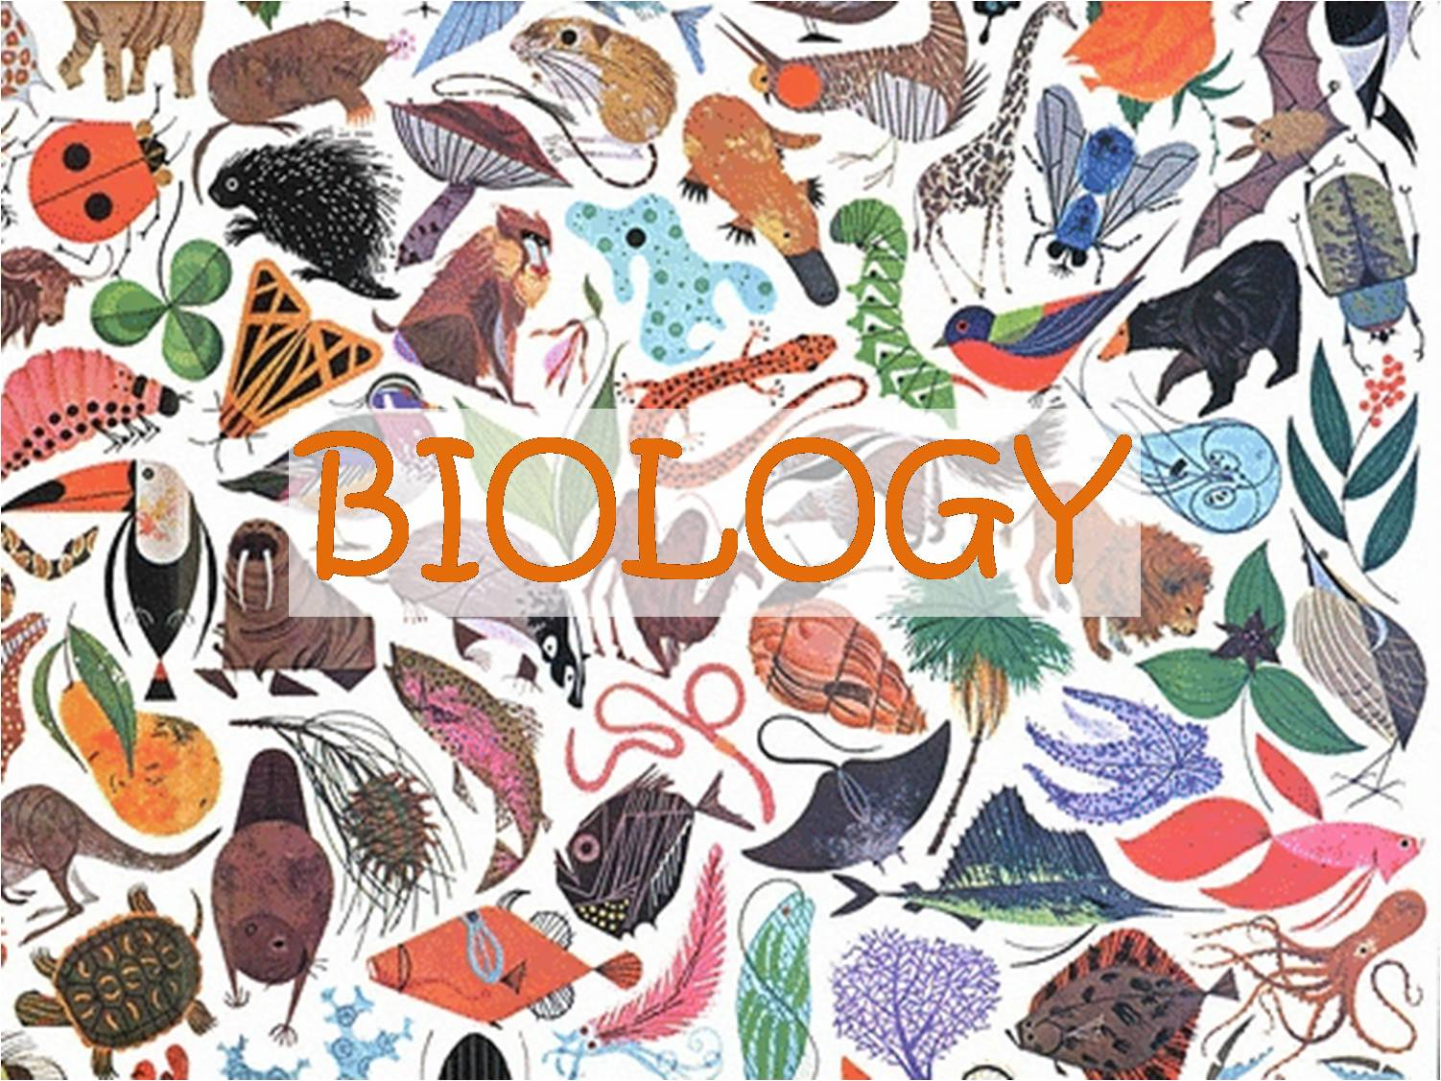
The Diversity of Life (Part 2)

Slide 2
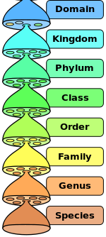
Domains
There are many different sizes of taxa
The biggest taxon is “domain”
There are 3 domains:
Bacteria
Archaea
Eukaryota
These are the biological taxa, with the biggest at the top

Slide 3
Bacteria
Bacteria are single-celled (each organism is only one cell)
They don’t have organelles
Some bacteria cause human diseases, but others help us
Bacteria can live in many places, including inside animals, like you!
This animation shows bacteria making copies of themselves

Slide 4
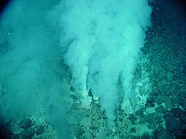
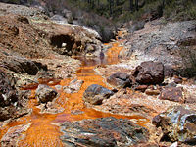
Archaea
Archaea are like bacteria in that they are single-celled and don’t have organelles
They can live in extreme places where, until recently, it was thought life cannot exist
Archaea can live in hot springs, underwater volcanoes, and sewage treatment plants
A lot is still being learned about Archaea
A new group of archaea was recently discovered in poisonous water from mines
Archaea can live in hydrothermal vents, which are parts of an underwater volcano

Slide 5
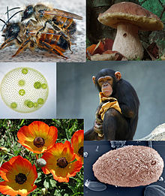
Eukaryota
Eukaryota cells have organelles and are bigger and more complex than bacteria or archaea
Eukaryota are the only group that can have more than one cell in one organism (multicellular), although some eukaryota are single-celled
Which domain are humans in?

Slide 6
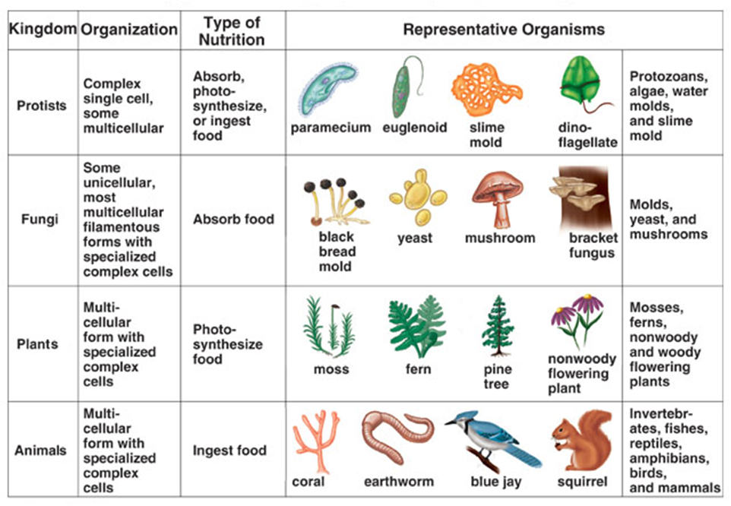
Domain Eukaryota’s 4 Kingdoms

Slide 7
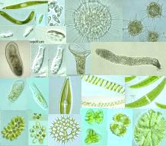
Protists: 1 of Eukaryota’s 4 Kingdoms
All protists are very small
Some protists are like plants and make food from sunlight, while others are more like animals and get their food from other living things

Slide 8
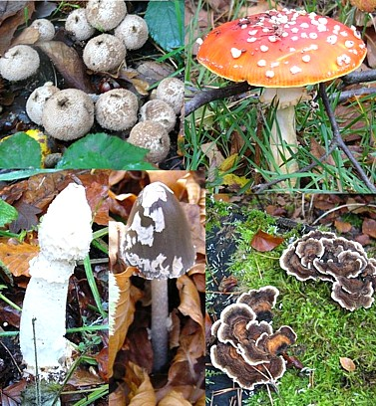
Fungi : 1 of Eukaryota’s 4 Kingdoms
Multicellular, except yeast
Fungi digest food outside their body and then absorb it
Besides Protists and Fungi, the other 2 Kingdoms are Plants and Animals

Slide 9
Species
“Species” is the smallest commonly used unit of biological classification
There are about 1.7 million known species of organisms
New species are still being found
About 70% of all known species are Arthropods, which is a phylum (a smaller group) within the animal kingdom

Slide 10
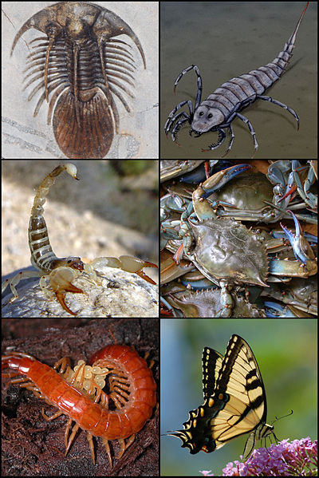
Arthropods
An arthropod is an animal with no backbone but with an hard shell on the outside
Insects, spiders, shrimp, crabs, and scorpions are arthropods

Slide 11
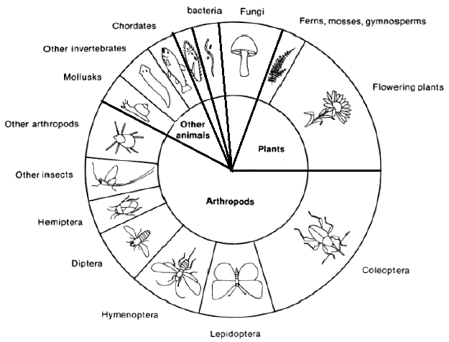
Known Species of Organisms
Protists

