Slide 1
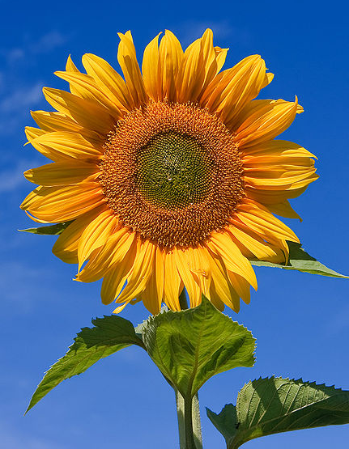
Botany
Botany is the study of plant life, including sunflowers

Slide 2
What is Botany?
Botany, also called plant science or plant biology, is the science of plant life and is part of biology
A scientist who studies plants can be called a ‘botanist’ or a ‘plant scientist’
“Botanical” is an adjective used to describe something related to botany
Botany began thousands of years ago as herbalism (the study and use of plants as medicine)

Slide 3
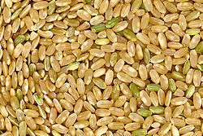
Why Study Plants?
Plants are used as food and give humans and other animals the energy they need to live
Plants also make many medicines and products for people
The more people know about plants, the better we can keep them and use them
The food we eat comes directly or indirectly from plants such as rice.

Slide 4
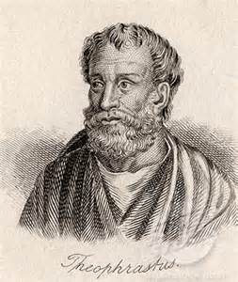
Early Botany
Examples of early botanical texts have been found in texts from India from before 1100 BC, and from China before 221 BC
The ancient Greeks started botany in Europe
The ancient Greek philosopher Theophrastus (371–287 BC) is sometimes called the "Father of Botany"

Slide 5
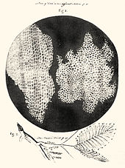
Discoveries
Many important biological discoveries started with plants. Here are two:
In 1665 Robert Hooke discovered the basic unit of living things, cells, in plants
In the 1800s Gregor Mendel did experiments with pea plants that showed how the characteristics of living things are passed from parents to children (genetics)
A drawing of cells by Hooke

Slide 6
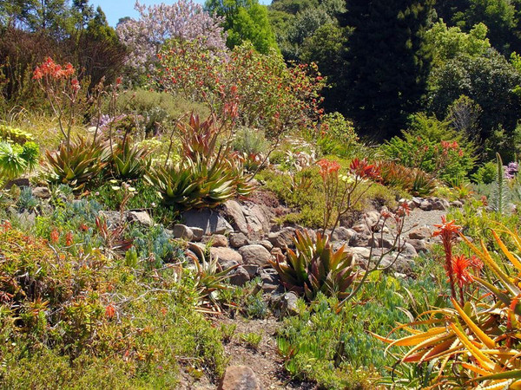
Botanical Gardens
A botanical garden is an area with many different plants used for research and education
European botanical gardens started as gardens for plants to be used as medicine
Today, most botanical gardens are open to the public
Some plants in the University of California botanical garden

Slide 7
What do I know about plants?
True or False
All plants do photosynthesis.
All plants need water and nutrients.
All plants make flowers.
All plants make seeds.
F
T
F
F

Slide 8
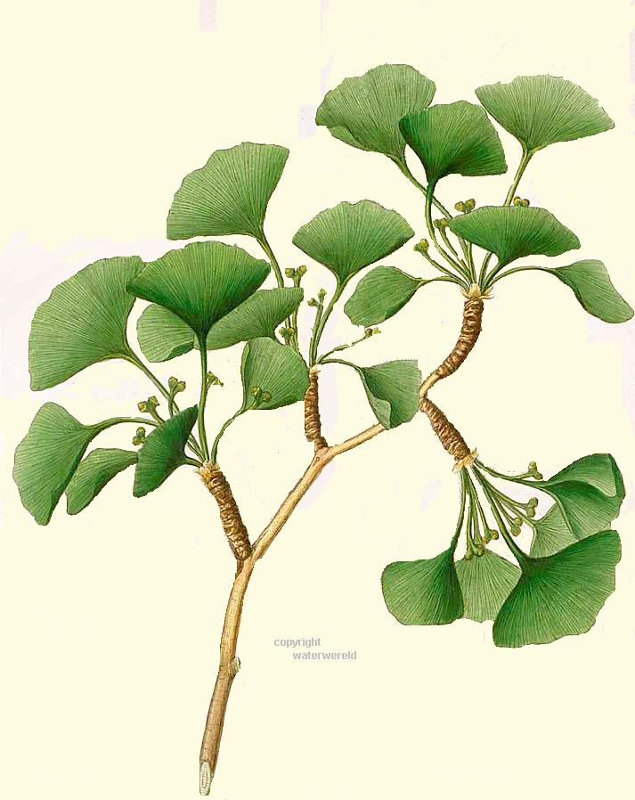
4 Main Groups of Plants
“Vascular” means that the plant has a transport system. “Transport” means tubes that can carry water and nutrients.
Nonvascular plants
– lack transport & seeds
Seedless vascular plants
– have transport, lack seeds
Gymnosperms (vascular)
- have seeds, but not in shells
Angiosperms (vascular)
- seeds in shells, flowers
Ginko trees have seeds but no flowers. What group does it belong to?

Slide 9
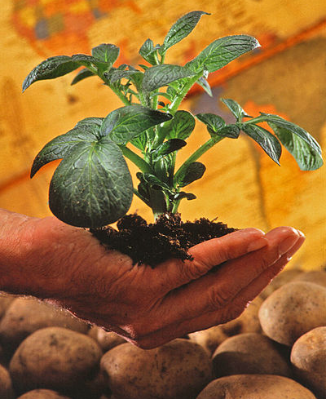
Botany Today
Modern botany is a big subject with many different areas of research
Botanical research is useful in providing foods, chemicals, energy, medicine, and materials for construction
Potato plant. Potatoes spread to the rest of the world after European contact with the Americas and have since become an important food source.

