Slide 1
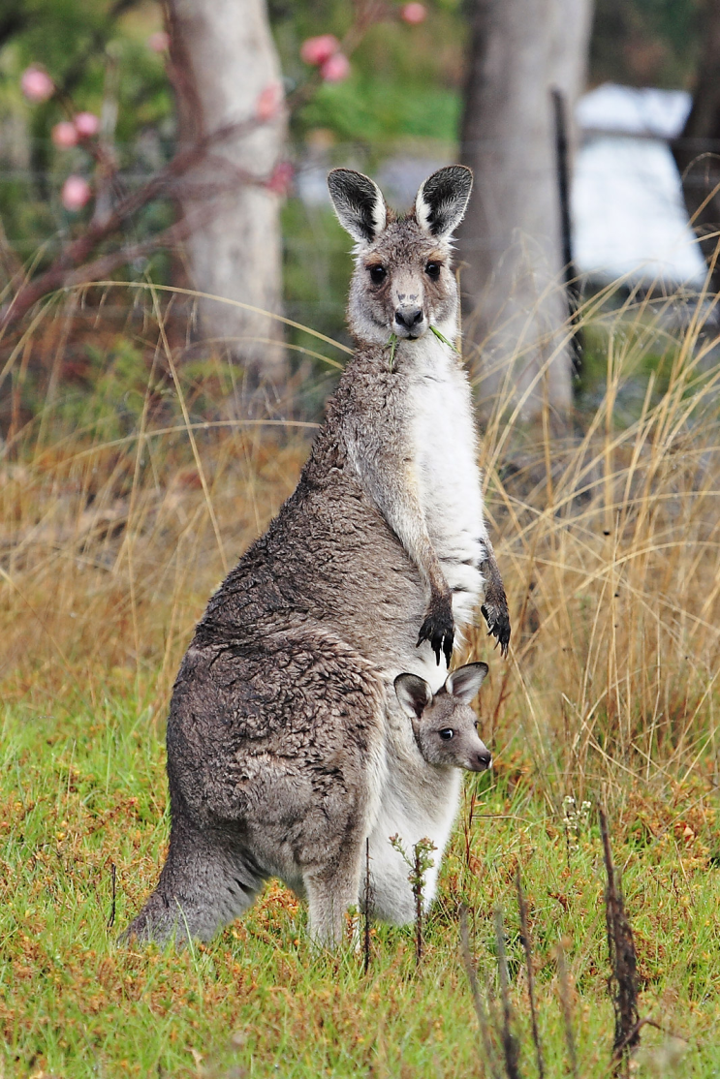
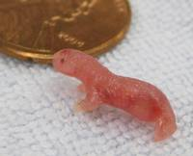
Marsupials
Babies are born alive but not fully developed.
The baby crawls into the pouch to drink milk and grow until more developed.

Slide 2
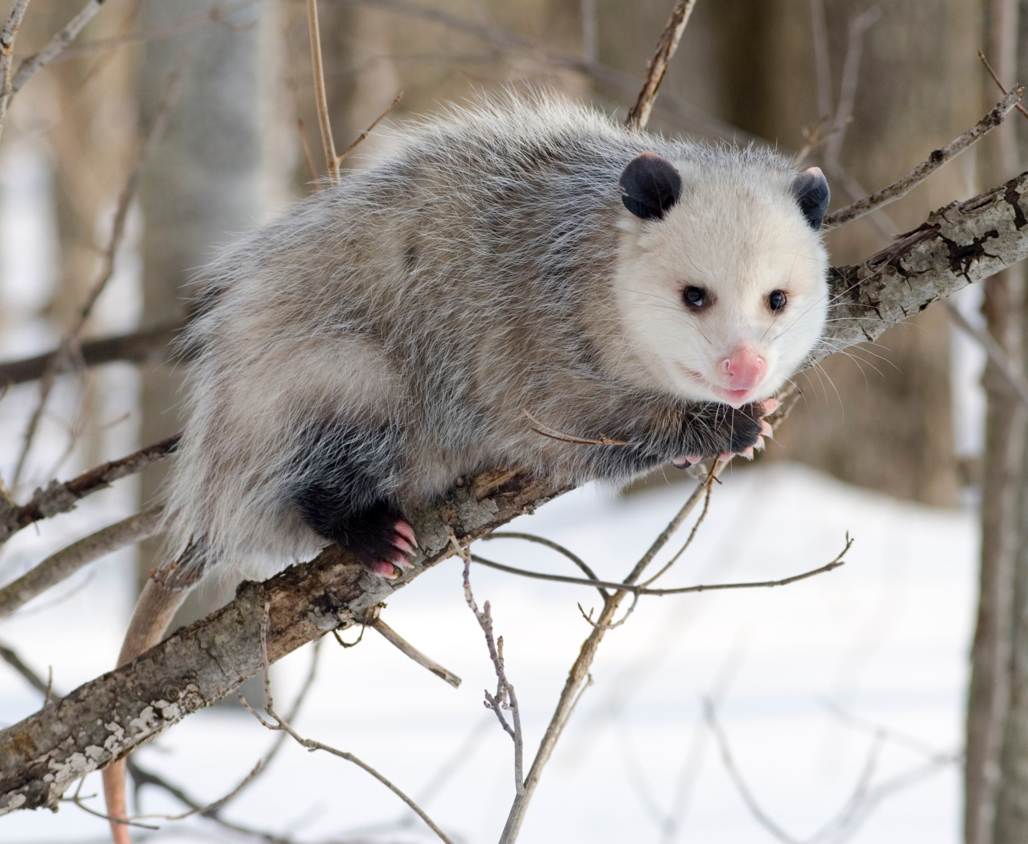
Marsupials

Slide 3
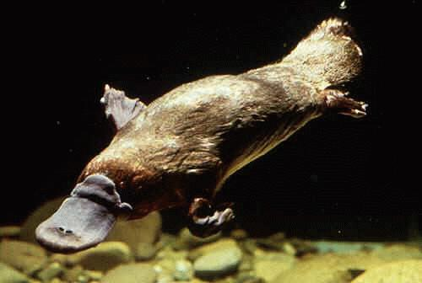
Monotremes
AKA…FREAKS OF NATURE!!!

Slide 4
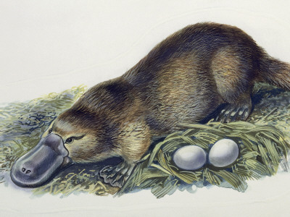
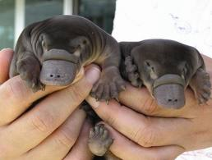
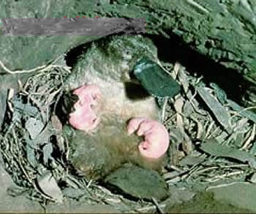
Monotremes
2) Eggs hatch and young drink milk that comes out of pores…
1) Lay Eggs
3) Young are raised by the mother

Slide 5
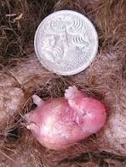
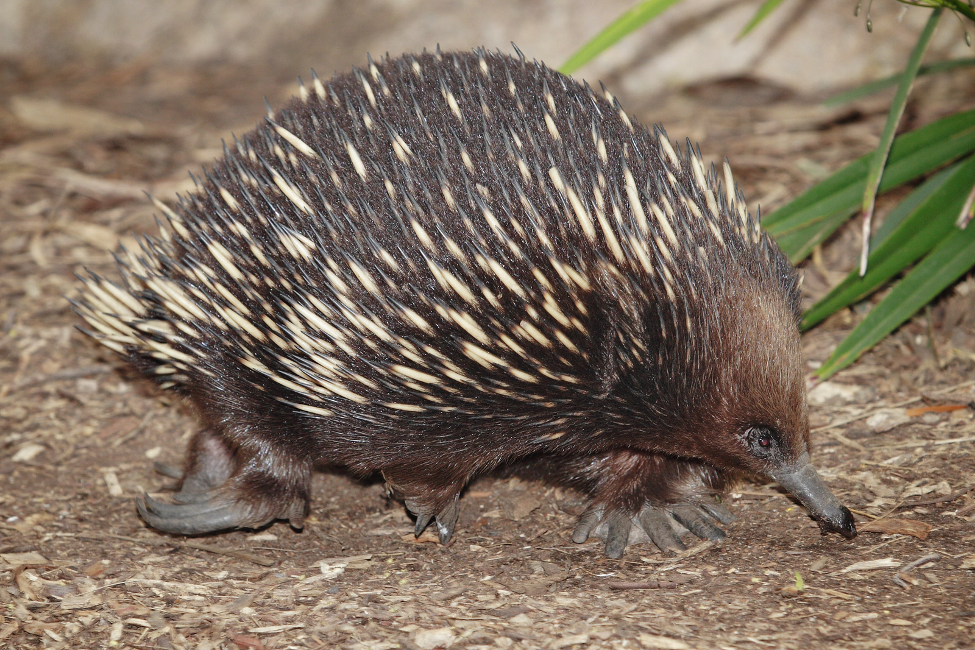
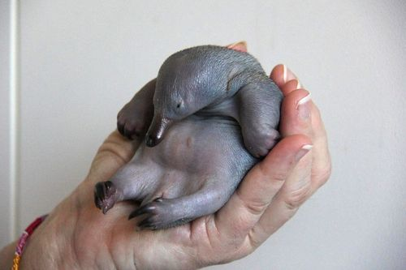
Monotremes
What is a baby echidna called?

Slide 6
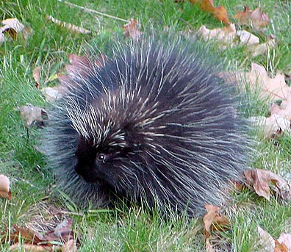
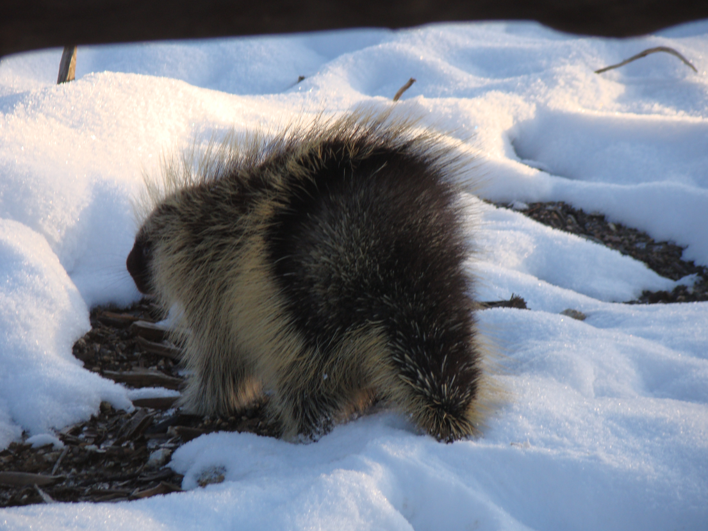
Porcupines
Um, how exactly do porcupines reproduce?
It seems a little dangerous…

Slide 7
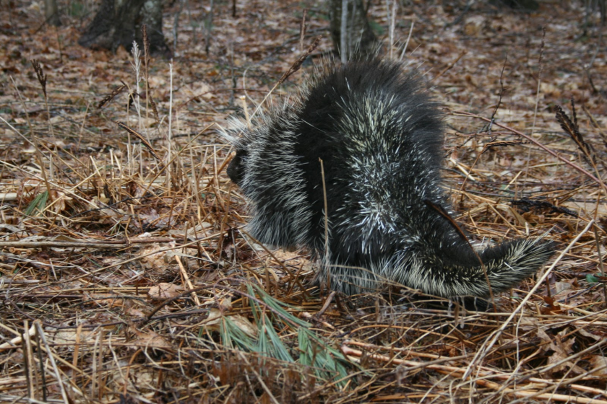
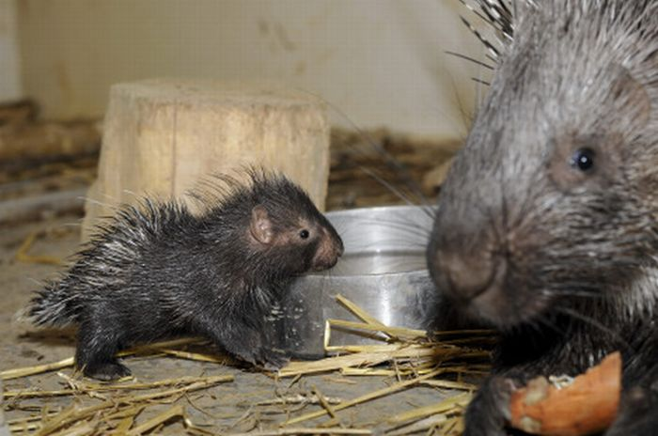
Porcupines
Female porcupines (porcupettes) are only fertile 8-12 hours a YEAR!
Males will fight over females and get stuck with quills. If you see a pile of quills in the woods, it’s probably from a porcupine fight.
If she likes the male, she will flip up her tail where there are no quills and he can mate with her (very carefully).

Slide 8
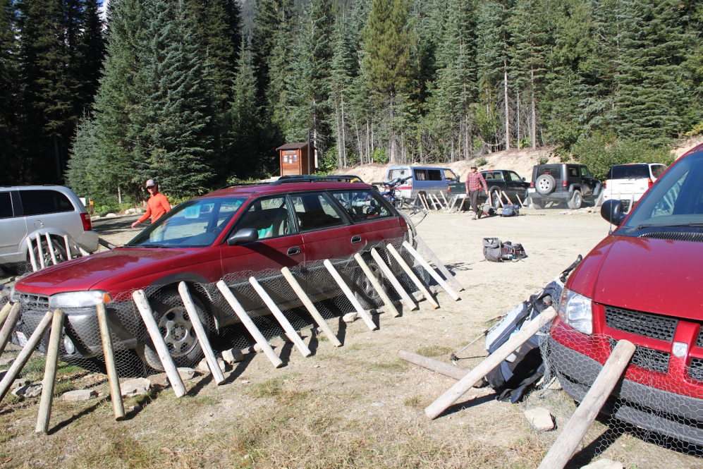
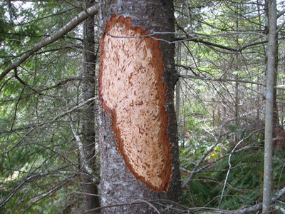
Porcupine facts
The don’t shoot out quills, but they do have 30,000 of them and they grow back in about a month.
Porcupines are the 3rd largest rodent in the world.
They LOVE salt. They will chew on anything that has the slightest amount of salt on it, like the wheelbarrow handle you were touching.

Slide 9
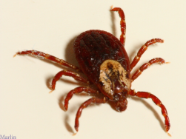
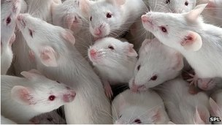
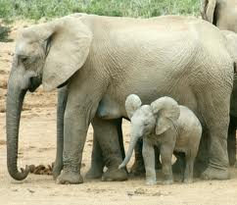
Population control
Use the table on the next slide to calculate the number of babies one female will produce in the assigned number of years.
Mouse- 1 year
Dog/Cat- 3 years
Horse- 4 years
Elephant- 30 years
Tiger- 9 years
Tick- 2 years

Slide 10
How many babies?
Animal | Age to reproductive maturity | Gestation Time | Number of Offspring | Frequency of Estrous | Time Between births
Mouse | 50 days | 20 days | 10 pups | Every 3-4 days | 30-40 days
Horse | 1 year | 11 Months | 1 foal | Seasonal 21 days | 1 year
Dog | 8 months | 63 days | 6 puppies | 6 months | 9 months
Cat | 6 months | 66 days | 4 kittens | Seasonal 14 days | 4 months
Tiger | 3 years | 3.5 months | 3 cubs | 6 weeks | 18-24 months
Elephant | 10 years | 22 months | 1 calf | 4 months | 4 years
Tick | 2 feedings <1 year | x | 10,000 eggs | x | Once only

Slide 11
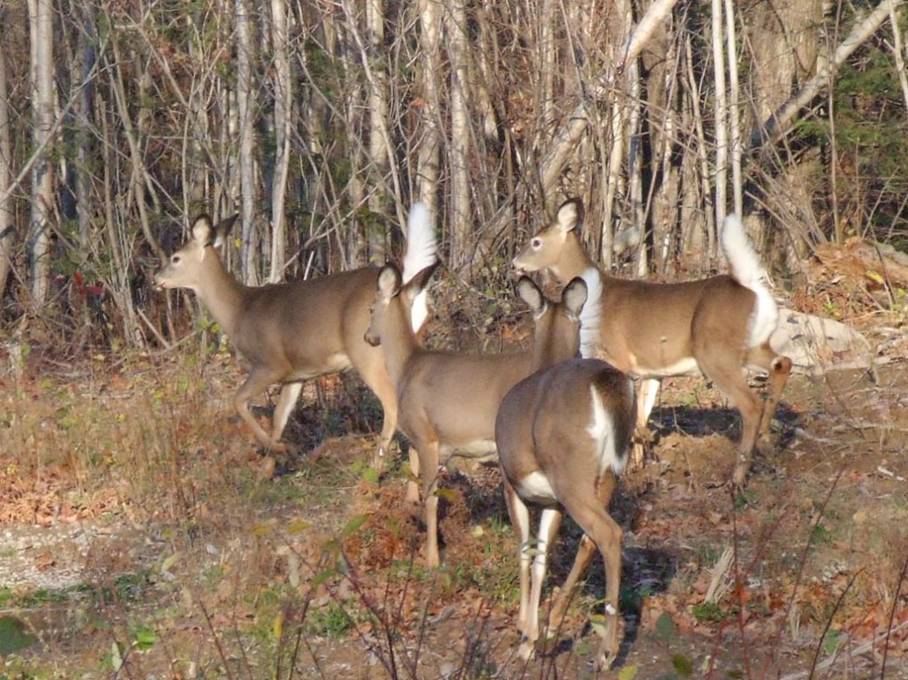
Population control
What natural factors help control animal populations?
Food sources
Space/habitat
Predators/ Competitors
What are some artificial factors?
Hunting
Relocating
Birth Control

Slide 12
Population control
Questions:
What does limiting factor mean?
What are some factors that influence a population?
Why does the porcupine population stay rather stable?
Why do deer have a more dynamic population?
Population Dynamics

Slide 13
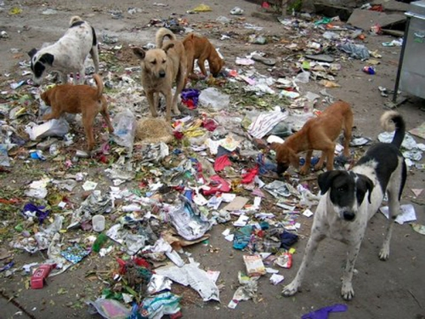
Population control
What about our domestic animals?
Spay
Neuter/Castrate
Keep separate
What is an animal called that was once domesticated but is now wild?
Feral
Dogs and cats reproduce quickly
Ave. lifespan of a feral dog- 1-2 years
Ave. lifespan of a feral cat- 4.7 years
It’s not a good life.

Slide 14
Population control
Feral-if born in the wild from domestic origins
How do the dogs acting with each other? With people?
Stray- once had a home but is lost or abandoned
Why does Detroit have so many stray dogs?
How many postal workers had been bitten from Oct to July?
Feral Dogs in Russian
Stray Dogs in Abandoned Detroit Aug. 2013

Slide 15
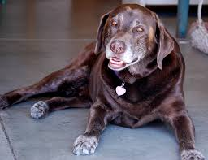
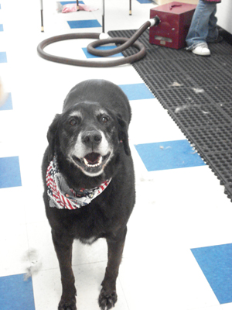
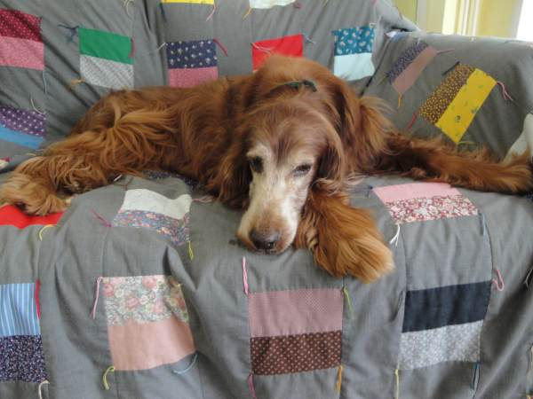
Population control
A USA Today article cites that pets who live in the states with the highest rates of spaying or neutering also live the longest. According to the report, neutered male dogs live 18% longer than un-neutered male dogs and spayed female dogs live 23% longer than unspayed female dogs. The report goes on to add that in Mississippi, the lowest-ranking state for pet longevity, 44% of the dogs are not neutered or spayed. (May 7, 2013)

Slide 16
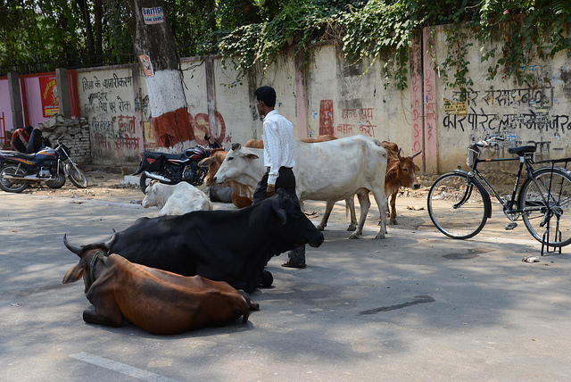
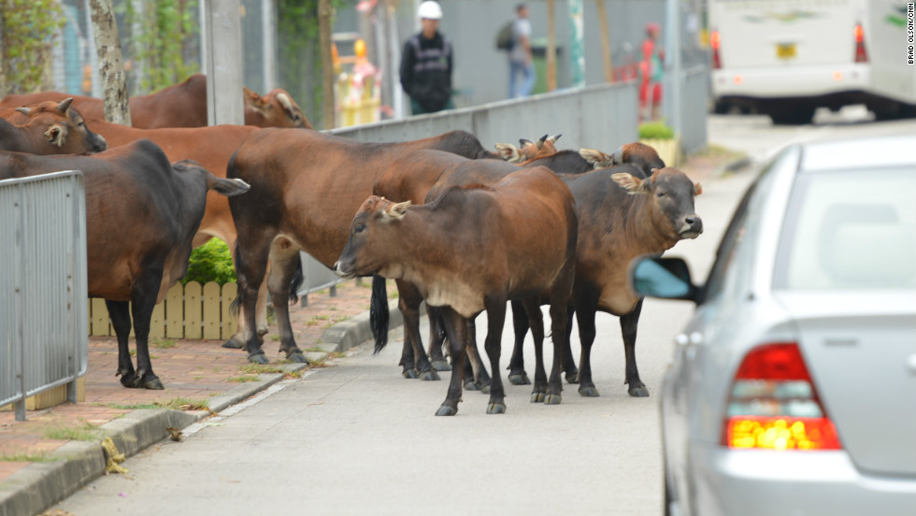
Population control
Cows can be feral too…
Holy Cow 21:53-26:15

Slide 17
Marsupials
Babies are born alive but not fully developed.
The baby crawls into the pouch to drink milk and grow until more developed.

Slide 18
Marsupials

Slide 19
Monotremes
AKA…FREAKS OF NATURE!!!

Slide 20
Monotremes
2) Eggs hatch and young drink milk that comes out of pores…
1) Lay Eggs
3) Young are raised by the mother

Slide 21
Monotremes
What is a baby echidna called?

Slide 22
Porcupines
Um, how exactly do porcupines reproduce?
It seems a little dangerous…

Slide 23
Porcupines
Female porcupines (porcupettes) are only fertile 8-12 hours a YEAR!
Males will fight over females and get stuck with quills. If you see a pile of quills in the woods, it’s probably from a porcupine fight.
If she likes the male, she will flip up her tail where there are no quills and he can mate with her (very carefully).

Slide 24
Porcupine facts
The don’t shoot out quills, but they do have 30,000 of them and they grow back in about a month.
Porcupines are the 3rd largest rodent in the world.
They LOVE salt. They will chew on anything that has the slightest amount of salt on it, like the wheelbarrow handle you were touching.

Slide 25
Population control
Use the table on the next slide to calculate the number of babies one female will produce in the assigned number of years.
Mouse- 1 year
Dog/Cat- 3 years
Horse- 4 years
Elephant- 30 years
Tiger- 9 years
Tick- 2 years

Slide 26
How many babies?
Animal | Age to reproductive maturity | Gestation Time | Number of Offspring | Frequency of Estrous | Time Between births
Mouse | 50 days | 20 days | 10 pups | Every 3-4 days | 30-40 days
Horse | 1 year | 11 Months | 1 foal | Seasonal 21 days | 1 year
Dog | 8 months | 63 days | 6 puppies | 6 months | 9 months
Cat | 6 months | 66 days | 4 kittens | Seasonal 14 days | 4 months
Tiger | 3 years | 3.5 months | 3 cubs | 6 weeks | 18-24 months
Elephant | 10 years | 22 months | 1 calf | 4 months | 4 years
Tick | 2 feedings <1 year | x | 10,000 eggs | x | Once only

Slide 27
Population control
What natural factors help control animal populations?
Food sources
Space/habitat
Predators/ Competitors
What are some artificial factors?
Hunting
Relocating
Birth Control

Slide 28
Population control
Questions:
What does limiting factor mean?
What are some factors that influence a population?
Why does the porcupine population stay rather stable?
Why do deer have a more dynamic population?
Population Dynamics

Slide 29
Population control
What about our domestic animals?
Spay
Neuter/Castrate
Keep separate
What is an animal called that was once domesticated but is now wild?
Feral
Dogs and cats reproduce quickly
Ave. lifespan of a feral dog- 1-2 years
Ave. lifespan of a feral cat- 4.7 years
It’s not a good life.

Slide 30
Population control
Feral-if born in the wild from domestic origins
How do the dogs acting with each other? With people?
Stray- once had a home but is lost or abandoned
Why does Detroit have so many stray dogs?
How many postal workers had been bitten from Oct to July?
Feral Dogs in Russian
Stray Dogs in Abandoned Detroit Aug. 2013

Slide 31
Population control
A USA Today article cites that pets who live in the states with the highest rates of spaying or neutering also live the longest. According to the report, neutered male dogs live 18% longer than un-neutered male dogs and spayed female dogs live 23% longer than unspayed female dogs. The report goes on to add that in Mississippi, the lowest-ranking state for pet longevity, 44% of the dogs are not neutered or spayed. (May 7, 2013)

Slide 32
Population control
Cows can be feral too…
Holy Cow 21:53-26:15

Slide 33
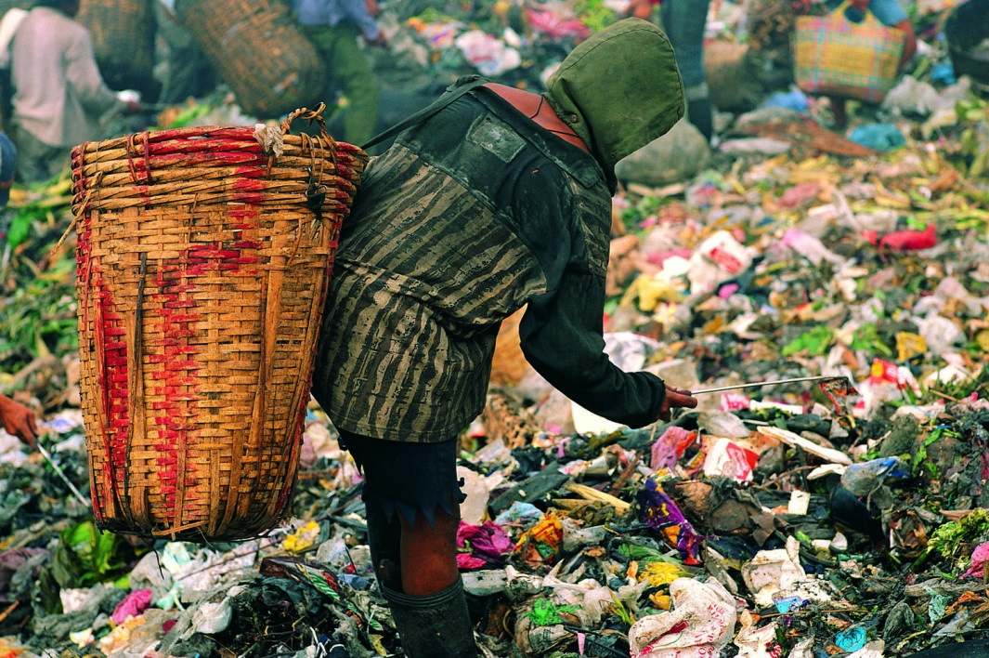
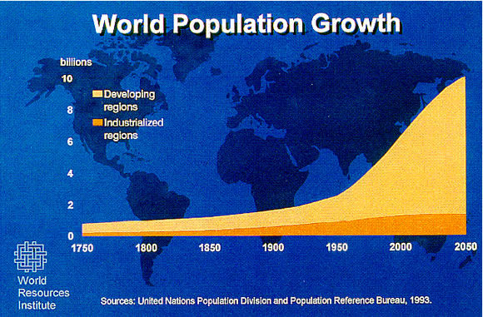
It’s Our problem
We need to be good managers of other animals around us and ourselves. The populations of all animals affect each other.

