Slide 1
Animal Behavior
We will study two types of animal behavior.
You are the mouse in the maze.

Slide 2

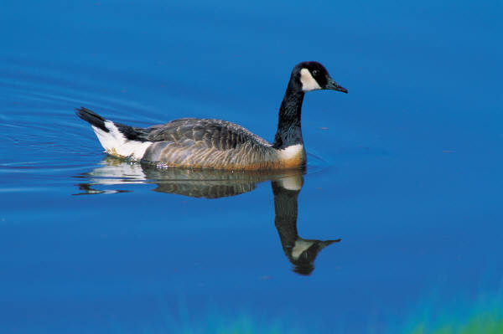
The first type is instinctive behavior.
Instinctive behavior is something the animal is born knowing how to do.
Examples include fish swimming and geese migrating.
What other examples can you think of?

Slide 3
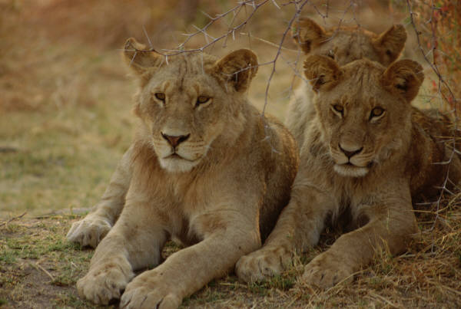
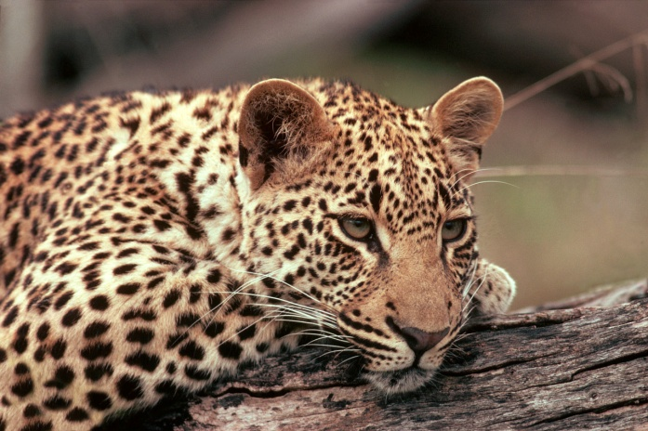
The other type is learned behavior.
As you can probably guess, learned behavior is not instinctive.
Animals are not born knowing what to do or how to do it.
Learned behavior is learned by experience and sometimes from a parent.
Examples include lions and leopards learning how to hunt by watching and practicing with their mothers.

Slide 4

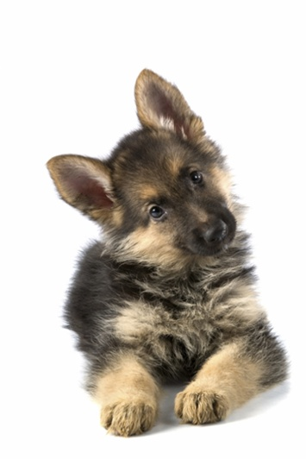
Your behavior – think, think, think…
What parts of your behavior are instinctive?
What parts are learned?
Who do you learn from?
Name three things you have learned in the last week….

Slide 5
This powerpoint was kindly donated to
www.worldofteaching.com
http://www.worldofteaching.com
Is home to well over a thousand powerpoints submitted by teachers. This a free site. Please visit and I hope it will help in your teaching

