Slide 1
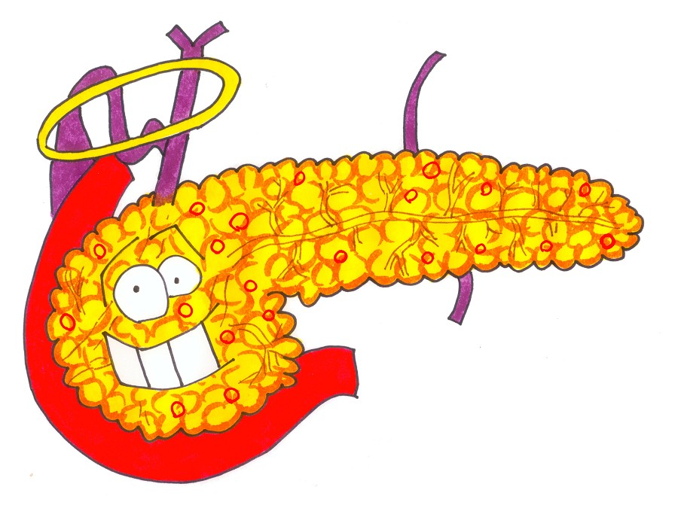
All about the Pancreas

Slide 2
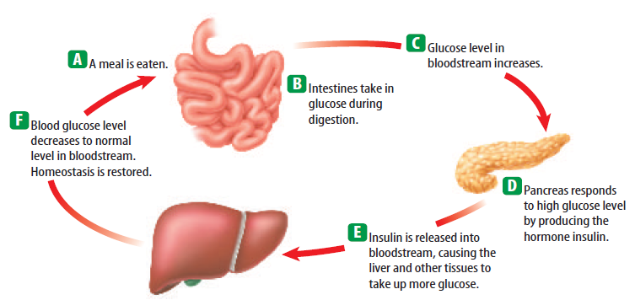
You start by eating a meal containing carbohydrates.
These carbohydrates are turned into glucose. The glucose is absorbed by the stomach and intestines and goes into the blood.
Now, your blood has a high glucose level. Your blood has the glucose but who needs the glucose???? The cells!! Cells use glucose to make energy called ATP.

Slide 3
D. The cells can only take in glucose if the pancreas secretes insulin (a hormone.)
E. Insulin attaches to muscle, liver and fat cells and lets them take in glucose. Think of it like insulin knocking on the door of the cells to let glucose in.
F. Then, the glucose level in the blood goes down BACK TO NORMAL. HOMEOSTASIS!!!!. Now, the pancreas stops secreting insulin

Slide 4
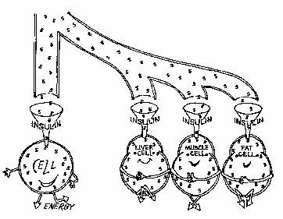
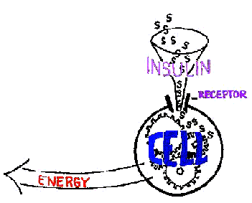
Insulin binds to a receptor on the surface of a cell. The sugar goes into the cells and is used for CELLULAR RESPIRATION

Slide 5
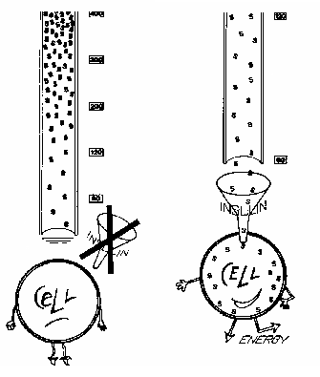
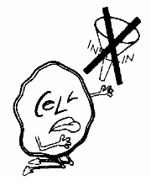
Hyperglycemia: HIGH BLOOD SUGAR LEVELS
What are some symptoms of hyperglycemia?
very thirsty
frequent urination
Dry skin
Blurred vision
hungry
Kidney problems (they have to filter all the glucose out of your body!!!)

Slide 6
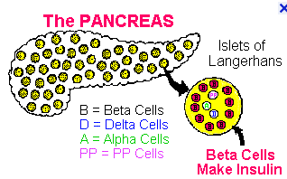
What if your blood doesn’t have enough sugar?
Also called HYPOGLYCEMIA: NOT ENOUGH BLOOD SUGAR
The islets of Langerhans (in your pancreas) would make the opposite hormone of insulin.
Alpha cells would make Glucagon!!!! This makes the liver release stored glucose into your blood!
So to review, your pancreas has areas called the islets of Langerhans. Inside them, the alpha cells make glucagon and the beta cells make insulin
HOMEOSTASIS!!!!!

Slide 7
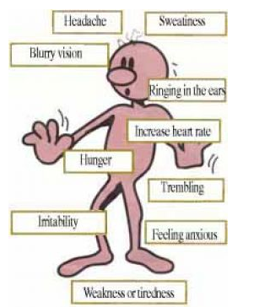
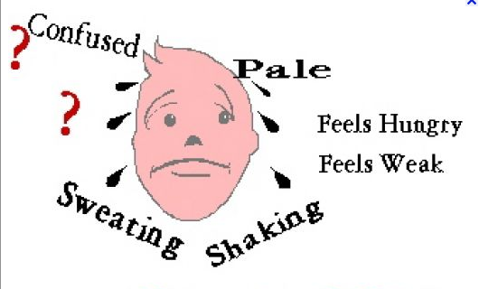
Symptoms of hypoglycemia
Confusion/abnormal behavior
Blurred vision
Pass out
Sweating
Nervous
Shakiness
Heart palpitations (not normal heartbeat)

Slide 8
What if your pancreas makes less insulin, no insulin OR cells just don’t care about insulin anymore (resistance) ?
Diabetes 당뇨병

Slide 9
Diabetes
Type I (~10%): pancreas cells (beta cells of the islets of Langerhans) that make insulin are lost. Most cases are in children so this was called “juvenille diabetes”
Type II (~90%): the cells of the body stop responding to insulin (insulin resistance) or can lose insulin production

Slide 10
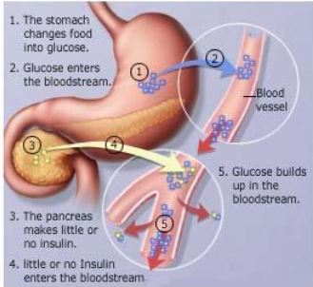
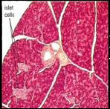
Diabetes Type I
Around 5-10% of people in the U.S.A. with diabetes.
Develops in people at a very young age (under age 20).
Not caused by diet (immune system attacks body)
Their pancreas damaged and they cant make insulin
islet cells of the pancreas

Slide 11
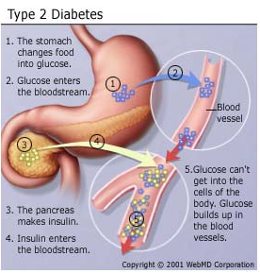
Diabetes Type II
The patient can make insulin, but the cells are resistant (they don’t respond or “care”)

Slide 12
Diabetes Type II:
This is called Diabetes Type II. It usually affects adults. This type of diabetes is 90-95% of all diabetes cases in the U.S.A.
Cause: genetics and LIFESTYLE

Slide 13
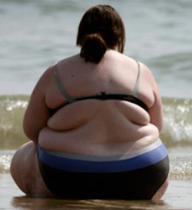
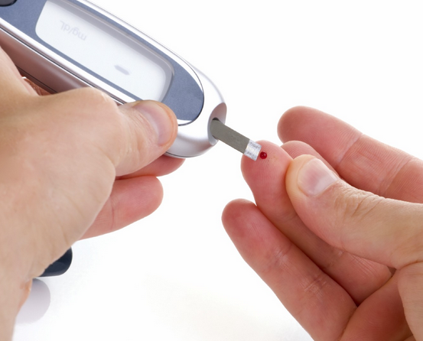
Diabetes Type II
Why would your pancreas make less insulin or your cells (e.g. muscles) not care about insulin anymore (insulin resistance)?
This usually develops with people who have a horrible diet with too much sugar. If you eat so much sugar every day, your pancreas “gets tired” of making so much. (less insulin)
Also, like most drugs, the cells that need insulin become resistant. The cells no longer “hear insulin knocking on the door” to let glucose in.
Either way, the glucose stays in the blood and NOT THE CELLS THAT NEED IT.

Slide 14
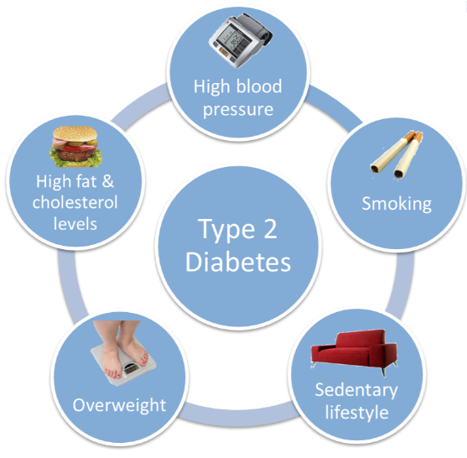
Diabetes creating lifestyle

Slide 15
October, 2010
Obesity:비만
“…..almost no obesity”
“…expect no one in Korea would have diabetes”
“…..weight alone doesn’t cause diabetes”

Slide 16
“…..Korea has the same incidence (rate) of diabetes”
“…..is work, not obesity the cause?”
“…..Miracle of the Han river……work, work, work, work….”

Slide 17
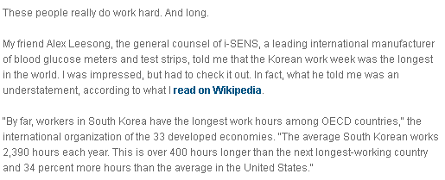
“…..workers in South Korea have longest working hours…”
OECD: The Organization for Economic Cooperation and Development [group of 34 democracies]

Slide 18
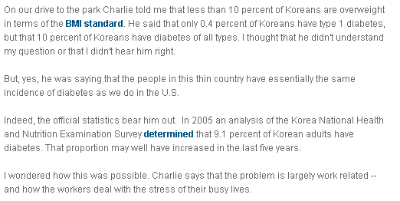
“…..a thin country has nearly the same rate of diabetes as the U.S.A…”
“…..9.1% of Korean adults have diabetes (2005)…”

Slide 19
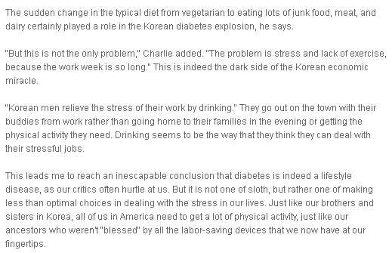
“…..change from vegetarian to eating junk food, meat and dairy..…”
“…..problems include stress and little exercise…”
“…..Korean men relieve (lose) stress by drinking, not with exercise…”
“…..diabetes is a lifestyle disease….what we consume (eat), exercise, how we deal with stress…”

